Slide 1
Vehicle Components and Systems
Lesson 2

Slide 2
Learning Objectives
After completing this lesson, you should be able to:
Identify and describe commercial vehicle systems and controls, and have the basic knowledge required to safely operate a commercial vehicle
Notes:
SAY: This lesson is intended to provide you with a basic understanding of the components and systems of trucks. You should be able to identify and describe commercial vehicle systems and controls, and have the basic knowledge required to safely operate a commercial vehicle.

Slide 3
Systems and Components
After completing this section, you should be able to:
Describe the general layout and function of vehicle components and systems
Explain the differences between single, tandem, tridem and other multi-axle configurations
Explain the physical features and operation of common types of suspension
Describe how steering control is lost when tires skid during heavy brake use or when braking with poor traction
Notes:
Do: read slide

Slide 4
Pre-Class Assignment
You will have:
Reviewed the textbook and answered the questions in the exercise book.
Any questions about exercise book, Lesson 1?
Notes:
SAY: Your homework was to review the textbook and answer the questions in your exercise book.
Are there any questions that came up with your after-class assignment?
DO: Go over any questions about the exercise book questions in Lesson 1.

Slide 5
Know Your System and Components
You are expected to be able to locate, identify and know how to use your vehicle’s component’s and system’s.
Gauges, switches, warning lights, air brakes, auxiliary safety equipment, coupling and suspension system, trailer
Some controls, systems and instruments are unique to specific truck/tractor trailers and may not be found in other types of vehicles.
Since trailer types vary, take time to review the various trailer types and check with your operator for specific details about your trailer.
Always consult the manufacturer’s manual before operating the vehicle.
Notes:
SAY: As you develop driving skills, you will understand the importance of knowing the functions of all controls, systems and instruments found in a vehicle.
Some controls, systems and instruments are unique to a specific truck/tractor trailer and may not be found in other types of vehicles.
You are expected to know the components of the trailer you haul.
Gauges, switches, warning lights, air brakes, auxiliary safety equipment, coupling and suspension system, trailer
Since trailer types vary, take time to review the various trailer types and check with your operator for specific details about your trailer.
You must consult the manufacturer’s manual of the vehicle you are driving to determine if the components and/or systems are functioning optimally.
Reference: https://www.tptrucking.ca/2016/08/understanding-trailer-types/
Reference: https://www.mpi.mb.ca/documents/ProfDriverHBookComp.pdf

Slide 6
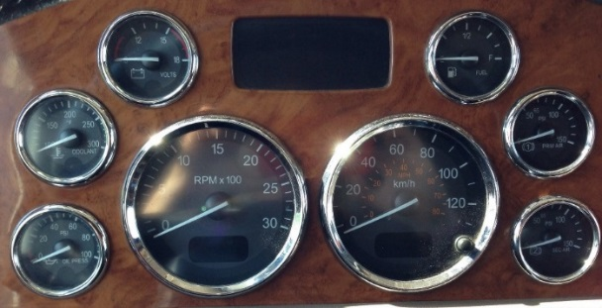
Gauges
Devices that displays measurements of monitored systems.
You should know just by looking whether the monitored systems are in the correct operating range or not
Notes:
SAY: Gauges are devices that display measurements of monitored systems through needles or pointers that move along a calibrated scale.
The instrument panel in large trucks vary in style and number of gauges. For each instrument or gauge, there is a correct and incorrect operating range.
You should know just by looking at their oil pressure, oil temperature, and water temperature gauges whether they are in the correct operating range or not. You must become familiar with the normal ranges as recommended by the manufacturer’s manual. You will need to continuously monitor the gauges for any deviations from the safe operating ranges.
Reference: A list of gauges are listed in Lesson 2 of the Textbook, in alphabetical order.

Slide 7
Warning Lights and Indicator Symbols
Warning lights and symbols inform the driver that a system or component needs attention, or is outside of the safe operating range. When a warning light is illuminated, it typically indicates a problem with the system.
Pull off the road as soon as possible to determine the problem. Shut the engine off to avoid further damage when necessary.
Notes:
SAY: Warning lights and indicator symbols
Commercial vehicles are equipped with warning lights and symbols to inform you that a system or component needs attention, or is outside the safe operating range. When a warning light is illuminated, it typically indicates a problem with the system. You must pull off the road as soon as possible to determine the problem, and in some cases, shut off the engine to avoid further damage.
Symbols, lights, and colors may differ slightly between manufacturers. Refer to the manufacturer’s manual before driving.

Slide 8
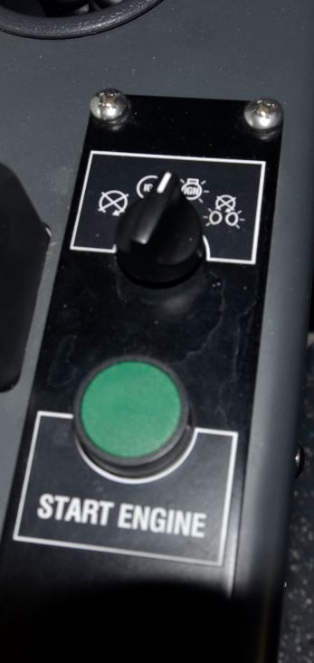
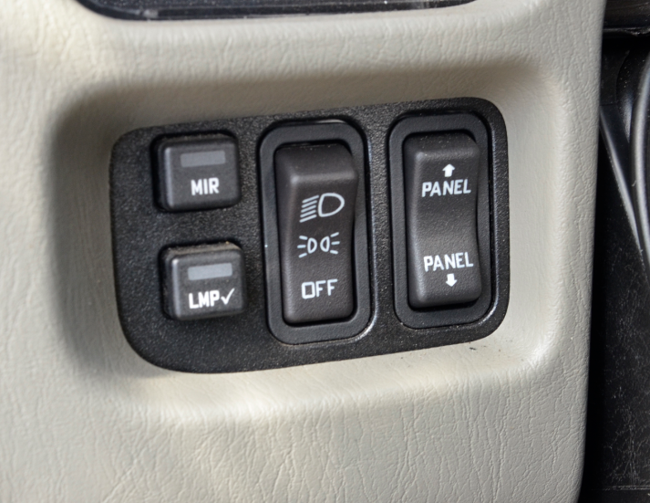
Switches
Devices that make and break the connections in electrical circuits.
Binary controls – either on or off, engaged or not engaged
Different trucks have different types, styles and configurations
Notes:
SAY: A switch is a device for making and breaking the connection in an electrical circuit.
Switches are binary controls – they are either on or off, engaged or not engaged. Some are operated electrically; other by air. Switches control important functions, so it is essential to know where they are, when to use them, and if they are in the correct operating position.
Depending on the manufacturer, different trucks will have different types, styles, and configurations of switches. They could be rocker, toggle, button, or some other style and will be identified by either names or symbols. You must become familiar with all of the controls of the vehicle you are driving, referring to the manufacturer’s manual when necessary.

Slide 9
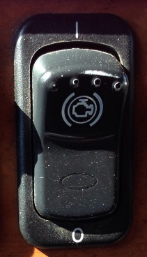
Switches
Engine Brake On/Off
Slows the truck by slowing the engine
Is useful when descending steep grades, or slowing down
Helps to limit the amount of actual braking required
Illegal to use within city/town limits due to noise- watch for signs
Notes:
SAY: Engine Brake On/Off: This is used to turn the engine brake ON or OFF. It is also referred to as “jake brake” or “engine retarder.”
The engine brake slows the truck down by slowing the engine and is useful when descending steep grades, or slowing down to come to a stop. It helps to limit the amount of actual braking required, which keeps your brakes from heating up. It is used together with the service brakes.
It is illegal to use engine brakes within city/town limits due to the noise they create when in use. Watch for signs indicating this.

Slide 10
Axles
Front Tractor Axle
The steering axle on a truck
Rear Tractor Axle
Also called the power or drive axle
Transfers power from the engine and the powertrain to the wheels
Notes:
SAY: The axle is a shaft on which two or more wheels revolve. It connects the wheel to the rest of the vehicle and also supports the weight of the vehicle. The tractor axle, along with trailer axle serve as connection points for brakes. Tractors have front axle and one or more rear axles.
Front tractor axle: The front tractor axle is the steering axle on a truck. Steering axle means the articulated axle of a commercial vehicle that you can control for the purpose of steering the vehicle.
Rear tractor axle: This is also called the power or drive axle. Power is transferred from the engine and the powertrain to the wheels by the rear axle.

Slide 11
Axles
Single Drive Axle
Truck with one rear axle
Tandem Drive Axles
Truck with two consecutive rear axles
Tridem/Tri-Drive Axles
A trailer or tractor with any three evenly-spaced consecutive axles
Notes:
SAY: Single axle: Two-axle trucks have one rear axle. The rear axle is called the single drive axle. This could also be any combination of two axles whose centres are less than one metre apart.
Tandem: Tandem trucks have two consecutive rear axles (two drive axles) where the axles have an axle spread of not less than 1.2 metres and not greater than 1.85 metres. In the case of a trailer manufactured before November 15, 1988, the axles have an axle spread of not less than 1.0 metre and not more than 2.4 metres.
Tridem/tri-drive axles: This is an axle group, on a trailer or tractor, consisting of any three consecutive axles where the axles are evenly spaced over a distance of not less than 2.4 metres and not greater than 3.7 metres, but does not include a lift axle in the down position or a single steer.

Slide 12
Brakes
Notes:
Say: Hydraulic Brake System
Hydraulic Brakes
Hydraulic brakes apply instantly
Hydraulic fluid is held in reservoir and brake lines so the system is constantly full
Brake fluid cannot be compressed as opposed to the air brake system
Brake fluid transfers pressure rather than flows
The force applied to the brake is immediate
Disc Brake
The components of a disc brake system consist of a disc and calliper. When the brakes are applied, the calliper squeezes the disc creating friction and slowing the vehicle.
Drum Brake
This is a drum attached to each side of the axle by bolts, to stop or slow down tire rotation when you apply pressure on the brake pedal. When brake is applied, friction is created when the brake shoe linings are forced against the inside of the brake drum.
Reference: Disc and drum brakes are mentioned in Lesson 2 of the Textbook, under Other Truck Systems – Other Components.

Slide 13
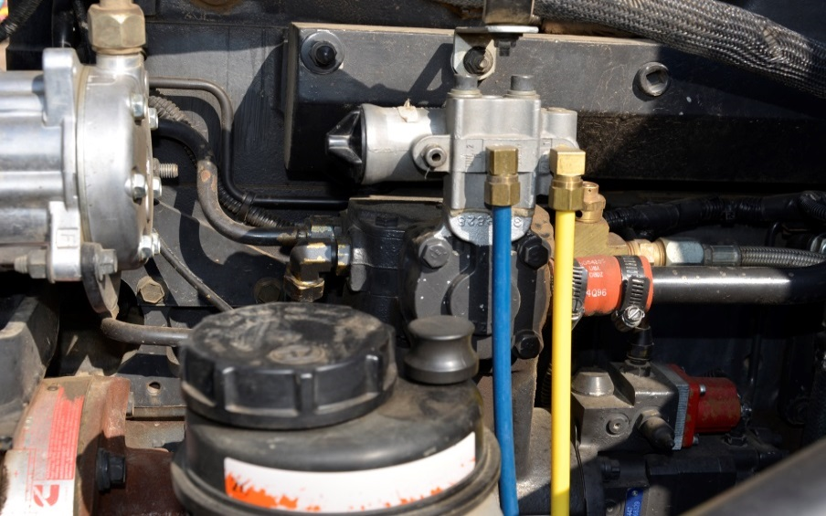
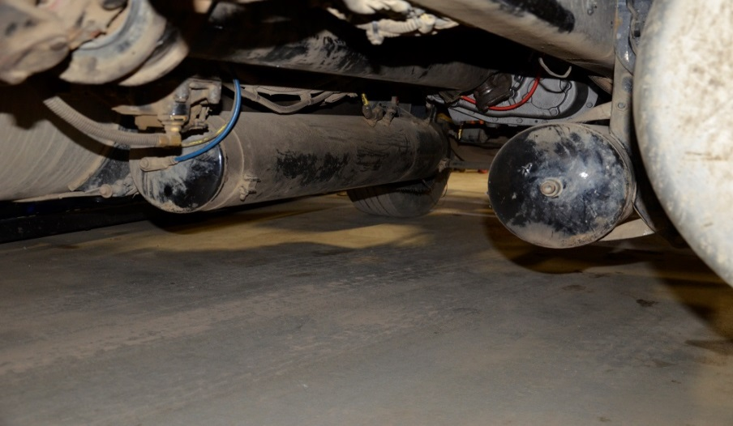
Air Brake Components
Air Compressor
Pressurizes air and pumps it into storage tanks
Air Tanks
Store the air pressure
Notes:
SAY: Air Compressor: This pressurizes air and pumps it into storage tanks. It is directly driven from the internal gearing of the engine and can either be single or multiple piston pump. It takes in air from the atmosphere and compresses (pressurizes) it.
Air Tanks: These store the air pressure. The size of the air tanks depends on the air volume required for the brake lines and chambers.

Slide 14
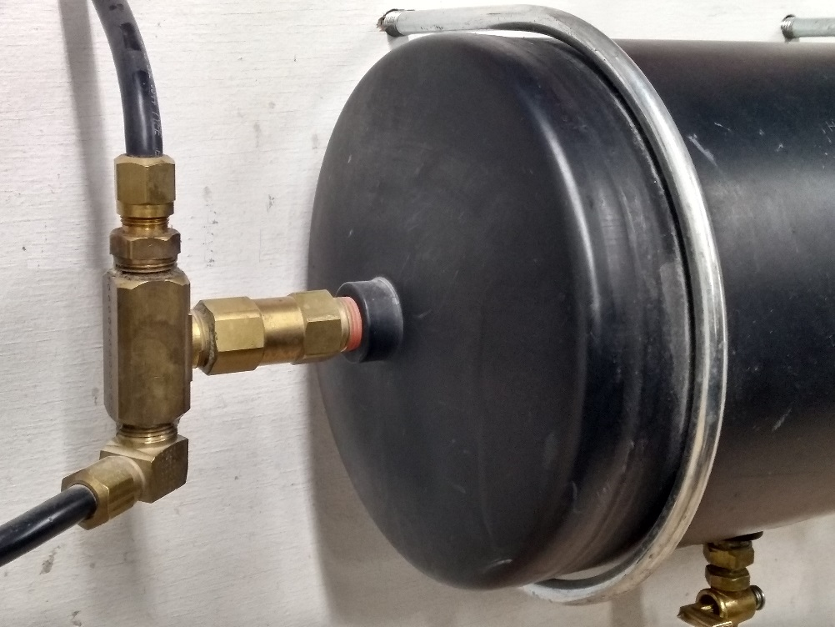
Air Brake Components
Air Tank Check Valves
Allow air flow from one side to the other, while blocking air flow in the opposite direction
Notes:
SAY: Air Tank Check Valves: Typically, these are one-way valves. The one-way check valves are located at the entrance of the primary and secondary air tanks, and are a major fail-safe of the air brake system. They allow air flow from one side to the other, while blocking air flow in the opposite direction.
Reference: Air Brakes are mentioned in Lesson 2 of the Textbook, under Other Truck Systems – Air Brakes. However, Lesson 3 goes into more detail on Air Brakes.

Slide 15
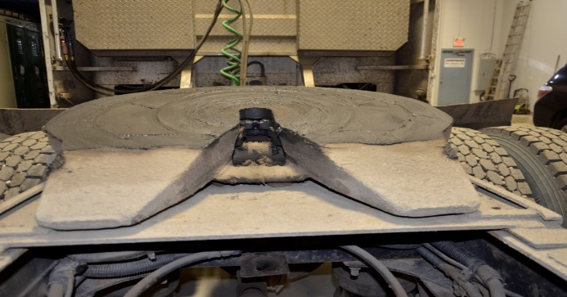
Coupler System and Hitches
Fifth Wheel
A coupling device mounted on the vehicle chassis that couples or connects to a kingpin on the other vehicle or component
Trailer Kingpin
A 2-inch high-strength steel pin that fits and locks into the jaws of the fifth wheel to couple a tractor to a trailer.
Notes:
SAY: Fifth wheel: This is a coupling device mounted on the vehicle chassis and consists of a skid plate, associated mounting brackets and a latching mechanism that couples or connects to a kingpin located on the other vehicle or component. It is used to support and tow a semi-trailer. There are two types of fifth wheels: a stationary and a sliding fifth wheel.
A stationary fifth wheel is mounted on the frame rails of the tractor and is positioned in a way that the optimum weight distribution is achieved between the front and the rear axles of a properly loaded trailer.
The sliding or adjustable fifth wheel can be adjusted back and forth along the frame rail to ensure even weight distribution on each axle. It can adjust the overall length of the tractor-trailer and hence, the turning radius of the vehicle.
Trailer Kingpin: This is usually a 2 inch high-strengthen steel pin that fits and locks into the jaws of the fifth wheel to couple the tractor to the trailer.
Reference: Coupler Systems and hitches are mentioned in Lesson 2 of the Textbook, under Other Truck Systems – Coupling System.

Slide 16
Coupler System
Coupler
A mechanism bolted or welded to the end of a trailer tongue.
Notes:
SAY: A coupler is a mechanism bolted or welded onto the end of a trailer tongue. It fits securely over, and pivots on, the tow vehicle hitch ball.
Reference: Coupler Systems and hitches are mentioned in Lesson 2 of the Textbook, under Other Truck Systems – Coupling System.

Slide 17
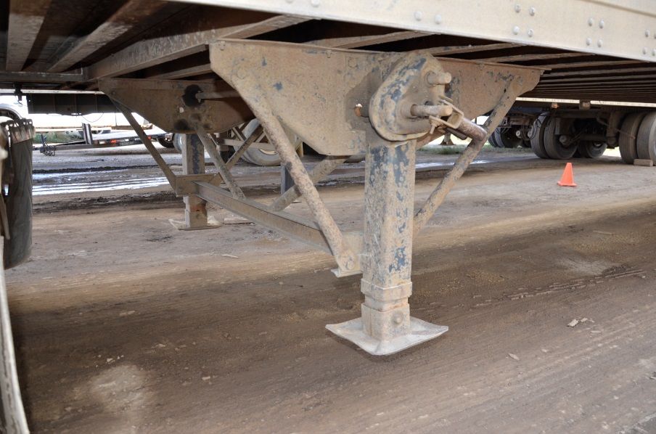
Coupler System and Hitches
Roll Coupling Hitch
A low-lash coupling that functions the same as a universal joint
Landing Gear
Provides stationary support for the front of a trailer when it is not coupled to a tractor
Notes:
SAY: Roll Coupling Hitch: This is a low-lash coupling that provides the same function as a universal joint – it allows motion around the yaw axis (turning corners) and pitch axis (driving over bumps) and prevents twisting unless the hitch is equipped with optional selective roll-coupling.
Landing gear: This provides stationary support for the front of a trailer when it is not coupled to a tractor.
DO: Show class examples of roll coupling hitches.

Slide 18
Suspension & Frame Attachments
The body of the tractor-trailer is connected to and strengthened by the frame. The frame rests on the suspension system. The suspension system carries and distributes the weight of vehicle.
Notes:
SAY: Let’s go over some of the controls and equipment that you need to know. We won’t go over all of the items now, but there is a complete list in your textbook. Become familiar with all of the items before the quiz. If you have any questions, don’t hesitate to ask.
Suspension & Frame Attachments: The body of the tractor-trailer is connected to and strengthened by the frame. The frame rests on the suspension system. The suspension system carries and distributes the weight of vehicle. The suspension system also supports the axles by enabling axle movement when the surface or ground changes. The system is divided into spring leaf (or fixed) suspension and air bag suspension.

Slide 19
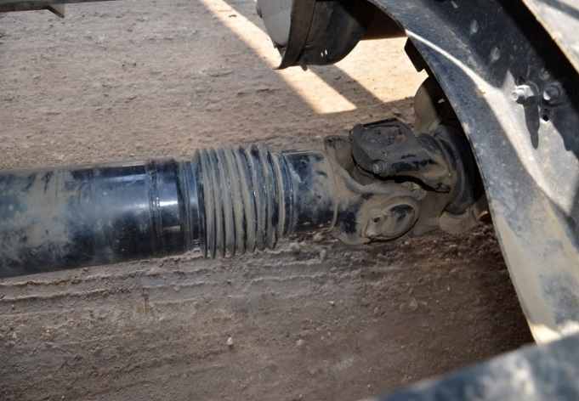
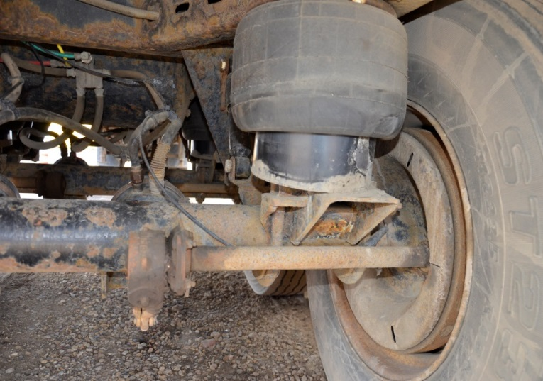
Suspension & Frame Attachments
Drive Shaft
A shaft between the front and rear axles
Air Bag Suspension
A type of vehicle suspension powered by an electric or engine-driven air pump or compressor
Notes:
SAY: Drive shaft: This is a shaft that runs between the front and the rear axles.
Air bag suspension: This is a type of vehicle suspension that is powered by an electric or engine-driven air pump or compressor.
Reference: Suspension and Frame Attachments are listed in Lesson 2 of the Textbook, under Other Truck Systems - Suspension.

Slide 20
Stability Control & Anti-Lock Brake System
After completing this section, you should be able to:
Describe how stability control systems operate and affect vehicle operation
Describe how Anti-Lock Brake Systems (ABS) keep wheels from locking but may not shorten vehicle stopping distance
Notes:
Do: read slide

Slide 21
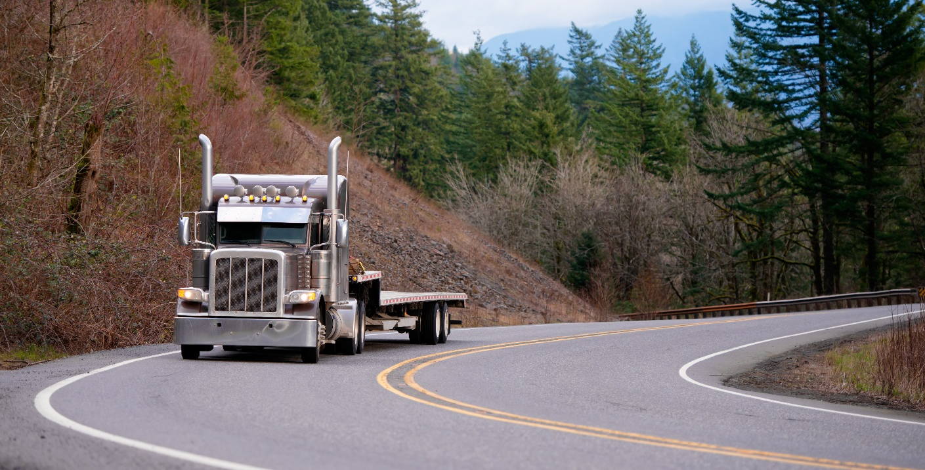
Electronic Stability Control
A crash avoidance system found on newer vehicles
Electronic Stability Control (ESC) detects loss of steering control and automatically applies the brake to offset over- or understeering
Notes:
SAY: Electronic Stability Control : New tractor trailers are equipped with Electronic Stability Control (ESC), a crash avoidance system.
This system helps you remain in control of your vehicle by detecting loss of steering control. It automatically applies the brakes to offset oversteering or understeering.
Through application of brakes, ESC can help you reduce the risk of vehicle instability while in a slippery curve, or with a sudden application of brakes to avoid obstacles.
Reference: ESC is mentioned in Lesson 6 of the Textbook, under High-Risk Driving Situations/Techniques – Skid Control.

Slide 22
Anti-Lock Brake System
An electronic system that monitors and controls wheel slip during braking
Notes:
SAY: Anti-Lock Brake System (ABS): This is an electronic system that monitors and controls wheel slip during vehicle braking by minimizing lockup. The wheel sensors detect wheel lock-up and automatically release and reapply the brakes repeatedly through a pulsing application. ABS enables the driver to maintain steering control and to stop the vehicle in the shortest possible distance, under most conditions.
Reference: ABS is mentioned in Lesson 6 of the Textbook, under High-Risk Driving Situations/Techniques – Emergency Braking.

Slide 23
Summary
You should now be able to :
Identify and describe commercial vehicle systems and controls, and have the knowledge required to operate a commercial vehicle.
Notes:
SAY: We have now reviewed some of the systems and components of a truck. Next, we will go into the yard, see them on an actual truck, and practice identifying and describing them.

Slide 24
Quiz
Lesson 2 Quiz
Time: 30 min to complete
Notes:
DO: Provide students with a printed copy of Lesson 2 Quiz. Time provided for this quiz is 30 minutes. Tell students how the quiz will be scored and weighted. Explain what is required for a passing grade.
When complete, fill out the assessment tracker for each student and the classroom assessment tracker.

Slide 25
Practical In-Yard Training
Component and System Checklist
The checklist in your exercise book provides a list of all the components and systems you need to know and understand
Notes:
Practical - In-yard training
SAY:
You will now head out to the yard where an instructor will spend time demonstrating how to perform the vehicle component and system identification. Then you will demonstrate the same thing by also identifying vehicle components and systems. You may wish to take your exercise book with the procedure job aid. Each time you attempt the activities, your instructor will provide you with a copy of your in-yard assessment which you should review to improve your skills in this area.
DO:
This In-yard training session is split into 30 minutes of instructor demonstration and 30 minutes of student practice.
Decisions about how to organize yard time will need to flex with each class based on numbers of students, available instructors for proper yard ratio, and physical training space.
Use one practical assessment sheet each time the student performs the activities. Students are encouraged to bring their textbook and/or exercise book with the lists of procedures and checklists to in-yard training.

Slide 26
Practical In-Yard Assessment
Time: 30 minutes to complete
Notes:
DO:
30 mins for instructor to assess
SAY:
You will now have a practical assessment where your instructor will assess your understanding and skill competency in identifying vehicle components and systems.
This assessment will count towards your final course mark.
DO:
Using the in-yard assessment, the instructor will grade students on the skill competency for this lesson. A minimum of one hour will be used for in-yard assessment.

