Slide 1

Air Brakes
Lesson 3
Notes:
Do: Use the air brake board/E-board to provide simulated and visual examples to support the delivery of this lesson.
This section of the curriculum relies heavily on the MPI Air Brake Manual. All students should have a copy of this manual, either paper or electronic format, for use during this lesson.

Slide 2
Learning Objectives
After completing this lesson, you should be able to:
Inspect and operate a commercial vehicle with air brakes
Demonstrate how to mark and measure for air brake adjustment
Notes:
SAY: Read slide.

Slide 3
Operating Principles of Air Brakes
After completing this section, you should be able to:
Explain the basic operating principles of air brakes
Explain the general function of supply, service, parking/emergency and trailer sub-systems and related components
Notes:
SAY: Read slide.

Slide 4
Why Learn about Air Brakes?
Every jurisdiction in Canada, except Nunavut, requires drivers of air brake equipped vehicles to have an air brake endorsement.
The “current driver” is responsible for the performance of the air brake system and ensuring everything is working correctly.
They must understand how an air brake system works and how it compares to other vehicle braking systems
Air brakes are different. The pedals feel different and the vehicle reacts differently than a vehicle with a hydraulic brake system.
Notes:
SAY:
It is important to learn about air brakes specifically because every jurisdiction in Canada, except Nunavut, requires drivers of air brake equipped vehicles to have an air brake endorsement.
Air brakes are different from other brake systems. The pedals feel different and the vehicle reacts differently than a vehicle with a hydraulic brake system.
There are more components in an air brake system than a hydraulic system. They require more driver involvement to ensure the system is operating properly and safely.
The “current driver” is responsible for the performance of the air brake system and ensuring everything is working correctly.
To do this, you must:
Understand how the brake system works
Air brakes are different. The pedals feel different and the vehicle reacts differently than a vehicle with a hydraulic brake system.
Perform effective air brake inspections
Ensure the brakes are correctly adjusted
Use the brakes properly

Slide 5
To Operate a Vehicle with Air Brakes
To operate a vehicle equipped with air brakes, you are required to pass:
A written air brake test, to operate as a learner
A Class 1 road test which includes a practical air brake test
After passing both tests, you will receive an “A” endorsement on your driver’s licence.
Notes:
SAY: The air brake “A” endorsement is independent of the class of licence held. The holder of a Class 1 licence must still pass the written and practical air brake test (which is part of the Class 1 road test) to operate a vehicle with air brakes.

Slide 6
Air Brakes vs Hydraulic Brakes
AIR BRAKE ADVANTAGES
Generates greater power
Tolerates small leaks
Pumps more air pressure
Easier coupling of air lines
Notes:
SAY: Air brakes provide several advantages. Compressed air generates greater power than hydraulic brakes. A hydraulic brake leak can lead to brake failure, but air brake systems are tolerant of small leaks because they have compressors to provide more air pressure when required. Air line couplings are easier to attach than hydraulic lines and the systems have proven to be reliable.
However, the main disadvantage of air brakes is that there is a split second delay in brake reaction compared to hydraulic brakes.

Slide 7
Operating Principles of Air Brakes
Heat: Created by acceleration and maintaining speed
Friction: The force that resists movement between two surfaces
Momentum: Brakes convert momentum energy into heat
  Brake damage and failure happens when more heat is absorbed by the drums or rotors than can be dissipated
Brake Lag: Time it takes for the air to pass through the lines to the brakes before the brakes apply
Stopping/Braking Distance: The distance a vehicle travels after the brake is applied
  How long does it take to see a hazard (perceive), think about stopping and apply the brake (react)?
About 1.5 seconds
Notes:
SAY:
Let’s review at a high level how air brakes work.
Heat is created by accelerating and maintaining speed. Your vehicle requires traction to move, which is the amount of grip your tires have on the surface of the road. Gas and diesel engines use fuel to move a vehicle. A by-product of internal combustion is heat, which is dissipated by the cooling system. Stopping also creates heat.
Friction is the resistance of motion between two objects or surfaces in contact with each other. Try rubbing your hands together quickly – you will feel them begin to heat as the friction builds.
Momentum - Brakes convert momentum energy into heat which is dissipated into the atmosphere by brake drums or disks. To stop a vehicle, brake shoe linings are forced against the machined surfaces of the brake drums. Brakes convert the energy of momentum into the energy of heat. This heat is then dissipated into the atmosphere by the brake drums or disc rotors. The amount of heat the brake drums can absorb depends on the thickness and type of metal. When enough friction is created between the brake linings and drums, the wheels stop turning. The final factor that stops the vehicle is the traction between the tires and the road surface.
Brake damage and failure happens when more heat is absorbed by the drums or rotors than can be dissipated. This can be caused by driving too fast for conditions. Most brake drums operate best around 115° C and should not exceed 215° C.
Driver’s perception and reaction time - It can take 3/4 of a second to 1 ½ seconds from the moment the hazard is identified to the time you apply the brake pedal.
Brake lag - is the time it takes for the air to pass through the lines to the brakes before the brakes apply. In a well maintained air brake system this can take about 4/10 of a second. Air lines to the service brakes are empty when the brakes are released. When the brakes are applied, air pressure must move through the air lines. This creates a delay before the service brakes apply. The longer a vehicle is, the greater the brake lag.
Air line layout and types of fittings also affect air pressure flow. The vehicle least affected by brake lag will be a body job - everything is fairly close together. The greatest brake lag occurs when three trailers are coupled to a towing unit (Triple). With this configuration, control air to the last trailer brakes must pass through five pairs of gladhand couplers with two 90-degree bends in each coupler set and long distances - up to 35 metres (114.8 feet).
Stopping/Braking Distance - Actual braking time and distance is the distance a vehicle travels after the brake is applied until the vehicle reaches a full stop. This distance depends on the ability of the lining to produce friction and the brake drums to dissipate the heat and then lastly for the tires to grip the road.
ASK: How long does it take to see a hazard (perception time), think about stopping and apply the brake (reaction time)?
DO: Wait for some answers. CLICK to reveal. Answer: About 1.5 seconds.

Slide 8

Consider the Larger Vehicle
Large vehicles:
Take longer to stop than small vehicles because of their “greater weight”
Need more space and time to perform manoeuvres
Notes:
SAY: Commercial trucks have larger brake components, more wheels and brakes than passenger vehicles. Greater weight creates greater stopping distance. Large vehicles take longer to stop than small vehicles. While this may seem obvious, most people who begin their professional driving career need to learn how much more space and time is required to perform manoeuvres in larger vehicles.

Slide 9
Stopping Considerations
If the vehicle’s: | To stop, you need:
weight is doubled | double the braking force
speed is doubled | four times the braking force
weight AND speed are doubled | eight times the braking force
Notes:
SAY: Maintaining appropriate following distance and speeds to allow for stopping is a must. Increased vehicle mass means increased braking requirements. All vehicles must comply with standardized weight restrictions. This means all drivers are dealing with comparable weights for a given vehicle design.
Increased speed also results in increased braking requirements.
Doubling both the weight and speed increases the complexity of the relationship between these factors and braking requirements.
Reference: MPI Air Brake Manual: Chapter 7: Demands on Brakes While Driving

Slide 10
Obtaining Power
Mechanically:
Leverage
Fulcrum
Use of Air:
Compressed
PSI
4 m
1 m
A
B
A
10 kg
C
Applied force
= 10 kg
Delivered force
= 40 kg
C
B
40 kg
B
40 kg
Notes:
SAY:
Power is obtained mechanically and through the use of air.
Braking systems use devices to gain a mechanical advantage. The most common device for this purpose is leverage. A lever is placed on a pivot called the fulcrum. If the distance from A to C is 4 metres, and from C to B is 1 metre, the ratio is four to one (4:1). Power is multiplied by the leverage principle. If a 10 kg downward force is applied at point A, then upward force at point B is 40 kg. This is the result of the mechanical advantage of leverage.
DO: CLICK to reveal
SAY:
When the air brake system applies pressure to the S-cam (A), it uses the principle of leverage to multiply the pressure to the brake drums (B), which will stop the wheels from turning.

Slide 11
Force of Air Pressure
1 sq in
10 psi
Notes:
SAY: Force can also be multiplied by the use of air to gain a further mechanical advantage. Everyone has felt the power of air on a windy day. Air can be compressed into a much smaller space than it normally occupies. For instance, air is compressed in tires to support the weight of a vehicle. The smaller the space into which air is squeezed, the greater the air’s resistance to being squeezed. This resistance creates pressure, which is used to gain mechanical advantage. If a constant supply of compressed air is directed through a pipe that is one-inch square, and if a one-square-inch plug was placed in the pipe, the compressed air would push against the plug. Holding a scale against the plug would register how many pounds of force were being exerted by the air against the plug.
If the scale registered 10 lb., for example, then it could be said the force was 10 lb. on the one-square-inch surface of the plug. This would be 10 lb. per square inch (psi).
The more the air in the supply tank is compressed, the greater the force exerted on the face of the plug.
Reference: MPI Air Brake Manual: Chapter 10: Inspecting Air Brake System Operation

Slide 12
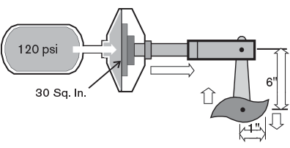
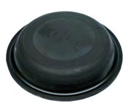
Leverage and Air Pressure
Diaphragm
120 psi x 30 sq in = 3,600 lbs of force
3,600 lbs of force x 6 in = 21, 600 lbs of force
Notes:
SAY: Let’s discuss the relationship between leverage and air pressure.
If compressed air of 120 psi acts on a 30 square inch diaphragm, 3,600 lbs. of force is produced (120 x 30).
Apply this force to a push rod to move a six-inch slack adjuster operating a cam, and the total force equals 21,600 inch pounds torque (3,600 x 6) or 1,800 foot pounds torque (21,600 ÷ 12). In comparison, it requires 25 to 30 foot pounds of torque to tighten the wheel on a car.
Reference: MPI Air Brake Manual: Chapter 10: Inspecting Air Brake System Operation

Slide 13
Review
How is power obtained in air brakes?
Discuss in groups of 4 and then present your answer to the class
Refer to the MPI Air Brake Manual
Write your answers in Exercise 1 of the Exercise Book
Notes:
DO: Students should discuss in groups of 4 and then present answers to the class. Look for references to mechanics, including leverage, levers and fulcrum, as well as use of air, including compression and PSI.
Advise students to use MPI Air Brake Manual for reference.
Students should write answers in Exercise 1 of the Exercise Book.
Time: 10 minutes
Reference: https://www.mpi.mb.ca/Documents/AirBrakeManualNEW.pdf

Slide 14
Exercise 1: Operating Principles
Time: 15 minutes
Notes:
DO: Section 2 of Exercise 1 of the Exercise Book is a Fill in the Table exercise. This activity prepares the students for the review questions that follow.
SAY: You have 15 minutes to complete Exercise 1 in the Exercise Book.

Slide 15
Review
If the weight of the vehicle is doubled, how many times must the stopping power be increased?
Answer: 2 times
Notes:
DO: This is an animated slide. To reveal the answer click after reading the question.

Slide 16
Review
If the vehicle speed is doubled, how many times must the stopping power be increased?
Answer: 4 times
Notes:
DO: This is an animated slide. To reveal the answer click after reading the question.

Slide 17
Review
If both the vehicle speed and weight is doubled, how many times must the stopping power be increased?
Answer: 8 times
Notes:
DO: This is an animated slide. To reveal the answer click after reading the question.

Slide 18
Components of Air Brakes
After completing this section, you should be able to:
Explain the visual characteristics, external components and basic function of foundation brakes
Identify common brake types and recognizes many of the components
Notes:
SAY: Read slide.

Slide 19
Components of Air Brakes
Air brakes have various components, which include:
An air compressor
A reservoir (air-tank)
A foot valve
Brake chambers
Brake linings and drums
Notes:
SAY: There are five main components of an air brake system. We’ll review what they are and their purpose.

Slide 20
Air Compressor
Builds up and maintains air pressure
Air compressors are either gear or belt-driven
All compressors run continuously while the engine is running, but air compression is controlled and limited by a governor which “loads” or “unloads” the compressor
Traditional standard for measuring pressure is pounds per square inch (PSI)
Notes:
SAY: The function of the air compressor is to build up and maintain the air pressure required to operate air brakes and air-powered accessories. Air compressors are either gear-driven directly from the engine or belt-driven. All compressors run continuously while the engine is running, but air compression is controlled and limited by a governor which “loads” or “unloads” the compressor. In the loaded stage, air is pumped into reservoirs. In the unloaded stage the compressor pumps air back and forth between the two cylinders without supplying the reservoirs.
The traditional standard for measuring pressure has been pounds per square inch (PSI) and many large vehicles still use this standard. An Original Equipment Manufacturer (OEM) may use kilopascal's (kPa), a measurement that is becoming more common.
European vehicles measure pressure in bars, which is about equal to the atmospheric pressure on earth at sea level. Although bars are never used on North American trucks, some may be familiar with this standard.
Reference: MPI Air Brake Manual:
Chapter 9: Inspecting Air Compressors
Chapter 9: Key points to Remember
Chapter 12: Mechanical Inspection Checklist

Slide 21
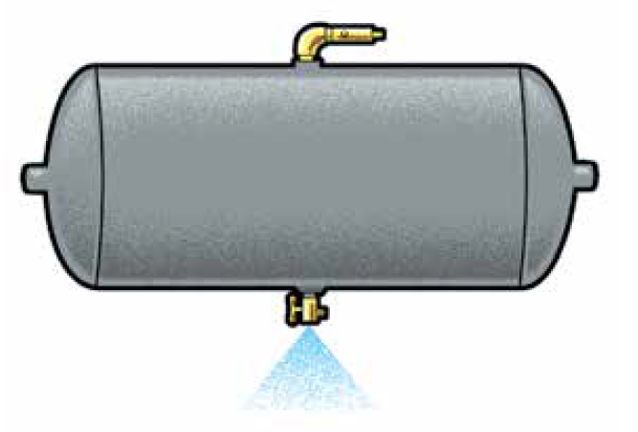
Reservoirs
Reservoirs are pressure-rated tanks that hold a supply of compressed air until required for braking or operating auxiliary air systems
Maximum air pressure available for brake applications depends on how much air is in the reservoir
A driver cannot make a higher pressure brake application than the amount of air pressure in the reservoir
Each reservoir is equipped with an air-tank drain valve that, when fully open, allows reservoirs to be drained of moisture and other contaminants that build up in the system
Notes:
DO: Read the slide.
Reference: MPI Air Brake Manual: Chapter 2: Air-Supply Subsystem

Slide 22
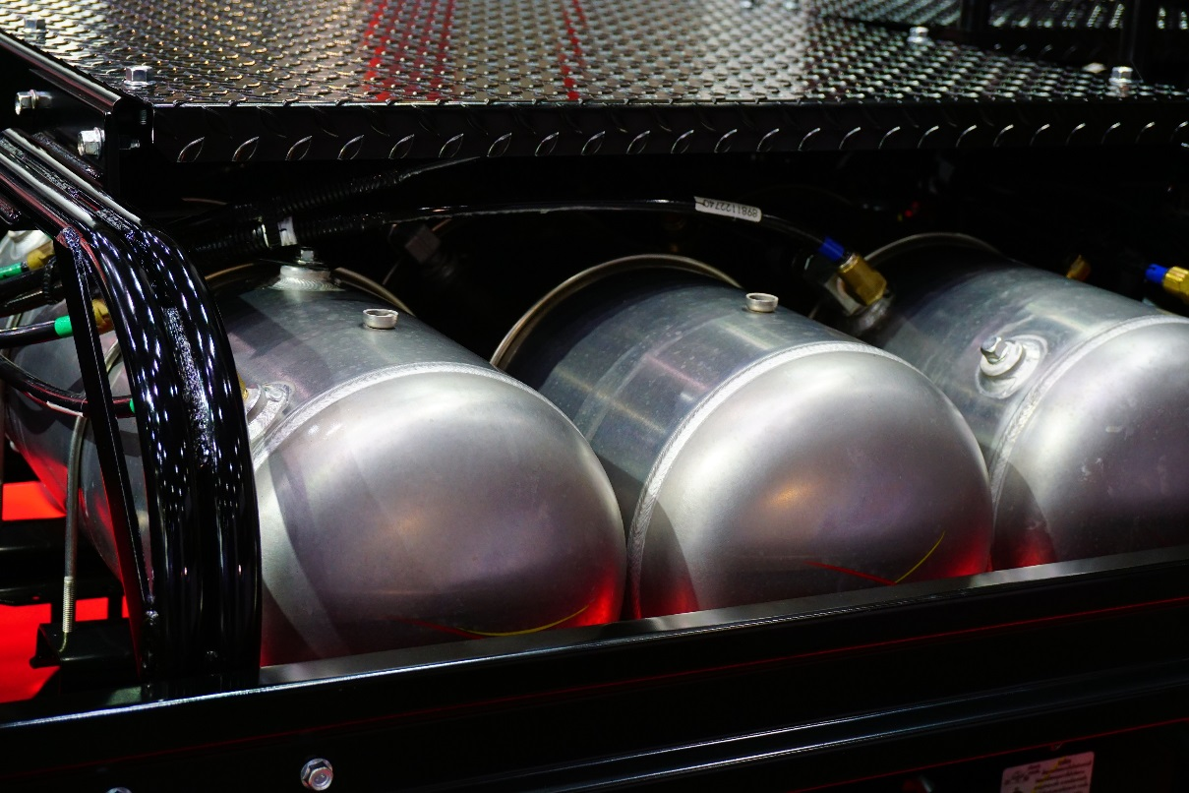
Reservoirs
All reservoirs must be completely drained daily.
Notes:
DO: Read the slide.

Slide 23

Foot Valve
Foot valve (application or treadle valve)
Applies air to operate the brakes
The amount of air delivered to the brakes is regulated by the driver
Styles you may see:
Overhead with a foot pedal hanging down
Floor-mounted version with a foot treadle
Floor-mounted version
Notes:
SAY: The foot valve (application or treadle valve) applies air to operate the brakes. You regulate the amount of air delivered to the brakes according to the distance the treadle or brake pedal is depressed. Releasing it exhausts air in the service brakes through its exhaust port. These valves are made in overhead styles with a foot pedal hanging down, or a floor-mounted version with a foot treadle.
Reference: MPI Air Brake Manual: Chapter 3: Service Brake Subsystem

Slide 24
Brake Chambers
Brake chambers or brake pots
Convert compressed air pressure energy into a mechanical force and movement, which apply the vehicle’s brakes
Disc brakes (rotors and pads)
Disc brakes can be either non-adjustable sealed units or adjustable
Notes:
SAY: Brake chambers or brake pots convert compressed air pressure energy into a mechanical force and movement, which applies the vehicle’s brakes.
With service-brake chambers, when you apply pressure to the foot valve, air pressure enters the pressure side of the brake chamber through the inlet port and forces against the diaphragm which moves the pushrod assembly forward. When air pressure is released from the service-brake chamber, the return spring returns the diaphragm and pushrod to their released positions.
Some trucks are now equipped with disc brakes (rotors and pads). Disc brakes can be either non-adjustable sealed units or adjustable. If your truck is so equipped, consult the manufacturer’s manual for information on how to keep the brakes properly adjusted.
Reference: MPI Air Brake Manual: Chapter 3: Service Brake Subsystem

Slide 25

Brake Linings and Drums
S-Cam
Is rotated so the high points act against the cam rollers and forces the brake shoes against the drum
Drum thickness
Determines the amount of heat that can be absorbed and dissipated to the atmosphere
Brake chamber
Brake lining
Brake drum
Purpose: To create friction needed to stop the vehicle
Notes:
SAY: The purpose of brake linings and drums is to create the friction needed to stop the vehicle.
The “S” cam brake is rotated so the high points act against the cam rollers and force the brake shoes against the drum. When the brakes are released, the brake cam shaft returns the brake cam to its normal position. The cam rollers roll down into the crook of the S-cam as the brake shoe return spring pulls the shoes away from the drum. Brake shoes generate heat through friction with the brake drum surface.
Drum thickness determines the amount of heat that can be absorbed and dissipated to the atmosphere. Thin or distorted drums, weak return springs, improper linings, poor adjustment, or grease or dirt on the lining results in erratic, unpredictable and potentially dangerous brake performance.
Reference: MPI Air Brake Manual:
Chapter 9: Inspecting Air Brake Components
Chapter 6: Foundation Brakes

Slide 26
Brake Linings and Drums
Signs of wear:
  Thin or distorted drums
  Weak return springs
  Improper linings
  Poor adjustment
  Grease or dirt on the lining
Notes:
SAY:
Signs of wear are thin or distorted drums, weak return springs, improper linings, poor adjustment, grease or dirt on the lining.
This type of wear can result in brake malfunction including erratic, unpredictable and potentially dangerous brake performance.
Reference: MPI Air Brake Manual:
Chapter 9: Inspecting Air Brake Components
Chapter 6: Foundation Brakes

Slide 27
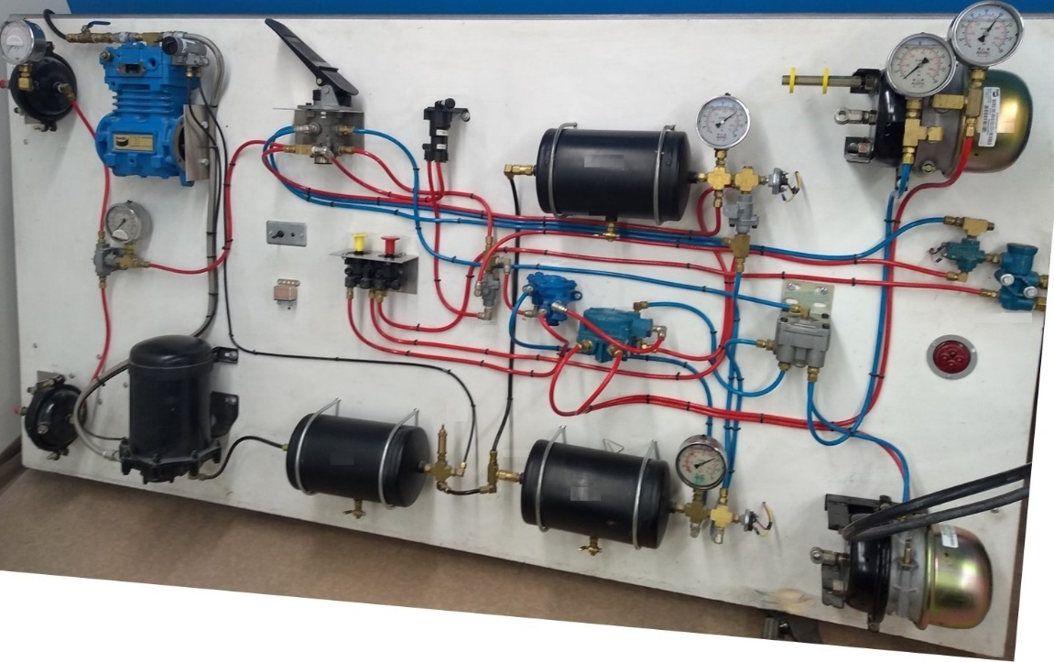
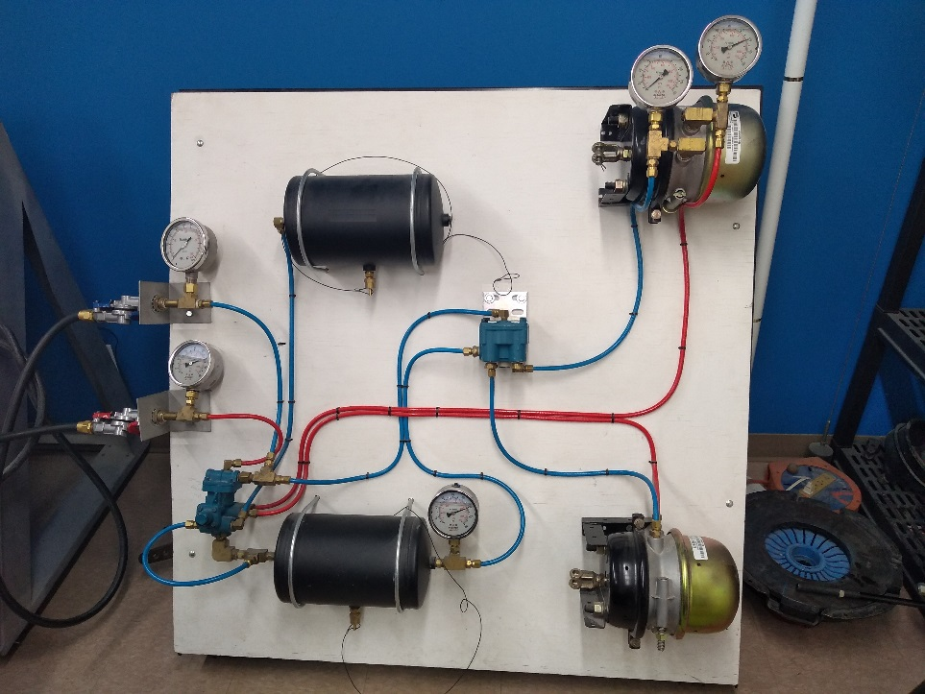
System Operation
  Tractor
  Trailer
Notes:
Do: Describe how the brakes operate
SAY:
Air is pumped by the compressor to the reservoir. When air pressure reaches 120 psi to 145 psi the governor places the compressor into its unloaded stage. At this stage the air system is fully charged.
When the brakes are applied, air is delivered through the foot valve to the service-brake chambers. Air pushes against each service-brake diaphragm causing the pushrod to move the slack adjuster. The slack adjuster rotates the brake cam, which forces the shoes against the brake drum. When you release the foot valve, air in the brake chambers is exhausted through the foot valve, which releases the brakes. When reservoir air pressure drops, the governor puts the compressor back into the pumping stage to keep adequate air pressure available for future brake applications.

Slide 28
Air Brake Board Demo
Time: 15 minutes
Observe a functioning air brake system on a brake board.
Notes:
DO: Have students watch while you explain how air brakes work using the board. Then have them come up one by one to explain it to the class. Field any questions that come up during this process.

Slide 29
Air Tanks
Supply reservoir or wet tank
The reservoir closest to the compressor
Service reservoir
The second reservoir: air is drawn from this reservoir to operate the brakes
Service tank
The supply tank receives the air from the compressor and distributes it to the service tanks
Notes:
SAY: The reservoir closest to the compressor is called the supply reservoir. Also known as the wet tank because most of the water and oil from the compressor gathers here.
The second reservoir is called the service reservoir. Air is drawn from this reservoir to operate the brakes.
The terms: supply, wet, and purge are all used interchangeably to describe the first tank that receives the flow of air pressure. Supply is the formal term. Wet tank is a more common term because this is the tank that captures the bulk of contamination. Most air dryers store their own air pressure to purge (back-flush) the desiccant, which is similar to the dry silica packets that is found at the bottom of your box of new shoes. Others allow some air pressure from the supply tank to, while others use a separate independent tank for purge air. The supply tank is often called the purge tank, when in fact it rarely is. Other than the Air Dryer Integrated Solution system, most dryers manage their own purge air rather than relying on the supply tank.
The supply tank receives the air from the compressor and distributes it to the service tanks. Compressed air heats when compressed and cools in the tanks. Humidity condenses and accumulates. Other contaminates such as compressor lube oil may also migrate through the system.
Reference: MPI Air Brake Manual: Chapter 2: Air Supply Subsystem

Slide 30
Air Tanks
Drain valves or lanyard
Available under all air pressure tanks
Can be opened with a manual tap or with a lanyard pull cable
How and when to drain them
Lanyard should be pulled often during the day, during pre-trip and en route inspections, and when fueling
If moisture is accumulating, drain the tanks completely at the end of the shift
Tanks do not drain properly until after the air pressure is depleted and the contamination settles down and starts to drip from the tank
Notes:
SAY: There is a drain valve under all air pressure tanks. It can be opened with a manual tap or with a lanyard pull cable. Most supply tanks have lanyard pulls and either lanyards or manual drain valves on the service tanks.
The supply tank lanyard should be pulled often during the day, during pre-trip and en route inspections, and when fueling. Although this does not drain contamination properly, it will ensure contamination does not accumulate. If moisture is accumulating, drain the tanks completely at the end of the shift. If necessary, hold the lanyard pulls open with tarp straps following a work shift.
Tanks do not drain properly until after the air pressure is depleted and the contamination settles down and starts to drip from the tank. Stand clear of discharging air pressure.
Reference: MPI Air Brake Manual: Chapter 2: Air Supply Subsystem

Slide 31

Safety Valve
Protects the supply reservoir from becoming over-pressurized and bursting
Is set at 150 psi and blows off excess pressure
If the safety valve blows off excess pressure, it indicates a problem with the governor
Normal air pressure
Air pressure greater than 150 psi
Notes:
SAY: The safety valve protects the supply reservoir from becoming over-pressurized and bursting. This valve is set at 150 psi and blows off excess pressure. If the safety valve blows off excess pressure, it indicates a problem with the governor.
Safety valves are located in the supply circuit so components downstream are protected. Some are external and others thread in so that the top is flush with the bung, and the pressure spring and seat is in the tank. Most air brake equipped vehicles have safety valves in both the air dryer and the supply tank, some only have a safety valve in the air dryer.
Reference: MPI Air Brake Manual: Chapter 2: Air Supply Subsystem

Slide 32
Air Dryers
Air dryers reduce the amount of moisture that passes into the air brake system
Vehicles using air dryers must still have the air tanks drained regularly.
Alcohol Evaporator
  Adds an alcohol vapor to the air that will mix with any moisture or ice present and reduce its tendency to freeze.
Notes:
SAY: Air dryers remove contamination from the air pressure being delivered by the compressor. Older air dryers were an after-cooler type arrangement where the air passed through a canister that cooled the warm air from the compressor very quickly. Contamination from the cooled air would collect in the sump of the air dryer which was then purged at the end of the pumping cycle. These older air dryers have cooling fins on their sides.
Modern dryers use desiccant which absorbs moisture as it passes by. This absorbed moisture is blown off of the desiccant as it is purged (back-flushed). Most air dryers manage their own purge air, but some have a separate air tank strictly for purge purposes that is not part of the air brake system. Other dryers use a bit of the supply tank air pressure to purge the desiccant.
The air dryer integrated system, or AD-IS, combines the governor, air dryer, safety valve and supply tank into one system. It uses a combination of pressure protection valves to protect the service circuits. This system collects and removes contaminants in solid, liquid and vapour form before they enter the brake system.
It eliminates the need for daily manual draining of air tanks. It is still recommended to pull drain lanyards regularly to confirm the dryer is working properly.
Air brake antifreeze is methyl-alcohol with a lubricant added to prevent rubber components in the valves from drying out. Some vehicles depend on air brake antifreeze to keep them running in the winter.
Some manufacturers do not recommend using air brake antifreeze, while others outfit their vehicles with inline alcohol injector kits at the factory. Pure alcohol can damage the air dryer desiccant so avoid adding alcohol ahead of that component. For example, do not add alcohol into the pressure line from the air compressor because that alcohol will go directly into the dryer.
Some trailers flow the emergency and service air lines through small desiccant dryers. Alcohol would damage these dryers. These trailers typically have a decal fitted to the front of the trailer warning against alcohol use.
Reference: MPI Air Brake Manual: Chapter 2: Air Supply Subsystem

Slide 33
Service Circuits
Service circuit components include:
Air tank protected by a check valve
Air pressure gauge and low air pressure warning device
Brake chambers, control valve and quick release or service relay valves
Power units have two service circuits:
    One for the steering axle, and one for the drive axles
    Each trailer axle group has its own independent service circuit
Notes:
SAY: Each axle group has an independent service brake circuit. Power units have two service circuits; one for the steering axle, and one for the drive axles. Each trailer axle group will have its own independent service circuit.
Every axle group will have an independent service brake circuit. Sometimes a trailer Original Equipment Manufacturer (OEM) fits one circuit per axle; others outfit one circuit for the complete axle group.
The service circuits components include:
Air tank protected by a check valve, air pressure gauge and low air pressure warning device
Brake chambers, control valve and quick release or service relay valves
The service tank holds the pressurized air used for service brake applications. The capacity is set to the size and number of brakes installed in the axle group. The air tank stores air pressure for the simplified service circuit and is sized according to the air volume required for the brake chambers.
The tanks are hydrostatically tested to handle at least five times the compressor cut-out pressure or 500 PSI (3,448 kPa) whichever is greater. Air tank volume capacity must be capable of providing for a minimum of 12 full-service brake applications for power units and 8 full-service applications for trailers.

Slide 34
One-Way Check Valve
A one-way check valve is installed between the supply and service reservoirs to keep the air from bleeding back
How do they work?
The valve is spring loaded
Air passes through the valve when pressure at the outlet becomes greater than at the inlet
The one-way check valve seals, prevent air from flowing back through the valve
Notes:
SAY: If the air compressor fails or a leak develops in the supply reservoir, a one-way check valve between the supply and service reservoirs keeps the air from bleeding back. The valve is spring-loaded. Air passes through the valve when pressure at the outlet becomes greater than at the inlet. The one-way check valve seals, preventing air from flowing back through the valve.
Reference: MPI Air Brake Manual: Chapter 2: Air Supply Subsystem

Slide 35
Air Pressure Gauges
Pressure gauges measure air pressure in tractor service tanks
Low pressure warning device
Warns of low air pressure at a minimum of 60 psi (414 kPa)
The Commercial Vehicle Safety Alliance (CVSA) out-of-service standard is a minimum of 55 PSI (310 kPa) or half of the governor cut-out pressure, whichever is less
Notes:
SAY: The air pressure gauges measure air pressure in the two tractor service tanks. Trailer service tanks receive air pressure from the tractor service tank with the highest pressure and do not have an air pressure gauge. The maximum brake application depends on the amount of air pressure available in the reservoirs.
A low pressure warning device warns of low air pressure at a minimum of 60 psi (414 kPa). Manufactured with both a visual indicator and audible alarm to warn you that the pressure has become too low. The Original Equipment Manufacturer (OEM) tends to activate the alarm sound around 70 psi (483 kPa).
The Commercial Vehicle Safety Alliance (CVSA), an organization that all enforcement agencies belong to, standardizes commercial vehicle inspections so that defects are applied equally throughout North America.
The CVSA out-of-service standard is a minimum of 55 PSI (310 kPa) or half of the governor cut-out pressure, whichever is less. Additionally, if either the audible or visual warning device is working, the vehicle will not be placed out-of-service.
Reference: MPI Air Brake Manual: Chapter 2: Air Supply Subsystem

Slide 36
Brake Chambers
Brake chambers convert air pressure into mechanical force
Two factors affect air-to-mechanical force conversion: brake chamber size and air pressure applied by the driver
Air pressure is a measurement of force over a surface area
Brake chambers are sized by the OEM but air pressure is controlled by the driver
Brake chamber
Notes:
SAY: Brake chambers convert air pressure into mechanical force. This is the end of the air system and the beginning of the mechanical linkages, which apply the foundation brakes. The two factors that affect this air-to-mechanical force conversion are the brake chamber size and the air pressure you apply. Air pressure is a measurement of force over a surface area. For example, 10 PSI (69 kPa) applies 10 pounds (4.5 kg) of force onto a single square inch of surface area. A surface area of 20 square inches (129 square cm) will multiply the force by the overall surface area, which in this example is 20 square inches (129 square cm). The pressure being applied would be the equivalent of 200 pounds (91 kg) of force on the push plate and on through to the pushrod.
Brake chambers are sized by the Original Equipment Manufacturer (OEM), but you control the air pressure. The typical size for steering axles is Type 20 meaning 20 square inches’ diaphragm surface area (129 square cm). The typical size for load bearing axles is Type 30 meaning 30 square inches’ diaphragm surface area (194 square cm).
Long stroke chambers have more total stroke before the push plate bottoms in the chamber. A standard Type 30 brake chamber has a total stroke of 2½ inches (64 mm), whereas a long stroke chamber has a total stroke of 3 inches (77 mm). Long stroke chambers have square inlet ports.
These components are not interchangeable with regular chambers.
Do: Refer back to slides 10 & 11 for the graphics that provide an explanation on power and force.
Reference: MPI Air Brake Manual: Chapter 3: Service Brake Subsystem

Slide 37
Control Valves
Control valves manage the air pressure flow from the service tanks through to the brake chambers
Work the same regardless of how they are activated
Activation can occur from the driver’s foot or hand, by air or electric signal
Control valves manage pressure flow with the help of two internal valves:
Inlet valve
Exhaust valve
Notes:
SAY: Control valves manage the air pressure flow from the service tanks through to the brake chambers. All control valves work the same regardless of how they are activated. Activation can occur by a linkage from your foot or hand, by air or electric signal.
Control valves manage pressure flow with the help of two internal valves: an inlet valve that allows air pressure to flow from the service tank to the brake chambers, and an exhaust valve that allows air pressure in the chambers to escape into the atmosphere. When the brake is released, the inlet is closed, holding the air in the tank and the exhaust open. This leaves the chambers open.
When the control is applied, the exhaust closes and the inlet opens. Air pressure travels through to the diaphragms in the chambers and the service brakes are applied. When the control valve is in the hold/balance position, both the inlet and exhaust are closed. This captures the application air in the brake chambers. When the brakes are released, the inlet remains closed and the exhaust opens, allowing the application air pressure to exhaust to the atmosphere.
Reference: MPI Air Brake Manual: Chapter 4: Spring Brake Subsystem

Slide 38
Quick Release Valves
Allow a more rapid exhaust of air from the brake chambers when the brakes are released
Air pressure in the brake chambers exhausts through the quick release valve allowing the brakes to release more rapidly
Notes:
SAY: Quick Release Valves allow a more rapid exhaust of air from the brake chambers when the brakes are released. The valve is mounted under the front cross member area or incorporated into the ABS system. Brakes apply normally through the foot valve. The brake chambers are close to the foot pedal, so brake lag is minimal. When the brake application is released, air pressure in the brake chambers exhaust through the quick release valve allowing the brakes to release more rapidly. Air exhausts through the quick release valve, but may also exhaust through the ABS modulators, if equipped.

Slide 39
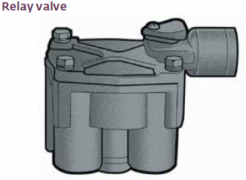
Relay Valve
A relay valve is installed near the rear brake chambers to minimize brake lag
Service line booster relays are often found on converters
Notes:
SAY: On long wheelbase trucks and tractors and on trailers, the distance from the brake chambers to the foot valve is too far to cause immediate application of the brake when the foot valve is depressed. This is called brake lag.
To correct this situation, a relay valve is installed near the rear brake chambers.
The air line from the foot valve to the relay valve now becomes a control line that signals to the relay valve the amount of air to be drawn from the service reservoir for faster application of the brakes. A quick-release valve is built in for faster release of the brakes.
Relays can be mounted directly into the service tank (typical of trailers) or mounted on the frame (typical of drive axles). You send a control signal to the top of the relay to trigger the application. Today’s air brake equipped vehicles may have brake management systems that use electronics to pilot the relays; all vehicles must maintain air pressure control signals.
The large volumes of air pressure from the tank to the relays are moved through larger air hoses, typically 5/8 to 3/4 inch (16 to 19 mm) in diameter. Air pressure signals tend to flow through smaller diameter lines providing a faster delivery. Brake signals are typically moved through 3/8 inch (10 mm) lines, governor signal pressures through 1/4 inch (7 mm) lines, and transmission signals through 1/8 inch (4 mm) lines.
Crack pressure is the amount of control air pressure from the foot valve that must be initially delivered to the top of the relay before the valve starts to open to deliver air pressure from the service tank to the brake chambers.
Different cracking pressures are used to regulate the timing of the service brakes down the length of the vehicle. Since the control (pilot) air comes from the cab, the relay valves further down the length of the vehicle will take longer to receive the control signals. Crack pressures are used to time the actual application of air to the chambers. Relay valves closer to the cab will have higher crack pressures - this allows more time for the control air to make its way to the back before the power unit brakes apply.
The exception to relay crack pressures is when a relay is used in a service line booster situation. Long trailer service lines tend to cause service signal to diminish (transmission loss). A special relay (booster) is used to recharge the service signal. These booster relays have zero crack pressures, otherwise the signal air coming from the booster relay would be reduced from what was originally sent from the tractor’s foot valve.
Service line booster relays are often found on converters. It is important that valves are replaced with the proper components. When service brakes are released, the air pressure in the chambers exhausts directly from under the relay and the smaller volume in the longer control line exhausts back out of the foot valve.

Slide 40
Bobtail Proportioning Relay Valve
A combination of two individual valves in a single housing
It reduces stopping distances and gives the driver greater control over the vehicle
Notes:
SAY: Some trucks are equipped with a bobtail proportioning relay valve, which is a combination of two individual valves in a single housing.
The lower portion contains a standard service-brake relay valve, which functions as a relay station to speed up brake application and release.
The upper portion houses a brake proportioning valve that reduces normal service-brake application pressure when the tractor is not towing a trailer.
During bobtail operation, this valve reduces stopping distances and gives you greater control over the vehicle.
The brake pedal has to be pushed farther to apply sufficient air to stop.

Slide 41
Review
What pre-set PSI is a safety valve set for to blow off excess pressure?
Answer: 150 PSI.
What does blowing off excess pressure indicate?
Answer: A problem with the governor.
Notes:
DO: This is an animated slide. To reveal the answer click after reading the question.

Slide 42
Review
What is the function of the quick release valve?
Answer: It rapidly exhausts air from the controlled device.
Notes:
DO: This is an animated slide. To reveal the answer click after reading the question.

Slide 43
Review
How is brake lag reduced?
Answer: Through a relay valve.
Notes:
DO: This is an animated slide. To reveal the answer click after reading the question.

Slide 44
Brake Circuits
Get into groups of 4 and plan how you will teach the class about brake circuits.
Use diagrams and write out some key points that you want the class to know.
Use the MPI Air Brake Manual, and any other resources you can find for reference.
Notes:
DO: Have students get into groups of 4 to prepare a lesson on brake circuits.
30 minutes

Slide 45
Spring Parking Brakes Systems
The installation of spring parking brakes and their piping arrangements into a vehicle air brake system vary depending on the vehicle make.
A spring mechanically applies the parking brake
Air pressure from the service tank releases the parking brake
Spring
parking
brake
chamber
Notes:
SAY: Air pressure is not reliable for parking brakes. Service brakes require air pressure to apply. Without air pressure the vehicle will not be secured.
The installation of spring parking brakes and their piping arrangements into a vehicle air brake system vary depending on the vehicle make.
A spring mechanically applies the parking brake. This is typically installed on all loaded-axle service chambers. The parking brake is firmly held without depending on air pressure to secure the vehicle. Air pressure from the service tank is used to release the parking brake which begins to release at 60 psi (414 kPa).
Reference: MPI Air Brake Manual: Chapter 4: Spring Brake Subsystem

Slide 46
Spring Parking Brake System
Parking brake
spring
Air pressure is applied to keep the spring brake caged.
Notes:
SAY: It takes approximately 90 psi of air pressure to keep the spring brakes caged. If reservoir air pressure is allowed to drop below 90 psi the springs will start to move. At approximately 70 psi the brakes will be partially applied making it difficult to continue driving. If the air pressure drops below 60 psi the brakes will be fully applied making it impossible to move the vehicle until enough air pressure is built up to cage the springs, or until they are manually caged.
Note: Spring parking brakes are under extreme pressure and could cause serious injury or death. DO NOT take brake chambers apart , there are no repairable parts inside!
Reference: MPI Air Brake Manual: Chapter 4: Spring Brake Subsystem

Slide 47
Spring Parking Brake Control Valve
The spring parking brake control valve (yellow button) is the driver’s control for the parking circuit.
Located in the cab
Controls air pressure to the parking brakes
Releases air pressure when pulled
Notes:
SAY: The spring parking brake control valve controls air pressure to the parking brakes and is located in the cab. Air pressure is released when the valve is pulled. The parking control valve (yellow button) is your control for the parking circuit.
Reference: MPI Air Brake Manual: Chapter 4: Spring Brake Subsystem

Slide 48
Spring Parking Brake Control Valve
When air pressure drops, the spring under the spool overcomes the air pressure that holds the spool in and pops the spool and button out
This typically happens between 20 - 45 PSI
(138 - 310 kPa)
A vehicle must be placed out-of-service if the parking control valve does not default back to the park position when the air pressure is depleted
Notes:
SAY: The yellow button sits on top of a spring-loaded spool in the housing. Air pressure holds it in (open). When air pressure drops, the spring under the spool overcomes the air pressure holding it in and pops the spool and button out. This typically happens between 20 - 45 PSI (138 - 310 kPa), although in new trucks it can happen as low as 10 PSI (69 kPa). A vehicle must be placed out-of-service if the parking control does not default back to the park position when the air pressure is depleted.
When the parking control valve (yellow button) is pulled, air is exhausted and the parking spring expands and applies the foundation brake.
Reference: MPI Air Brake Manual: Chapter 4: Spring Brake Subsystem

Slide 49
Air Pressure Failure Application
82 - 84 psi
The parking springs begin to expand
55 - 60 psi
The brake lining starts to drag on the drums
45 – 50 psi
The parking springs are applied firmly
Notes:
SAY: When air pressure drops to 82 - 84 PSI (566 - 580 kPa), the parking springs begin to expand. By the time the springs expands enough to take up the free-play, air pressure is down to 55 - 60 PSI (380 - 414 kPa). At this point, the brake lining starts to drag on the drums. The parking springs are applied firmly by 45 - 50 PSI (310 - 345 kPa) air pressure. Spring parking brakes begin to apply if system air pressure drops below 60 psi (414 kPa). An automatic application of the spring parking brakes provides minimum reaction time and can reduce vehicle control.

Slide 50
Air Pressure Failure Application
Control Valve
Foot Valve
Allows air pressure to flow to the pressure plate of the parking diaphragm.
It compresses the parking spring to release the spring parking brakes.
Service brakes applied with the foot valve use the service circuit and functions independently of the parking circuit to provide normal braking.
The parking brake would remain released.
Notes:
SAY: Opening the parking control valve (by pushing the yellow button) allows air pressure to flow to the pressure plate of the parking diaphragm. It compresses the parking spring to release the spring parking brakes.
Applying the service brakes with the foot valve uses the service circuit and functions independently of the parking circuit to provide normal braking. The parking brake remains released.

Slide 51
Manually Releasing the Parking Spring
Spring brakes can be manually released (caged) with a release bolt.
Found in a side pocket on the chamber
Caging bolts (release tools) are used to pull the parking spring off the application so the vehicle can be towed or repaired
NEVER TAKE THE PARKING CHAMBER APART!
Notes:
SAY: Spring brakes can be manually released (caged) with a release bolt. The release bolt is often found in a side pocket on the chamber. Some spring brake chambers incorporate the release tool into the body of the chamber.
Caging bolts (release tools) are used to pull the parking spring off the application so the vehicle can be towed or repaired. They are not to be used as a method of taking the parking chambers apart. If all of the parking brakes are to be caged, ensure chock blocks are placed on both sides of the wheels.
Reference: MPI Air Brake Manual: Chapter 4: Spring Brake Subsystem

Slide 52
Caging the Parking Brake
Vehicles with no air pressure and caged parking springs have no service or parking brakes.
Ensure chock blocks are used
Cage parking springs for towing and repairs
Do not operate vehicles with reduced braking capabilities
Notes:
SAY: Vehicles with no air pressure and caged parking springs have no service or parking brakes. Ensure that chock blocks are in place before caging the parking springs. Caging parking springs is a procedure used for towing vehicles and mechanical repairs only. Do not operate vehicles with reduced braking capabilities.
Reference: MPI Air Brake Manual: Chapter 4: Spring Brake Subsystem

Slide 53
Dual Air Supply
Air pressure for the parking circuit is delivered from the service tank with the higher pressure, and
Keeps the spring parking brake released
Allows the driver to make a safe and controlled stop
Notes:
SAY: Air pressure for the parking circuit is delivered from the service tank with the higher pressure. This keeps the spring parking brake released if there is a system failure in either service circuit and allows you to make a safe and controlled stop.
Reference: MPI Air Brake Manual: Chapter 3: Service Brake Subsystem

Slide 54
Trailer Air Brake Circuits
Service and parking brakes, relays and control lines work the same on trailers as on trucks.
Each axle group has:
  Air tank
  Relay valve
  Brake chamber
Notes:
SAY: Service and park brakes operate the same on trailers as they do on power units (i.e., the truck or tractor). Relays and control lines also work the same.
Air pressure is provided by the tow vehicle, so there is no supply circuit on the trailer. Each axle group has an air tank, relay valve, and brake chamber.
The two air lines that connect to the trailer carry the air supply and the brake signal to the trailers service and parking circuits.
Reference: MPI Air Brake Manual: Chapter 3: Service Brake Subsystem

Slide 55
Gladhand Couplers
Inspect before connecting:
Seals, air valves
Rubber seal (“O” ring)
Best practices:
Carry spare seals
To protect them (dirt, water):
  Discharge air pressure before connecting
  Store securely when not in use
  Use dead-end couplers when air lines not in use
  Lock gladhand of service line to supply line
Air Lines
Notes:
DO: Advise students to carry a supply of spare seals and demonstrate how to replace them. Remember that the thick side goes into the gladhand coupler. It may be helpful to display a sample of red and blue gladhand couplers with a variety of seals.
SAY: Gladhand couplers should be completely inspected before being connected. If the seals are soft or degraded, they will leak. If the gladhand couplers are damaged they may not press together properly and leak.
Gladhands connect the two air lines to the trailer. They are friction locked and rubber sealed, usually “polarized” to prevent cross-connection. Trailer air valves are expensive, so keep them clean. Dirt in the air lines from bobtails will migrate into and contaminate trailer valves resulting in expensive repairs.
Some best practices include:
Carrying spare seals
Protect them from dirt and water by:
A quick discharge of air pressure before connecting the gladhand couplers will help contamination blow out rather than sending it into the trailer. Leave the gladhand couplers lying open on the tractor deck. Pull the hand valve, and hold the red dash valve in for a few seconds. Release both the dash valve and the hand valve and then connect the air lines.
Store them securely when not in use
Use dead-end couplers when the air lines are not in use.
If the unit is not equipped with dead-end couplers, the gladhand of the service line can be locked to the gladhand of the supply line to keep water and dirt from entering the unused lines.
Gladhands and lines should also be secured to prevent the line from bouncing off the vehicle which could seriously damage the couplers.
There are different types of air lines. Plastic coiled air lines work well, but can become brittle over time. Rubber air lines are also available.
Flat deck haulers may run the trailer air lines from the back of the frame to the landing leg area of the trailer, rather than from the back of the cab to the nose of the trailer. This causes less interference from loads that overhang the front of the deck.
Reference: MPI Air Brake Manual: Chapter 5: Trailer Brake Subsystem

Slide 56
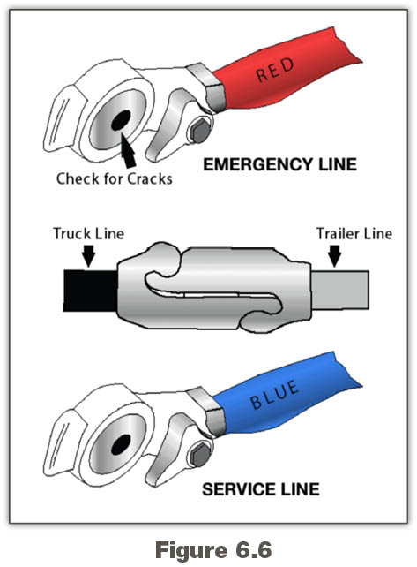
Supply or Emergency Line
Notes:
SAY: All supply couplers have the word “Emergency” or a large “E” on them. Typically, they couple to the left (driver) side of the two couplers on the trailer. This is a convention rather than a requirement.
The air pressure used to supply the trailer tanks will come from the higher of the two tractor service tanks.
The two functions of this supply line is to fill trailer tanks, and release trailer parking brakes. It is usually colour-coded red.
Reference: MPI Air Brake Manual: Chapter 5: Trailer Brake Subsystem

Slide 57
Service or Control Line
Notes:
SAY: The service or control line carries the control signal from the foot valve to the trailer circuit relays. It is usually colour-coded blue and generally mounted on the passenger side of the gladhand couplers. Service couplers will say “Service” or have a large “S” on them.
Reference: MPI Air Brake Manual: Chapter 5: Trailer Brake Subsystem

Slide 58
Tractor Protection System
Two components to the tractor’s protection system:
The trailer supply valve which controls the supply line
  If it does not work properly, the vehicle will be placed out-of-service
The tractor protection valve which opens the service line
  The trailer supply valve controls the tractor protection valve
Notes:
SAY: There are two components to the tractor’s protection system: the trailer supply valve and the tractor protection valve. The trailer air supply valve (red button) controls the supply line, and the tractor protection valve uses supply line pressure to open the service line. The trailer supply valve is an item checked by enforcement officers during roadside vehicle inspections. If it does not work properly, the vehicle will be placed out-of-service.
Enforcement officers during Level 1 Commercial Vehicle Safety Alliance (CVSA) inspection will check both parts of the tractor’s protection system. Both lines will be removed from the trailer and when the red button trips, you will be asked to apply the service brake. The service line should not leak. This procedure is a part of the air system pre-trip inspection.
Reference: MPI Air Brake Manual: Chapter 5: Trailer Brake Subsystem

Slide 59
Trailer Air Supply Valve
Red button (Push/Pull Type)
  Supplies air pressure to the trailer
  Driver pushes in to open and pulls out to close when no trailer attached
  Button pops out (closes) automatically between 20-45 psi
Yellow button (Spring Brake Control Valve)
  Master button
  Pulling it also pops out the trailer supply valve (red button)
  Activates all the vehicle’s spring parking brakes
Notes:
SAY: Push the red button to open and supply air pressure to the trailer. Pull to close and stop the air pressure supply. If the supply line separates, the button pops out automatically between 20-45 psi.
The trailer air supply valve is also controlled by the spring brake (parking and emergency) control valve (yellow button, see Spring Parking Brake Control Valve slide). This is the master button. Pulling it also pops out the trailer supply valve (red button) and activates all of the vehicle’s spring parking brakes.
In the two button system, the trailer air supply valve (red button) automatically applies or pops out when the spring brake control valve is pulled. Most drivers get into the habit of holding a thumb on the trailer air supply valve (red button) while pulling the spring brake control valve (yellow button). This applies the tractor spring parking brakes while keeping the trailer spring parking brakes released, which prevents the trailer brake linings from freezing onto the drums in cold weather.
Reference: MPI Air Brake Manual: Chapter 5: Trailer Brake Subsystem

Slide 60
Foot Valve Application
Applies the tractor and trailer brakes
Supplied by primary and secondary circuits
Trailer service application will occur should a primary or secondary circuit fail
Notes:
SAY: When the foot valve application treadle is depressed, air is delivered to the tractor and trailer brakes. The air is supplied by the service circuits. There will be a trailer service application if a circuit fails.
Reference: MPI Air Brake Manual: Chapter 5: Trailer Brake Subsystem

Slide 61
Trailer Control Valve
Hand valve:
  Controls only the trailer service brakes
  Not to be used for parking
  This system is still used on most converter dollies and on some specialized equipment for heavy hauling
  May be mounted in the steering column or in the dash
Notes:
SAY: The hand valve controls only the trailer service brakes, independently of the tractor service brakes. Hand valves send controlled air pressure through the trailer service (blue) line to the top of the trailer relays. These valves may be mounted on the steering column or in the dash. Some are spring-loaded, returning to the released position unless held by the driver, while others stay applied and must be manually released.
These are not to be used for parking.
Prior to 1976, trailers were equipped with air parking brakes. This system is still used on most converter dollies and on some specialized equipment for heavy hauling.
As of January 1, 1976, Section 121 of the Canadian Motor Vehicle Safety Standards (CMVSS) requires spring parking brakes on trailers.
The trailer’s air system communications are the same as modern spring brake trailers, so any tractor can pull any trailer. Pushing the trailer air supply valve (red button) releases the trailer’s air pressure parking brakes and maintains air pressure in the trailer’s air supply tank. Under normal conditions the service brake circuit works the same as the tractor service circuit. They control the air from the tractor signals relay, and application air is delivered to the trailer chambers from the local service tank.
Reference: MPI Air Brake Manual: Chapter 5: Trailer Brake Subsystem

Slide 62
Parking/Emergency Circuit
When air to the trailer is disconnected:
  Emergency relay opens the air tank to the diaphragm
  Trailer brakes apply firmly - powerful emergency brake
  Risk of brake lockup increases
Problem with air pressure parking brakes is they do not stay. Different operating procedures are required:
  Trailers must be chocked and uncoupled
  Trailers must be charged with air pressure and the trailer service or parking brakes applied before coupling
Notes:
SAY: When the air supply to the trailer is disconnected, the emergency relay opens the air tank to the diaphragm in the service chambers. Service air pressure will cause trailer brakes to apply firmly. This is a very powerful emergency brake - twice as powerful as spring parking brakes. It can create an increased risk of brake lockup in an emergency application.
The problem with air pressure parking brakes is that they do not stay on. As air pressure drains out of the system, the parking brakes will release. Very different operating procedures are required. Trailers must be chocked when uncoupled to prevent them from moving. Additionally, trailers must be charged with air pressure and the trailer service or parking brakes applied before coupling.

Slide 63
Supply Circuit Failures
Notice the failure:
Air pressure gets below cut-in level
Low air pressure warning
Causes:
  Plugged or collapsed line
  Ruptured supply tank
  Impact:
  All brakes will work properly but limited by the available air pressure
Notes:
SAY:
The failure is noticed when the air pressure gauges do not replenish when the air pressure gets below the cut-in level. In some vehicles the low air pressure warning come on.
The supply circuit failure could be caused by anything from a plugged or collapsed line to a ruptured supply tank.
All brakes will work properly, but they will be limited by the amount of air pressure available in the service tanks.

Slide 64
Primary Service Circuit Failure
When failure occurs in the primary service circuit:
  Spring parking brakes remain released with air pressure from the secondary circuit
  Service application applies the steering axle and trailer brakes
  Inversion valve releases controlled amount of air pressure to allow the spring parking brakes to apply the drive axle foundation brakes in a controlled manner
Notes:
SAY: The failure occurs in the primary circuit. Spring parking brakes remain released with air pressure from the secondary circuit. A service application will apply the steering axle and trailer brakes. Many trucks are outfitted with a tractor spring parking brake valve, sometimes called an inversion valve.
This valve releases a controlled amount of air pressure from the spring parking brakes. This allows the spring parking brakes to apply the drive axle foundation brakes in a controlled manner.
This valve uses the secondary service circuit to release an equal amount of circuit air pressure from the tractor’s spring parking brakes. However, more air pressure is used to release the spring parking brakes when the service brakes are released.
A steady brake application should be used to stop the vehicle if an air pressure gauge is seen dropping and when the low air pressure alarm activates.

Slide 65
Secondary Service Circuit Failure
How to recognize it:
  Parking brakes remain released with air pressure from the primary circuit
  The steering axle brakes will not apply
  What to do:
  If one circuit fails, the other circuit will provide enough brake function to stop the vehicle
  Hold a steady application to apply the drive and trailer axle brakes normally
Notes:
SAY: If the failure occurs in the secondary service the parking brakes remain released with air pressure from the primary circuit. This is the only tractor air system failure that will cause a service circuit’s brakes not to work during a service application. In this failure, the steering axle brakes will not apply.
Having two delivery circuits is a safety feature that ensures if one circuit fails, the other circuit will provide enough brake function to stop the vehicle. By holding a steady application, the drive and trailer axle brakes apply normally.

Slide 66
Parking/Emergency Circuit Failure
Causes both service circuits to lose air pressure
Parking brake applications are only half as strong as a full service application
Lockup depends on vehicle weight, shock or gradual brake application, and available traction
Apply a steady service brake application and expect the spring parking brakes to apply gradually
Notes:
SAY: A failure in the parking circuit causes both service circuits to lose air pressure. Spring parking brake applications are only half as strong as a full service application, and a lockup depends on the weight of the vehicle, how sharply the brakes apply (shock or gradual), and available traction. Once the brakes apply there is no control of the vehicle if it starts to slide.
ABS only operates on service circuits; it will not assist in this situation.
For a parking and emergency circuit failure, apply a steady service application and expect the spring parking brakes to begin to gradually apply as the air pressure is reduced to approximately 55 - 60 PSI (380 - 414 kPa). Both air gauges drop and low air alarm activates.

Slide 67
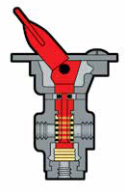
Trailer Service Line Failure
A trailer service line failure can be very dangerous because braking distances can be dramatically increased.
If there’s enough room for a gradual stop:
Use a steady service brake application
Monitor air pressure gauges and release service application at 70 psi
Continually downshift
If there isn’t enough room:
Use the dash parking control valve
Pull the trailer air supply valve (red button)
Dash control valve
Notes:
SAY: A trailer service line failure can be very dangerous. For example, a Super-B combination weighing 63,500 kilograms (139,994 pounds) will have its braking capacity reduced to a tandem 22,500 kilograms (49,604 pounds) loaded straight truck. Braking distances will be dramatically increased.
If there is enough roadway ahead of the vehicle for a gradual stop, a steady service brake application should be used. Monitor the air pressure gauges and release the service application when air pressure reaches approximately 70 PSI (483 kPa). The air pressure will rebuild when the service brakes are released. The vehicle should be continually down shifted to allow the compressor to rebuild air pressure faster and make the auxiliary retarder more effective.
The dash parking control valve is rarely used for emergency braking. It would be used in any situation where there is a loss of service brakes and a quick stop is required which could be caused by a service line failure or a trailer service tank failure.
The disadvantage of this is that the tractor’s drive axle service brakes will be decreased by half if it is fitted with a bobtail drive axle relay. Service brakes will have to be applied harder to meet the same braking requirements.
You do not have much time to think during an emergency situation. If the trailer service brakes are not working and the vehicle must be stopped quickly, pull the trailer air supply valve (red button).

Slide 68
Trailer Supply Line Failure
All control of the trailer is lost when the emergency line ruptures.
Very dangerous for other road users
The tractor’s protection system should activate on the tow vehicle and the trailer emergency brakes will apply
ABS has no effect
Proper air line security during coupling, pre-trip and en route inspections is vital to prevent failures.
Notes:
SAY: All control of the trailer is lost when the emergency line ruptures. The tractor’s protection system should activate on the tow vehicle and the trailer emergency brakes would apply.
Whether this causes the trailer axles to lockup depends on the weight on the axles, how rapidly the brakes are applied and the traction.
ABS has no effect on this situation, and if the trailer loses traction it will swing. Typically, the trailer will swing to the right because of the pavement crown. Centrifugal force in a turn will swing the trailer to the outside of the turn.
A trailer emergency line failure can be very dangerous for other road users. Proper air line security during coupling, pre-trip and en route inspections is vital. If there is any doubt about the security of the gladhand couplers repairs must be made.

Slide 69
Trailer Air Tank Failure
How to recognize it:
Unusually low readings on both air pressure gauges
Push in red button, pull out yellow button, look for air leaks
What to do:
If there’s enough room for a gradual stop:
Use a steady service brake application
Monitor gauges and release service application at 70 psi
Continually downshift
If there isn’t enough room:
Use dash parking control valve
Pull the trailer air supply valve
Notes:
SAY: A trailer air tank failure is indicated by an unusually low reading on both air pressure gauges. The response to this situation is the same as a trailer service line failure discussed earlier.
The trailer air system must be charged during pre-trip and en route inspections. Pushing in the trailer air supply valve (red button) with the parking control valve (yellow button) pulled out during these inspections allows any air leaks to be noticed and dealt with before the equipment is put into service.
If there is enough roadway ahead of the vehicle for a gradual stop, a steady service brake application should be used. Monitor the air pressure gauges and release the service application when air pressure reaches approximately 70 PSI (483 kPa). The air pressure will rebuild when the service brakes are released. The vehicle should be continually down shifted to allow the compressor to rebuild air pressure faster and make the auxiliary retarder more effective.
The dash parking control valve is rarely used for emergency braking. It would be used in any situation where there is a loss of service brakes and a quick stop is required which could be caused by a service line failure or a trailer service tank failure.
As previously mentioned, if there is any sign that the trailer service brakes are not working and the vehicle must be stopped quickly, pull the trailer supply valve.

Slide 70
Crossed Trailer Air Lines
Polarized
  Cannot be reversed
How do you know if they are reversed?
  Parking brakes will not release on spring brake trailers
What can happen if they are?
  There will be no service or park brakes
Notes:
SAY: Gladhand couplers that are polarized and in good shape cannot be reversed. Parking brakes will not release on spring brake trailers if trailer lines are reversed. However, reversed air lines on an older style air parking brake trailer can be a problem. If the trailer tank is empty, there will be no service or parking brakes. During driving, repeated service brake applications will cause the trailer air parking brakes to drag as air pressure accumulates in the trailer’s tank.
Monitor the air gauges for air pressure loss when pushing in the trailer air supply valve (red button) after coupling to a trailer. This loss is expected and normal. For example, a tridem trailer with empty air tanks and air ride suspension can substantially reduce the tractor’s air tank pressure. If the air pressure gauges do not drop, the trailer air tanks are already full or the lines are reversed.

Slide 71
Review
What are 4 important things to remember in the event of a brake failure?
Answer:
Different responses to different circuit failures
Avoid jackknifing
Hold steady brake application to avoid additional air loss
Repairs must be made before driving
Notes:
SAY: The vehicle reacts differently to different circuit failures. Care must be used to avoid jackknifing when attempting to stop. Hold a steady brake application to avoid additional loss of air. Once the vehicle has safely stopped it must not be driven until repairs have been made.
DO: Click to animate to reveal answer.

Slide 72
Exercise 2: Air Brake Components
Time: 20 minutes
Notes:
SAY: You will have 20 minutes to complete Exercise 2 in the Exercise Book.

Slide 73
Variables that Affect Vehicle Braking
  After completing this section, you should be able to:
  Explain how speed, weight, vehicle specifications and downhill grades affect vehicle braking
  Describe conditions such as brake fade and brake lag

Slide 74
Tractor Bobtailing
Bobtailing is operating a tractor without a trailer which reduces:
Traction
Vehicle stability
Primary service circuit applications
To safely operate a bobtail tractor:
Avoid excessive acceleration and heavy brake applications
Reduce vehicle speed
Avoid using auxiliary retarders at powerful settings
Leave appropriate following distance
Exercise caution
Notes:
SAY: “Bobtailing” is operating a tractor without a trailer. Tractor drive axles are designed to carry weight. Removing the trailer significantly reduces the traction of the drive axle. A brake application causes weight to transfer to the steering axle, further reducing drive axle traction. Strong engine power and brakes, with very little traction, can cause a serious loss of vehicle stability.
Highway tractors are designed to carry a lot of weight. Driving a bobtail with no weight on the axles can be dangerous. Exercise caution even during safe road conditions.
Tractors with bobtail relays cut primary service circuit applications by as much as 80 per cent when the trailer air lines are empty.
To safely operate a bobtail tractor:
Avoid excessive acceleration and heavy brake applications
Reduce vehicle speed when road surfaces are slippery
Avoid using auxiliary retarders at powerful settings
Leave an appropriate following distance from the vehicle ahead
Exercise more caution when bobtailing in poor weather

Slide 75
Travelling On Down Grades
Mountain grades
Greatest challenge for drivers of air brake equipped vehicles
Travelling downgrade accumulates more heat into the brakes
Most brake failures and runaway crashes are caused by the brake system’s inability to handle excessive heat
In rural areas
Control speed to enable quick response to any emergency
Select a gear low enough that service breaks are not required
Notes:
SAY: Driving down mountain grades is a challenging skill. Downgrades present one of the greatest challenges for drivers of air brake equipped vehicles because travelling downgrade accumulates more ongoing heat into the brakes. Almost all brake failures and runaway crashes are caused by the brake system’s inability to handle excessive heat.
In rural areas, control your speed so you can respond to any emergency. Follow advisory speed limits while allowing for the vehicle weight, grade percentage, weather and road conditions. Select a gear low enough that the service brakes are not required (one to two gears lower than what is required to climb the grade. Use your four-way flashers and stay in the right lane where possible. Use auxiliary retarders.
Reference: MPI Air Brake Manual: Chapter 7: Demands on Brakes While Driving

Slide 76
Travelling On Down Grades
Urban areas
Similar to descending hills in rural areas
Many municipalities have bylaws that prohibit use of auxiliary retarders
Unfamiliar grades
Requires more caution
Select a low gear and turn on the retarder before the hill crest
Notes:
Say: Descending hills in urban areas are similar to rural areas, except many municipalities have bylaws prohibiting the use of auxiliary retarders. Control the speed to be able to respond to any emergency. Select a safe speed that is not too fast for the vehicle weight, grade, weather and road conditions. Use the auxiliary retarder unless signs prohibit its use.
Unfamiliar grades require more caution. When descending an unfamiliar grade, select a low gear and turn on the retarder before the hill crest. Stay in that gear until the steepest part of the descent. If the gear lowers the engine significantly, shift up one gear at a time, testing each new gear (avoid splits). On extreme grades avoid shifting. A balance between retarder, speed, load and grade is reached when speed is maintained without service brakes.
If speed increases: apply the brakes firmly to reduce speed by 10-15 km/h. The brakes should be cold at this point. Down shift to a lower main gear, do not use splitter valve. Continue down the hill using auxiliary retarder to control the speed. Repeat this process until the retarder can maintain the speed without the service brakes. If the vehicle is in the proper gear before descending the grade this process will not be necessary. Descending hills often require
slower speeds in large trucks than for other vehicles.
Reference: MPI Air Brake Manual: Chapter 7: Demands on Brakes While Driving

Slide 77
Runaway Lanes
Runaway lanes are:
Additional lanes located beside some downhill sections
Usually found on roads preceded by a mandatory brake-check
Used when the brakes are not controlling the descent
Remember that these lanes should not be used for any other purpose.
Notes:
SAY: Runaway lanes are additional lanes located beside some downhill sections, usually on roads preceded by a mandatory brake-check. They are often located on downhill grades where runaways have previously occurred. They provide an extra path to help vehicles slow down and stop if the brakes fail.
When using a runaway lane remember to use the lane when the brakes no longer control the descent, but before the vehicle is out of control. A narrow steep runaway lane will be hard to see if the vehicle is out of control on the highway. These lanes should not be used for any other purpose.

Slide 78

Water on Roadways
Dangers may include:
Tires losing contact with the road surface causing loss of control (hydroplaning)
Adjust your driving by:
Reducing speed and cover the brake when approaching
Applying slight constant brake pressure to reduce water entering between the brake drums and shoes
After leaving the water, testing the brakes
Notes:
SAY:
On wet roads, your tires may lose contact with the road surface. This is called hydroplaning. The loss of contact between the road surface and your tires can cause you to lose control of your vehicle.
If this happens, do not brake. Release pressure on the accelerator to allow the vehicle to slow. Look and steer where you want the front of the vehicle to go.
Reduce your speed before driving through large volumes of water. If water enters the brake drum, it affects braking efficiency. However, if it is necessary, reduce speed and cover the brake when approaching. Apply slight constant pressure while driving through the water to reduce the amount of water entering between the brake drums and shoes. After leaving the water, test the brakes for safe operation. This also helps dry them out.

Slide 79
Combination Unit Braking
Challenges
Loss of brake balance caused by uneven load distribution
Heavy load at the front of a trailer provides the drive axles with good traction for pulling and braking
Empty load at the rear of the trailer receives the same amount of application air pressure causing the rear of trailer to slide and swing
Notes:
SAY: The biggest challenge for combination units is the loss of brake balance caused by uneven load distribution. For example, a heavy load at the front of a trailer provides the drive axles with good traction for pulling and braking. However, the brakes under the empty rear of the trailer will receive the same amount of application air pressure as the drive axles, without the load to hold them on the ground. This can cause the rear of the trailer to slide and swing. ABS can help to maintain brake balance.

Slide 80
Brake Management Systems
Brake management systems are highly effective, but drive as though they don’t exist.
Assist in loss of control situations
Override service brakes to help maintain control
Do not work with parking brakes
DO NOT drive in a manner that requires these systems
to maintain the vehicle’s safety.
Notes:
SAY: All vehicles have some type of brake management system. You do not need to know the details of how they work, but you should understand how to use them and how to recognize when service is required.
Brake management systems are highly effective, but drive as though they don’t exist. Brake management systems are technology that assists in loss of control situations. They override service brakes to help maintain control but do not work with parking brakes. DO NOT drive in a manner that requires these systems to maintain the vehicle’s safety.

Slide 81
Antilock Brake Systems (ABS)
Anti-lock brake systems are electronic systems that monitor and control wheel speed during braking.
Function:
Monitors the wheel speed at all times
Detects wheel locking during braking and releases brake pressure to that wheel only
Prevents skidding and increases vehicle stability and control
ABS is in addition to the air brake system and does not allow for faster stopping. The braking distance may be longer.
Notes:
SAY: An anti-lock brake system (ABS) is an electronic system that monitors and controls wheel speed during braking. The system monitors the wheel speed at all times. If it detects a wheel locking up during a brake application, the system releases brake pressure to that wheel only. This prevents the wheel from skidding and increases vehicle stability and control even when braking on wet or ice-slicked roads, through curves or during lane changes.
When driving a vehicle with an ABS, apply the brakes as normal to stop in time. When the ABS starts working, do not release the pressure you have applied to the brake pedal. Avoid pumping the brakes as the system automatically applies and releases the brakes up to five times per second, much faster than you can pump the brake pedal.
If you encounter a slippery road surface, when using an engine brake, the ABS will detect the wheel lock-up and automatically turn off the engine brake until traction is regained, then resume engine braking.
ABS systems have been mandatory on all air brake trucks, buses, and trailers since April 1, 2000. ABS is additional to the air brake system and does not allow for faster driving or stopping. In some situations, the braking distance may be greater.
Antilock Brake Systems (ABS) are handled by sensors, modulators and a computer. Sensors mounted on the axle ends relay a voltage signal that is interpreted as wheel speed by the ABS computer.
The computer calculates any differences in wheel speed and directs a modulator to release air pressure in the service chamber of the slower rotating wheels. The modulators can be mounted separately, near the chambers they control, or wing mounted directly to the relay or quick release valve of the axle group.
Reference: MPI Air Brake Manual: Chapter 7: Demands on Brakes While Driving

Slide 82
Using the ABS
Apply firm, steady pressure to the brake pedal
Pumping the brakes uses air pressure and turns the system on and off – can be very dangerous
Know which units in the combination have ABS
Know what the ABS warning lights mean
Check for faults by looking down the left side of the trailer
Notes:
SAY: To learn how to use ABS safely, read the manufacturer’s manual. Apply firm, steady pressure to the brake pedal. Pumping the brakes uses air pressure and turns the system on and off – and can be very dangerous. Be careful when steering around obstacles. Make sure you know which units in the combination have ABS. If the tractor or any of the trailers do not have ABS, then use a light steady braking technique.
The ABS warning light on the vehicle’s dash is similar to other systems’ warning lights. The light will flash on when the ignition is started (bulb test) and will normally stay unlit. A continuously flashing light indicates that the ABS is controlling the service brakes and a steady light indicates a problem with the system.
Trailers equipped with ABS brakes will have an ABS warning light located at the rear of the left side. How the “bulb test” functions depends on how the trailer’s ABS system receives electric power. If electric power is only available through the stop light circuit, the light will come on when the service brake is applied and go out indicating a normal function. Most modern tractors have steady electric power through the blue wire of the trailer light cord (centre pin) when the ignition is on. The bulb will light when the ignition is turned on and go out indicating a normal function. In either case, a system fault is indicated if the light stays on.
It is a good practice to look down the left side of the trailer when the ignition is turned on, and occasionally when braking, to look for ABS faults.
Reference: MPI Air Brake Manual: Chapter 7: Demands on Brakes While Driving

Slide 83
Air System Defects
Minor Defect Example
Audible air leaks and slow air pressure build up
Must be reported
Major Defect Examples
Pushrod stroke of any brake exceeds the adjustment limit
Air pressure loss rate exceeds the prescribed limit
A vehicle must be placed out-of-service for major defects!
Notes:
SAY: There is a difference between major and minor defects. Minor defects must be reported before the next required inspection and the vehicle can continue to be driven. Major defects require the vehicle to be placed out-of-service, even if it is in the middle of your shift.
Minor defects must be reported but do not impact the vehicle’s ability to be in service. Audible air leaks and slow air pressure build up are examples of minor defects.
Additional information commercial vehicle inspections can be found here: https://www.gov.mb.ca/mit/mcd/carriers_drivers/pdf/guide/vehicle_maintenance.pdf
A vehicle must not be driven with any of the following major defects:
Pushrod stroke of any brake exceeds the adjustment limit
Air pressure loss rate exceeds the prescribed limit
Tractor protection system malfunction in towing vehicles
Low air pressure warning system fails or activates
Service or parking/emergency brake malfunction

Slide 84
In-Service Brake Checks
When signs are posted in advance of steep or long downgrades:
Driver must stop the vehicle and inspect braking system before proceeding (risk of brake failure increases)
Check the following:
Compressor is maintaining full reservoir air pressure
Pushrod travel is within limitation on all chambers
No air leaks
Gladhand and lines are secure
Drums, bearings and tires are not overheating or cracking
Notes:
SAY: In some areas signs are posted in advance of steep or long downgrades. These signs indicate that you must stop the vehicle in the pullout area and inspect the braking system before proceeding. The risk of brake failure increases on steep or long downgrades.
Check that:
The compressor is maintaining full reservoir air pressure
Pushrod travel is within limitations on all chambers
There are no air leaks
The gladhands and the lines are secure
The drums, bearings and tires are not overheating or cracking
The trailer supply valve is operating properly
This should be used as an in-service check only and not mistaken as a daily pre-trip air brake inspection.
In-service brake checks involve examining the brake systems that are monitored while the vehicle is in motion.
Monitor the following while driving:
Air pressure gauges
Low air pressure warning indicator
Be aware of brake system response when brakes are applied

Slide 85
Exercise 3: Variables Affecting Braking
Time: 15 minutes
Notes:
SAY: You will have 15 minutes to complete Exercise 3 in the Exercise Book.

Slide 86
Foundation Brake Operation and Adjustment
After completing this section, you should be able to:
Explain the importance of proper brake pushrod stroke
Use an effective method for measuring brake pushrod stroke
Notes:
DO: Read slide and explain the learning objectives for this section of lesson 3.

Slide 87
Foundation Brakes
What are foundation brakes?
Mechanical components at the axle ends
If they aren’t working properly:
Will not be able to stop the vehicle
Almost all runaways are caused by foundation brake failure, not the air system.
Notes:
SAY: Foundation brakes are the mechanical components at the axle ends. If they are not working properly, the air brake system will not be able to stop the vehicle. Almost all runaways are caused by failures in the foundation brakes, not the air system. They are activated by the service or parking brake circuits and can be either drum or disc brakes.
Reference: MPI Air Brake Manual: Chapter 6: Foundation Brakes

Slide 88
S-Cam Drum Brake
Most common type of foundation brake
Type 20 Brake Chambers
On the steering axle
Type 30 Brake Chambers
On the load axle
Notes:
SAY: The “S” cam brake is the most common type of foundation brake used on commercial vehicles with air brake systems.
The mechanical process starts from the brake chamber. Air pressure is converted from a service brake application to physical force based on the multiplication of the diaphragm's surface area and air pressure being applied. Type 20 brake chambers on the steering axle and type 30 brake chambers on load axles (drive and trailer).
Reference: MPI Air Brake Manual: Chapter 6: Foundation Brakes

Slide 89
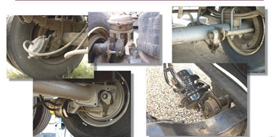
S-Cam Brake Shaft
Notes:
SAY: The cam lobes on the s-cam shaft cause the brake shoe platforms to expand, pressing the lining into the drum with the s-cam head.
Do: Show the various layouts that are available, ensuring students understand that the mechanical processes are the same.
Reference: MPI Air Brake Manual: Chapter 6: Foundation Brakes

Slide 90
Slack Adjuster
What does the slack adjuster do?
Converts pushrod force
Slack adjusters are available with 5-7 inch centre-to-centre lengths in ½ inch increments
Important to replace brake components using proper equipment
Notes:
SAY: The slack adjuster converts pushrod force from the brake chamber to torque on the s-cam shafts. They take up extra clearance created by normal brake wear. Self-adjusting slack adjusters have been around since 1996.
Slack adjusters are available with 5-7 inch (125 – 179 mm) centre-to-centre lengths in 1/2 inch (13 mm) increments, with either coarse or fine splines on different s-cam shaft thicknesses.
It is vital that brake components are replaced using the proper equipment. Understanding brake balance is a complex process and Original Equipment Manufacturer (OEM) engineers have created systems that work properly and efficiently.
Reference: MPI Air Brake Manual: Chapter 6: Foundation Brakes

Slide 91

Brake Linings and Drums
Linings that are cracked, loose, missing or contaminated are defective
  Must be replaced when worn to ¼ inch (7mm)
Most brake drums operate best around 115°C and should not exceed 215°C.
115°C - 125°C
Normal
215°C - 225°C
Hot
590°
Danger
Notes:
SAY: When inspecting the foundation brake components, the driver must check for cracked, loose, missing or contaminated (with oil or grease) brake linings.
Brake linings are expanded into the drum by the s-cam shaft. This creates the friction and heat needed to stop the vehicle. Brake linings must be replaced when worn to ¼ inch (7mm). The 1/4 inch (7 mm) minimum lining thickness is from the Commercial Vehicle Safety Alliance (CVSA) roadside inspection out-of-service criteria.
Most brake drums operate best around 115°C and should not exceed 215°C.
Reference: MPI Air Brake Manual: Chapter 1: Vehicle Braking Systems, Chapter 7: Demands On Brakes While Driving and Chapter 9: Inspecting Air Brake Components

Slide 92
Brake Drums
Brake drums dissipate heat and should be checked for cracks and excessive wear as their condition is critical for proper operation of the brakes
Brake adjustment requirements will not be noticed under normal operating conditions
Important to know how brakes are adjusted and more importantly, how to recognize if they need adjustment
Know the dangers and proper procedures for checking the brakes
Notes:
SAY: Brake drums dissipates the heat into the atmosphere. The drum condition is critical to proper operation of the brakes. They should be checked for cracks and excessive wear.
When the brake is released, the pushrod is at the back of the chamber. The s-cam is rolled back and the brake lining does not contact the drum. Properly adjusted brakes will use the upper half of available pushrod stroke.
Brakes out of adjustment will be using the lower half of available pushrod stroke. However, you may not notice a change in braking capacity under normal operating conditions.
With increased lining to drum clearance, the pushrod stroke is longer. The application is more than ½ of the available stroke.
Brake adjustment requirements cannot be felt when driving. You may “feel” that the brakes are good, only to have them fail when more is required of them.
You should always check the brakes to ensure they are adjusted correctly.
When adjusted incorrectly (cold drum): With normal brake application pressures this brake will seem to be effective.
When adjusted incorrectly (hot drum): Brake fade occurs partly from component expansion and from reduced brake co-efficiency between the lining and the drum. Cast iron drums expand when heated requiring pushrods to stroke further. Eventually the chamber can bottom out which creates a total loss of brakes.
Many companies do not want their drivers adjusting brakes. However, it is important to have a functional understanding of how brakes are adjusted, and more importantly, how to recognize if brakes need to be adjusted before putting equipment into service.
Tractor trailers can have the spring parking brakes alternated on the tow and trailer vehicles. Push in the park control valve (yellow button) and pull out the trailer air supply valve (red button) to check tractor brakes, and pull the yellow button out and push the red button in to check the trailer brakes. Do not leave the ignition key in the vehicle and ensure wheels are properly chocked. Leaving the transmission in gear is not a replacement for properly chocking the wheels.
Do: Discuss the dangers and proper procedures of going under a vehicle with the spring parking brakes released.

Slide 93
Free Stroke Method
With brakes released pull the pushrod
Optimum is ½ inch (13mm) travel
More than ¾ inch (19mm) signals adjustment required
Correctly adjusted brake will have:
½ inch (12.7mm) to ¾ inch (19mm) of slack 2 inch (50.8mm) reserved chamber stroke
The most common cause of brake loss is poor brake adjustment.
Notes:
SAY: With the brakes released pull the pushrod. Optimum is ½ inch (13mm) travel with a firm hand-pull or pry bar. Less than ½ inch (13mm) may drag some brakes, more than ¾ inch (19mm) must be adjusted. The optimum 1/2 inch (13 mm) free stroke and the re-adjustment guideline of 3/4 inch (19 mm), applies to manual slack adjusters. Automatic slack adjusters will feel loose, but still within the required applied stroke.
The most common cause of loss of braking is poor brake adjustment. The popular type-30 air chamber has 2-1/2 in. (63.5 mm) of available stroke. A correctly-adjusted brake will have 1/2 in. (12.7 mm) to 3/4 in. (19 mm) of slack, leaving two in. (50.8 mm) of reserve chamber stroke. When slack reaches 3/4 in. (19 mm) the brakes MUST be adjusted.
Here’s why:
At an 80 psi (552 kPa) application, a brake chamber with 3/4 in. (19 mm) of slack will stroke 1 3/4 in. (44.5 mm) due to component stretch. This reduces reserve chamber stroke to 3/4 in. (19 mm).
Cast iron expands when heated. On a hot brake drum this can cause the chamber to stroke a further 1/2 in. (12.7 mm), reducing reserve stroke to 1/4 in. (6.4 mm)
At high temperature, brake lining wears rapidly. Lining wear thickness of three sheets of paper causes the chamber to stroke a further 1/4 in. (6.4 mm), resulting in the chamber “bottoming out” and a probable runaway truck.
Even with cold drums, a vehicle with poorly adjusted brakes will have up to a 75% longer stopping distance than normal.

Slide 94
Automatic or Self-Adjusting Slack Adjusters
Installed on all trucks, tractors, trailers and buses since 1996
Are designed to continuously and automatically maintain the brakes in proper adjustment
Must be checked daily
May take up to 12 brake applications of 100 psi to adjust them
Do not try to adjust yourself.
Notes:
SAY: Vehicles manufactured with automatic slack adjusters cannot be retrofitted with manual slack adjusters. Automatic slack adjusters have been installed on all trucks, tractors, trailers and busses since 1996.
Automatic slack adjusters are designed to continuously and automatically maintain the brakes in proper adjustment during normal use. However, they must be checked daily to ensure they are maintaining proper pushrod travel - less than one in. (25.4 mm) when manually pulled and less than two in. (50.8 mm) when the brake is applied. Normally two to four brake applications of 100 psi (689 kPa) per day will keep the brakes properly adjusted. If they are badly out of adjustment, it may take up to 12 brake applications of 100 psi to adjust them. If they are still out of adjustment, they must be repaired.
Do not try to adjust them yourself unless you have been trained by a mechanic or trainer who is familiar with setting up and backing off this type of automatic slack adjuster.
Reference: MPI Air Brake Manual: Chapter 6: Foundation Brakes

Slide 95
Disc Brakes
How they work?
When brakes are applied, the caliper squeezes the disc creating friction and slows down the vehicle
How to inspect them?
Inspect the rotors to observe if there are any cracks
Adjustments and repairs
Should be done by a heavy equipment technician
Notes:
SAY: When the brakes are applied, the caliper squeezes the disc creating friction and slowing the vehicle. The brake chamber forces the caliper to clamp the brake lining against the rotor. Most air disk brakes feature internal automatic brake adjustment mechanisms.
Inspect the rotors to observe cracks. Rotors can be hard to see, with cracks hiding behind the brake pads and backing plate. However, some part of the rotor is generally visible. By inspecting the rotors often, any cracks will eventually become visible.
Adjustments and repairs should be done by a qualified heavy equipment technician.
Reference: MPI Air Brake Manual: Chapter 6: Foundation Brakes

Slide 96

Braking Safely
Controlled braking:
Ease off the brakes just before stopping to prevent jerking back
Maintain safe speed and following distance
Ensure :
Brakes are correctly adjusted
Load is balanced
Tires are in good condition
Notes:
SAY: Effective and controlled braking is important to the safe and efficient operation of equipment. Ease off the brakes just before stopping to prevent jerking back. Maintain a safe speed and following distance. Ensure brakes are correctly adjusted, load is balanced and tires are in good condition.

Slide 97
Auxiliary Retarders
What do they do?
Help to control speed on down grades
Preserve the service brakes for emergency stopping
Four types of auxiliary retarders:
Engine compression release
Exhaust back pressure
Hydraulic driveline
Electric driveline
Notes:
SAY: Many heavy vehicles have auxiliary retarders to assist the service brakes. They help to control speed on down grades and preserve the service brakes for emergency stopping.
There are four types of auxiliary retarders. Engine compression release, Exhaust back pressure, Hydraulic driveline, and Electric drive line.
Engine brakes help control speeds when properly used, but are not intended for emergency braking. Auxiliary retarders provide additional braking control, but do not meet sudden or large braking demands.
Engine Retarders change the exhaust valve timing by opening the exhaust valve at the top of the compression stroke, essentially turning the engine into an air compressor. Compressing combustion chambers without the rebound of compressed air and diesel combustion, works against the driveline. This technique is common in North American engines.
Exhaust Retarders can be thought of as a stovepipe damper closing the exhaust pipe. Exhaust can be retarded by either a butterfly type valve or a sliding gate valve. Retarding increases back pressure in the exhaust, making it harder to push the spent combustion gasses from the cylinder. This increases the crank’s resistance as it pushes the rods up into the increased back pressure. Limiting this is the strength of the exhaust valve springs. If the back pressure is too high, the exhaust valves start to float open, causing them to hit the piston tops at the top of their stroke. The exhaust retarders need to be adjusted so the back pressure stays within the engine’s back pressure capacity.
Hydraulic Driveline Retarders are similar to torque converters. The rotor vanes pump oil into the housing vanes, which puts resistance into the driveline. You need to be mindful of engine oil temperature and turn the retarder off when the engine oil becomes too hot.
Electric Driveline Retarder is an electromagnet designed to retard drive shaft rotation. All the heat generated is vented out through the rotor vanes and housing. These can be found on all types of vehicles, but are primarily installed on transit buses, emergency vehicles and waste disposal vehicles. They are activated by service brake applications unlike the operation of the previous three retarders.
Auxiliary retarders work best with lower speeds, and with the engine just under the rated RPM. When using auxiliary retarders, select the appropriate gear before starting down hills. Be cautious on slippery roads. They can overpower available traction causing loss of control.
Be aware of excessively loud retarders in urban areas. In many urban areas they are prohibited.

Slide 98
Exercise 4: Operation and Adjustments
Time: 15 minutes
Notes:
SAY: You will have 15 minutes to complete Exercise 4 in the Exercise Book.

Slide 99
Review
What temperature do most brake drums operate best at?
Answer: 115 °C
Drums should not exceed what temperature?
Answer: 215 °C
Notes:
DO: This is an animated slide. To reveal the answer click after reading the question.

Slide 100
Review
What is the basic principle of the dual-circuit system?
Answer: Prevents total brake failure.
Notes:
DO: This is an animated slide. To reveal the answer click after reading the question.

Slide 101
Review
What does compounding the brakes mean?
Answer: Making a service brake application with the parking brake applied.
Notes:
DO: This is an animated slide. To reveal the answer click after reading the question.

Slide 102
Review
What PSI is required when making a brake application to adjust the automatic slack adjusters?
Answer: 100 psi
Notes:
DO: This is an animated slide. To reveal the answer click after reading the question.

Slide 103
Review
When should you manually release (cage) a spring parking brake?
Answer: If the vehicle needs to be towed or repaired.
Notes:
DO: This is an animated slide. To reveal the answer click after reading the question.

Slide 104
Air Brake Inspections
After completing this section, you should be able to:
Inspect a commercial vehicle with air brakes
Ensure air brakes are adjusted correctly according to proper specifications

Slide 105
En Route Inspections
Brake systems must be inspected:
During shift – ideally done every few hours
  Confirm foundation brakes are not overheating
  Brake adjustment is maintained
  Check trailer air line couplers are firmly connected and suspended
  Pull supply tank drain lanyard to check for any moisture accumulating in the tank
End of shift
  Look for worn or damaged components
Notes:
SAY: Brake systems must be inspected during and at the end of a shift. During the shift:
Confirm that the foundation brakes are not overheating and brake adjustment is maintained
Check that the trailer air line couplers are still firmly connected and suspended
Pull the supply tank drain lanyard (or crack the drain valve) to check for any moisture accumulating in the tank
Ideally an en route inspection should be done every few hours to confirm that the vehicle can remain in service.
At the end of shift look for worn or damaged components.

Slide 106
Post-Trip Inspection
Post-trip inspection is important because:
Automatic slack adjusters can malfunction and not keep the brake in adjustment
Most common problems
Excessive premature wear
Internal contamination
Open drain valves on the tanks to allow the tanks to drain
Notes:
SAY: Inspecting equipment at the end of your shift is important. At the end of the shift, conduct a post-trip inspection and report any defects for repair. Confirm that the foundation brakes have not overheated. Ensure that they have maintained proper adjustments. Open the drain valves on the tanks (supply first) to allow the tanks to drain.
Automatic slack adjusters can malfunction and not keep the brake in adjustment, especially when the vehicle has been in service for a long time. The two most common problems are excessive premature wear and internal contamination. Through normal usage, the internal components that sense when an adjustment is required wear out, resulting in more stroke required for the lining to contact the brake drum. If not checked the brake could be out of adjustment.
If even a small amount of water is sucked into an automatic slack adjuster mechanism it can cause corrosion or, in winter, it can freeze the internal sensing components and inhibit or prevent adjustment.

Slide 107
Pre-Hill Inspection
Brakes must be checked before descending a steep grade
White regulatory sign must be followed
Yellow or green signs are recommended
Inspect the vehicle’s brake system and load security before proceeding
Notes:
SAY: Brakes must be checked before descending a steep grade. White – regulatory signs – Brakes must be checked. Yellow or green signs – Brake check is recommended.
Park in the pullout area and inspect the vehicle’s brake system and load security before proceeding.
Brake check pullouts have information signs advising you what you should be inspecting. Additionally, many have signs that provide information about the grade ahead.

Slide 108
Air Brake System Inspection
Daily pre-trip inspections are mandatory.
To ensure brakes are working properly
To ensure they comply with The Highway Traffic Act and regulations.
To follow proper procedures
If new equipment is added, it should be inspected and written down on the Trip Inspection Report prior to use.
You may be held responsible if the brakes are incorrectly adjusted or not working properly.
Notes:
SAY: The Commercial Vehicle Safety Regulation outlines the requirements of daily vehicle trip inspections. Equipment in service is covered by a daily vehicle Trip Inspection Report, which is valid if it was completed within the previous 24 hours. If any new equipment is added to the vehicle, it should be inspected and written down on the Trip Inspection Report prior to its use.
Daily pre-trip inspections are mandatory to ensure brakes are working correctly, to ensure compliance with HTA regulations and to follow proper procedures.
The air brake system pre-trip inspection ensures the brake system works properly. It is performed during the daily vehicle trip inspection. Trucks pulling trailers should be inspected after coupling, and the trailer is charged.
The procedure to check an air system has been designed to be included with other vehicle trip inspection activities, rather than being conducted as a separate procedure. There is no mandatory order for conducting a vehicle trip inspection, but all drivers must incorporate the air brake pre-trip in their normal vehicle trip inspection process.
DO: The detailed list of major and minor defects is located in the textbook as well as on the Manitoba government website. You will need to have the regulation, inspection schedule and MPI Air Brake Manual accessible to students in this section.
Reference: https://www.mpi.mb.ca/Documents/AirBrakeManualNEW.pdf

Slide 109

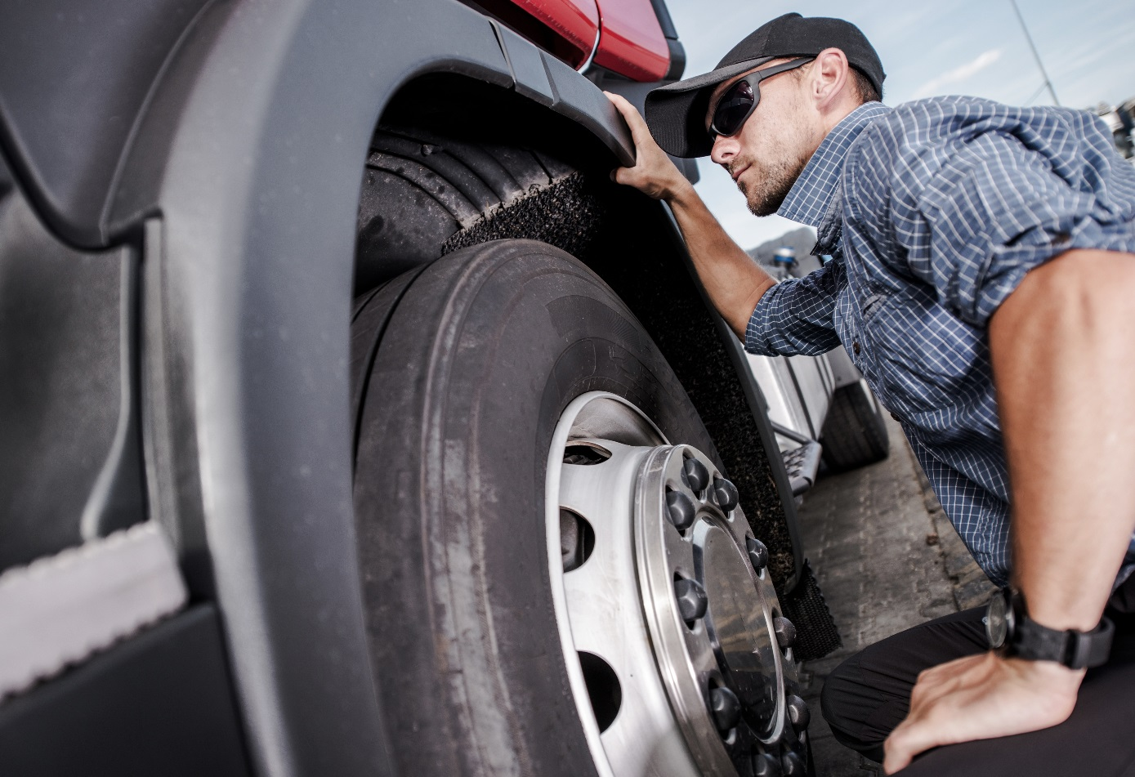
Air Brake Daily Procedure
Inspection for air single unit
Notes:
SAY: The daily inspection procedures reflect align with the regulation, and the standards published in the 2014 National Safety Code (NSC) Standard 11B.
Periodic Mandatory Vehicle Inspections are performed by Commercial Vehicle Safety Alliance(CVSA) authorized officers. The Out-of-Service Criteria (or OOSC) informs officers when to place vehicle out of service at roadside safety inspections. The OOSC identifies serious violations that render a commercial vehicle or commercial vehicle operator an imminent danger to the general public. Commercial vehicles and operators placed Out-of-Service cannot operate until those items that rendered them out of service are remedied or repaired.
For more information, visit the Canadian Council of Motor Transport Administrators (www.ccmta.ca).

Slide 110
Inspection
Air Brake System Operation
Notes:
SAY: The next section explains the details of the inspection procedures.

Slide 111
Testing Warning System Operation
Ensure air brake system pressure is above 90 psi
(621 kPa)
Ignition must be on
Fan brakes to lower air pressure
Observe primary and secondary air tank
pressure gauges
Watch and listen for low air-pressure warning device to activate
When device activates, note air pressure displayed by the gauges
Notes:
SAY: To test the low air-pressure warning device, pressure in the system must be reduced to the point where the device activates or 55 psi (380 kPa), whichever is higher. The pressure when the warning device deactivates during a rise in pressure is not necessarily the same point at which it activates during a drop in pressure. Begin the test with the pressure above 90 psi (621 kPa) and the engine running. Reduce pressure by fanning the brakes (repeatedly pressing and releasing the brake pedal).
Observe the air-pressure gauges and note when the device activates. Most warning devices will activate above 60 psi (414 kPa). If the warning device fails to activate at a minimum of 55 psi (380 kPa), the low air-pressure warning device is defective.
Build pressure to 80 psi (552 kPa). Observe the air-pressure gauges and note when the device deactivates. Most warning devices will deactivate before reaching 80 psi (552 kPa).
Reference: MPI Air Brake Manual: Chapter 10: Inspecting Air Brake System Operation

Slide 112
Results of Warning Device Inspection
PASS
Device activates when pressure is at or above 55 psi (380 kPa)
AND
Deactivates when pressure is at or below 80 psi (552 kPa)
on both primary and secondary air tank gauges.
Notes:
SAY:
If the warning device fails to deactivate at a maximum of 80 psi (552 kPa), the low air-pressure warning device is defective.
A warning system pass is when the device activates when pressure is at or above 55 psi (380 kPa) and deactivates when pressure is at or below 80 psi (552 kPa) on both primary and secondary air tank gauges.
A fail of this system is when the device does not activate or activates when pressure is below 55 psi (380 kPa) on either the primary or secondary air pressure gauge.
Also a failure is noted when the device does not deactivate or deactivates when pressure is above 80 psi (552 kPa) on either the primary or secondary air pressure gauge.
Is this a major or minor defect according to Schedule A?
DO: Wait for answers, then provide correct answer if no one has given it.
SAY: This is a major defect.
Reference: MPI Air Brake Manual: Chapter 10: Inspecting Air Brake System Operation

Slide 113
Testing Air Pressure Build-Up Rate
If vehicle has a trailer attached, ensure trailer supply valve is closed (pulled out).
Lower air brake system pressure to below 80 psi (552 kPa).
Run engine at 600 to 900 rpm.
Observe primary and secondary air-tank pressure gauges.
Note time when pressure reaches start value of 85 psi (587 kPa) on the primary gauge.
Note time when pressure reaches end value of 100 psi (690 kPa) on the secondary gauge.
Notes:
SAY: The air compressor must be able to meet the demands of the air brake system and restore pressure to normal range quickly. Confirm this by testing whether air pressure rises to a specified level in a specified time, by reducing the system pressure to below 80 psi (552 kPa).
If the vehicle has a trailer attached, ensure the trailer supply valve is closed (pulled out). With the engine idling between 600 and 900 rpm, observe the time required for the air pressure to rise from 85 psi (587 kPa) to 100 psi (690 kPa).
Reference: MPI Air Brake Manual: Chapter 10: Inspecting Air Brake System Operation

Slide 114
Results of Compressor Inspection
PASS
Pressure build-up time is equal to or less than 2 minutes
Notes:
SAY:
A pass occurs if pressure build-up time is equal to or less than two minutes.
If pressure build-up time is greater than two minutes, this is a failure of the compressor operation and the air brake system is defective.
Is this a major or minor defect according to Schedule A?
DO: Wait for answers then provide correct answer if no one has given it.
SAY: This is a minor defect.
Reference: MPI Air Brake Manual: Chapter 10: Inspecting Air Brake System Operation

Slide 115
Testing Governor Operation
Secure vehicle and release tractor spring brakes.
Observe the primary and secondary air-tank pressure gauges.
Run engine until air brake system pressure reaches maximum level and note cut-out pressure setting.
Fan brakes to lower system pressure and note cut-in pressure setting.
Notes:
SAY: Air brake systems must operate with air pressure within a prescribed range. The system’s pressure range is controlled by the air-compressor governor settings, which determine when the air compressor will cut-out and cut-in.
The model year can affect the governor pressure setting. Air brake system operating pressure ranges have increased over the past 20 years. Older systems may operate with lower pressure settings.
Air pressure gauges stop climbing with compressor cut-out. When a vehicle uses an air dryer, its exhaust cycle also indicates that the compressor has reached the cut-out setting. Observe the primary and secondary air-tank gauges to confirm when the pressure stops climbing and when the cut-out setting is reached.
The cut-in pressure setting is normally 20 to 25 psi (138 to 173 kPa) below the cut-out pressure setting. Compressor cut-in changes the sound of the engine and can be observed when the air-tank gauges begin to show a pressure increase.
Cut-out and cut-in pressures should remain within the range specified by the vehicle manufacturer, and any change in these pressures should be reported. Inspection is based on the maximum actual cut-out pressure and maximum actual cut-in pressure.
Reference: MPI Air Brake Manual: Chapter 10: Inspecting Air Brake System Operation

Slide 116
Results of Governor Inspection
PASS
Cut-in and cut-out pressure settings are within the range specified by the vehicle manufacturer
AND
Cut-out pressure is below 145 psi (1000 kPa)
AND
Cut-in pressure is above 80 psi (552 kPa) and is within 25 psi (173 kPa) of the cut-out pressure.
Notes:
SAY:
Actual cut-out pressure must never be higher than 145 psi (1000 kPa). Actual cut-in pressure must never be less than 80 psi (552 kPa) or the air brake system is defective.
In order to pass inspection, the cut-in and cut-out pressure settings are within the range specified by the vehicle manufacturer, cut-out pressure is below 145 psi (1000 kPa), and cut-in pressure is above 80 psi (552 kPa) and is within 25 psi (173 kPa) of the cut-out pressure.
A failure of the governor operation is when the actual cut-out pressure is above 145 psi (1000 kPa) or actual cut-in pressure is below 80 psi (552 kPa) or is more than 25 psi (173 kPa) lower than the cut-out pressure.
Is this a major or minor defect according to Schedule A?
DO: Wait for answers then provide correct answer if no one has given it.
SAY: This is a minor defect.
Reference: MPI Air Brake Manual: Chapter 10: Inspecting Air Brake System Operation

Slide 117
Testing System Air-Loss Rate
Secure vehicle and release tractor spring brakes.
Open trailer supply valve (for combination
units only).
Ensure air brake system is within normal operating pressure range.
Shut off engine.
Press and hold brake pedal in fully applied position.
Note pressure indicated on primary and secondary air tank gauges.
Note change in pressure over one minute.
Notes:
SAY: Watch for air brake system leaks and pressure loss in the air tanks when brakes are not being used, which indicates air loss in the air brake system. For safety, you should test the air loss rate.
Properly secure the vehicle.
Release the spring brakes, establish normal air pressure and shut off the engine. Hold the brake pedal in the fully applied position and observe the air pressure readings for one minute.
The pressure drops noticeably when the brakes are first applied, but must not continue to drop at a rate greater than specified in the chart in the air brake manual.
Do not consider the amount of pressure drop that happens when brakes are first applied.
Reference: MPI Air Brake Manual: Chapter 10: Inspecting Air Brake System Operation

Slide 118
Results of Leak Test Inspection
PASS
Drop in pressure is equal to or less than the value specified for the vehicle.
Notes:
SAY:
According to the MPI Air Brake Manual, what results indicate a pass in the leak test?
DO: Wait for answers then provide correct response if no one has given it. Animated slide, click to reveal answer.
SAY: When the drop in pressure is equal to or less than the value specified for the vehicle, the leak test passes the inspection.
According to the MPI Air Brake Manual, what results in a failure?
DO: Wait for answers then provide correct answer if no one has given it.
SAY: A failure is when the drop in pressure exceeds the value specified for the vehicle.
Is this a major or minor defect according to Schedule A?
DO: Wait for answers then provide correct answer if no one has given it.
SAY: This is a major defect.
Reference: MPI Air Brake Manual: Chapter 10: Inspecting Air Brake System Operation

Slide 119
Testing Tractor Protection System
Ensure trailer supply valve is closed and tractor spring brakes are released.
Ensure air brake system is within normal operating
pressure range.
With engine shut off, disconnect both air lines and
place trailer service line where it can be observed.
Be aware of any audible air leaks.
Open trailer supply valve.
Observe air pressure gauge and note when trailer supply valve closes.
Start engine to rebuild pressure to normal operating range.
Press and hold brake pedal.
Observe whether air is exhausting from the trailer service line.
Notes:
SAY: The tractor protection valve on a tractor ensures that an air loss problem in the trailer does not result in loss of air from the tractor.
Ensure the trailer supply valve is closed (pulled out) and tractor spring brakes are released.
Ensure that the air brake system is within its normal operating pressure range.
With the engine shut off, disconnect both air lines and place the trailer service line where it can be observed. Be aware of any audible air leaks.
Open the trailer supply valve.
Observe the air pressure gauge and note when the trailer supply valve closes (pops). Failing to close or closing below 20 psi (138 kPa) indicates a major defect in the trailer supply valve.
Start the engine (if needed) to rebuild pressure to normal operating range.
Press and hold the brake pedal.
Observe whether air is exhausting from the trailer service line.
Reference: MPI Air Brake Manual: Chapter 10: Inspecting Air Brake System Operation

Slide 120
Results of Tractor Protection Valve Inspection
PASS
Air does not exhaust from the trailer service line
Notes:
SAY:
If air does not exhaust from the trailer service line, the tractor protection valve has passed inspection.
If air exhausts from the trailer service line, the valve has failed inspection.
Is this a major or minor defect according to Schedule A?
DO: Wait for answers then provide correct answer if no one has given it.
SAY: Exhausting air indicates a major defect in the tractor protection valve as per Schedule A.
Reference: MPI Air Brake Manual: Chapter 10: Inspecting Air Brake System Operation

Slide 121
Testing Trailer Spring Brake Application
Ensure trailer supply valve is open (pushed in) and trailer is fully charged.
Ensure air brake system is within normal operating pressure range.
Pull out trailer supply valve to close it.
Listen for air exhausting, indicating application of trailer’s spring brakes.
If necessary, confirm brake application by attempting to gently move vehicle forward or backward.
Notes:
SAY: A trailer’s spring brakes must automatically apply whenever the trailer is disconnected from the towing vehicle. To test this, open (push in) the trailer supply valve to fully charge the trailer. Then pull out the trailer supply valve to close it. The trailer spring brakes should apply. Disconnecting the trailer air-supply line also activates this function, but closing the trailer supply valve is the recommended testing method. Brake application may be confirmed by gently applying engine power to move the vehicle forward or backward.
Reference: MPI Air Brake Manual: Chapter 10: Inspecting Air Brake System Operation

Slide 122
Results of Spring Brake Application
PASS
Trailer spring brakes apply automatically
Notes:
SAY:
To pass inspection, the trailer spring brakes apply automatically.
The vehicle fails the test if the trailer spring brakes do not apply.
This is a major defect as per Schedule A.
Reference: MPI Air Brake Manual: Chapter 10: Inspecting Air Brake System Operation

Slide 123
Performing a Brake Performance Test (Tug Test)
Remove wheel chocks or blocks.
Close the trailer supply valve and release the tractor spring brakes.
Gently apply engine power in a low gear.
Observe the vehicle’s response - no significant movement of vehicle.
Ensure trailer supply valve is open and tractor spring brakes applied.
Gently apply engine power in a low gear
Observe the vehicle’s response - no significant movement of vehicle.
Ensure trailer supply valve is open and release tractor spring parking brakes.
Move vehicle forward in a low gear and at a slow speed.
Apply service brakes and ensure brake application stops vehicle.
Test Trailer Spring Brakes
Test Tractor Spring Brakes
Test Service Brakes
Notes:
DO: Animated slide, click for each part of the tug test.
SAY: A vehicle’s spring brakes must be able to hold the vehicle in place, while the service brakes must stop the vehicle when applied. Test the performance of your tractor-trailer brakes by performing separate tests of each braking system.
To test your trailer spring brakes, remove the wheel chocks or blocks. Close the trailer supply valve and release the tractor spring brakes then move forward slowly. The vehicle may rock and shake and the wheels may move slightly, but there should be no significant movement of the vehicle but there should be no significant movement of the vehicle. Test your tractor spring brakes by repeating this process with your tractor spring brakes applied and the trailer supply valve open. Test your service brakes by opening the trailer supply valve, releasing the tractor spring brakes and moving forward at a slow speed before applying the service brakes. If the vehicle has a hand valve, it should be tested in the same way as the service brakes.
If equipped with a trailer hand valve, the procedures include 4 extra steps for testing trailer service brakes. These procedures are covered in the MPI Air Brake Manual.
Reference: MPI Air Brake Manual: Chapter 10: Inspecting Air Brake System Operation

Slide 124
Results of Brake Performance Test
PASS
Trailer spring brakes and tractor spring brakes hold vehicle in place, and service brakes stop vehicle when they are applied
Notes:
SAY:
If the trailer spring brakes and the tractor spring brakes hold the vehicle in place, and the service brakes stop the vehicle when they are applied, the brakes have passed the inspection.
An inspection failure is when the trailer spring brakes and the tractor spring brakes do not hold the vehicle in place, or the service brakes are not able to reasonably stop the vehicle.
Is this a major or minor defect according to Schedule A?
DO: Wait for answers then provide correct answer if no one has given it.
SAY: This is a major defect as per Schedule A.
Reference: MPI Air Brake Manual: Chapter 10: Inspecting Air Brake System Operation

Slide 125
Testing Air-Tank Drain Valves
Ensure air brake system is within its normal operating pressure range.
Locate and drain supply tank until valve discharges only clean air.
Locate and drain remaining air tanks.
Watch discharge from each air tank and ensure all air tank drain valves function properly.
Notes:
SAY:
Ensure that the air brake system is within its normal operating pressure range.
Locate and drain the supply tank until the valve discharges only clean air. The supply tank should always be drained first to prevent accumu­lated moisture in the supply tank passing farther into the system.
Locate and drain the remaining air tanks.
Watch the discharge from each air tank and ensure that all air tank drain valves function properly.
Reference: MPI Air Brake Manual: Chapter 10: Inspecting Air Brake System Operation

Slide 126
Results of Air-Tank Drain Valve
PASS
Each drain valve functions properly
Notes:
SAY:
The vehicle passes the test when each drain valve functions properly.
The vehicle fails the test when any drain valve fails to function properly.
Is this a major or minor defect according to Schedule A?
DO: Wait for answers then provide correct answer if no one has given it.
SAY: This is a minor defect as per Schedule A.
Reference: MPI Air Brake Manual: Chapter 10: Inspecting Air Brake System Operation

Slide 127
Inspection
Air Brake Adjustment
Notes:
SAY: The next section explains the details of the air brake adjustment inspection procedures.

Slide 128
Measuring Applied Pushrod Stroke
Ensure air pressure is above 90 psi (621 kPa) and release spring brakes.
Take first measurement
Raise or lower air pressure by running engine or pumping brake pedal until both primary and secondary air-tank gauges display 90 to 100 psi (621 to 690 kPa).
Shut off engine.
Press and hold brake pedal in fully applied position.
Take second measurement (continue with previous method.)
Calculate applied pushrod stroke measurement:
Subtract measurement 1 from measurement 2
Determine number size and type of brake chamber.
Determine adjustment limit for brake chamber
Compare applied pushrod stroke to applicable adjustment.
Method 1: Mark the pushrod at the brake chamber or at a suitable fixed reference point. (Use chalk, soapstone, marker or other similar instrument — marks must be narrow and precise.)
Method 2: Measure the released position of the pushrod. (Measure and note the distance from a point on the pushrod to a suitable fixed point at the brake chamber.
Method 1: Measure the distance from the brake chamber or fixed reference point to the mark on the pushrod.
Method 2: Measure the applied position of the pushrod. (Re-measure and note the distance from the previously selected point on the pushrod to the previously selected fixed point at the brake chamber.
Notes:
DO: Animated slide, click to reveal the 2 different methods for obtaining each measurement
SAY: The pushrod stroke of each brake chamber is critical to the proper functioning of a brake system. As the brakes wear, brake pushrod stroke increases. Brake wear occurs at varying rates, depending on the type of vehicle and driving conditions. To determine whether brake adjustment is correct, the pushrod stroke must be inspected at least daily.
Secure the vehicle with wheel chocks or blocks.
Ensure air pressure is above 90 psi (621 kPa) and release the spring brakes.
Select one of the following methods:
DO: Click to animate
SAY: Method 1: Mark the pushrod at the brake chamber or at a suit­able fixed reference point. (Use chalk, soapstone, marker or other similar instrument — marks must be narrow and precise.)
Method 2: Measure the released position of the pushrod. (Measure and note the distance from a point on the pushrod to a suitable fixed point at the brake chamber. This is measure­ment number 1.)
Raise or lower the air pressure by running the engine or pumping the brake pedal until both the primary and secondary air-tank gauges display 90 to 100 psi (621 to 690 kPa).
Shut off the engine.
Press and hold the brake pedal in the fully applied position.
Determine the applied pushrod stroke. (Continue to use the previously selected method.):
DO: Click to animate:
SAY:
Method 1: Measure the distance from the brake chamber or fixed reference point to the mark on the pushrod.
Method 2: Measure the applied position of the pushrod. (Re-measure and note the distance from the previously selected point on the pushrod to the previously selected fixed point at the brake chamber. This is measurement number 2.) Subtract measurement 1 from measure­ment 2 to calculate the applied pushrod stroke measurement.
Determine the number size (such as 16, 20, 24 or 30) and type (such as standard or long-stroke) of the brake chamber.
Determine the adjustment limit for the brake chamber (see the chart in the foldout section).
Compare the applied pushrod stroke to the applicable adjust­ment limit and identify any brake that exceeds the adjustment limit as defective.
SAY: The Air Brake adjustment limits chart is used to determine the adjustment limit for the brake chamber.
DO: Provide Job Aid to students for review of how to compare the measured value with the adjustment limit.
References:
MPI Air Brake Manual: Chapter 11: Inspecting Air Brake Adjustment
Job Aid: Air Brake adjustment limits chart

Slide 129
Results of Pushrod Travel Test
PASS
Push rod travel is within the adjustment limit for the size and type of brake chamber
AND
the difference in pushrod travel is within ¼ inch for brake chambers on the same axle
Notes:
SAY:
A pass condition is when the push rod travel is within the adjustment limit for the size and type of brake chamber and the difference in pushrod travel is within ¼ inch for brake chambers on the same axle.
A failure is when the push rod travel exceeds the adjustment limit for the size and type of brake chamber or there is more than ¼ inch difference in the pushrod travel of brake chambers on the same axle.
Is this a major or minor defect according to Schedule A?
DO: Wait for answers then provide correct answer if no one has given it.
SAY: This is a major defect as per Schedule A.
Reference: MPI Air Brake Manual: Chapter 11: Inspecting Air Brake Adjustment

Slide 130
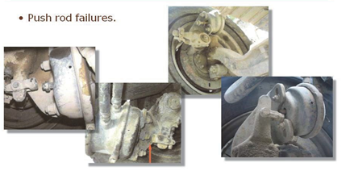
Push Rod Failures
Notes:
SAY: These are examples of broken push rods. Both service and park applications cannot deliver brake power to the foundation brake.
DO: Point out the damage to students and advise them that these are not always obvious. If the push rod and slack adjuster are still lined up damage can be hard to notice. Push rods must be directly looked at to find these failures.

Slide 131
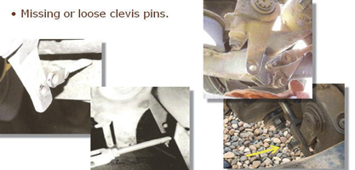
Clevis Failures
Notes:
SAY: These are clevis pin failures. The cotter pins sheer and allow the clevis pins to work their way out. The brakes cease to work when the clevis completely separates. The clevis pin in the fourth picture has not completely separated; brake applications will still apply normally. Note the vehicle in the picture is new. Failures can happen on both new and older vehicles.

Slide 132
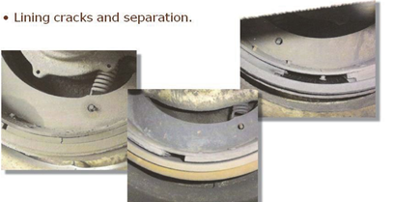
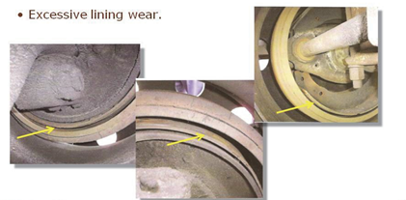
Brake Lining Failures
Decreased braking power
No braking power
Notes:
SAY: Brake lining failure decreases the friction surface area. How much the brake force is reduced depends on whether any brake lining is missing. These types of failures will decrease brake capacities as the brake material continues to separate.
These are examples of extremely worn brake linings. There is no brake power in any of these situations.
Excessively worn brake linings lead to a condition called “cammed over”. This occurs when the lining becomes so thin that nothing stops the rollers from going past the largest radius of the s-cam lobes as the brakes are applied, making the brakes ineffective.
CVSA standards require at least 1/4 inch (7 mm) lining thickness.

Slide 133
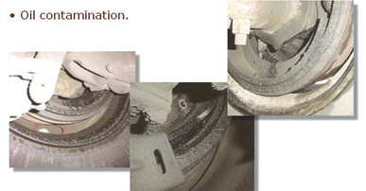
Oil Leaks
Notes:
SAY: Oil saturation is caused by leaking wheel seals. It shows up in two different ways. If the oil is leaking while moving, the oil will streak in radius lines around the entire inner sidewall of the inner tire. If the oil is leaking while the vehicle is parked, it will drain down the inner sidewall of the inner tire below the axle and puddle on the ground.

Slide 134
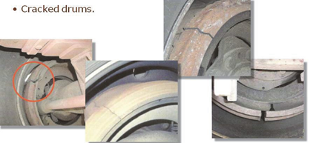
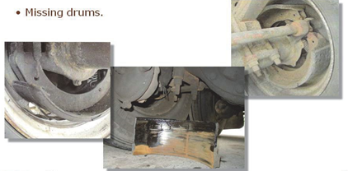
Cracked and Missing Drums
Notes:
SAY: Cracked drums are caused by a series of overheating and cooling. The cracking starts from the friction surface of the drum and works its way to the outside surface. The centrifugal force on the separated sections causes the cracks to widen, and eventually the drum comes apart.
This is what happens to drums when early cracks are not repaired. The second picture shows a drum section that has recently separated. Pieces usually become separated while the vehicle is moving, and become dangerous projectiles to other road users. You generally won’t know when or where the separations take place or the damage that they may cause.

Slide 135
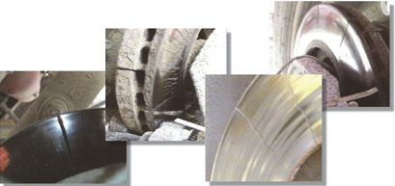
Rotor Cracks
Notes:
SAY: Rotor cracking is easy to spot unless the rotors are covered by backing plates, or when cracks are hidden under the calipers. Disc rotors should be checked during the inspections and during the work shift.

Slide 136
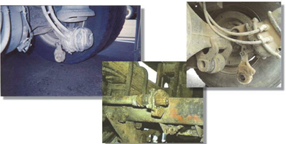
Slack Adjusters
Notes:
SAY: The first and third pictures are caused by a separated retaining snap ring from the end of the s-cam shaft. The slack adjuster then works its way off of the s-cam shaft’s splines. The brakes will apply normally until the moment the slack adjuster separates, after which there will be no applications at the foundation brake. The slack adjuster in the second picture was rusted to the point that a brake application broke it off.

Slide 137
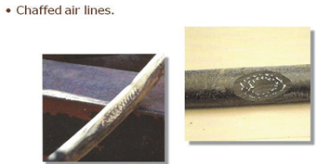
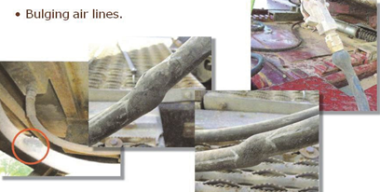
Air Lines
Notes:
SAY: Chaffed air lines are the result of incorrectly secured air lines which rub on nearby parts. Chaffing does not cause any reduction in brake performance until the hoses rupture. This will cause circuit failures, as discussed previously.
Hose bulges are caused by internal structure failure or excessive chaffing. Bulging hoses will rupture causing circuit failures.

Slide 138
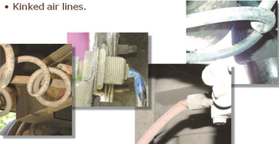
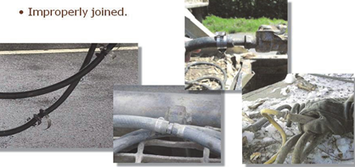
Air Lines Cont.
Notes:
SAY: Kinked hoses cause reductions in brake performance by restricting or blocking the flow of air pressure. The first three pictures show plastic air line kinks. Once the plastic air line is kinked, it is permanently damaged and must be replaced. The fourth picture is a rubber air line. A rubber air line kink can cause internal structural damage, which can eventually lead to bulging.
Fittings are designed to cause a minimum of air pressure flow restriction while still securely gripping the hose. Different systems of fittings are not compatible with each other and should never be mixed. Air lines must be installed with the correct fitting system designed for the hose used.

Slide 139
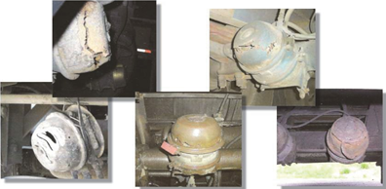
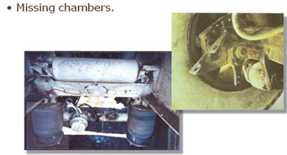
Spring Parking Brake Chambers
Notes:
SAY: The compressed parking spring is relatively safe when secured in its housing. However, the corrosion shown in these pictures weakens the chamber so the parking spring can eventually escape with tremendous force. This is an extremely dangerous failure that can cause severe injury or death.
Any corrosion or damage seen in brake chambers or clamp rings must be immediately repaired by certified heavy equipment technicians.
The two lower pictures are examples of separated brake chambers. There will be no application at the respective foundation brakes.

Slide 140
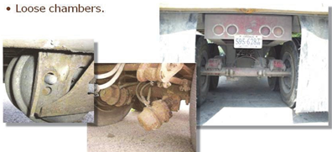
Spring Parking Brake Chambers Cont.
Notes:
SAY: Loose brake chambers can still apply some application force to the foundation brakes depending on how loose they are. The application force is reduced by chamber deflection caused by the failed mounting components. Inspect the mounting fasteners and brackets to confirm that the brake chamber is securely installed.

Slide 141
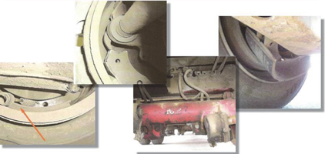
Mechanical Failures
Notes:
SAY: Foundation brake component failures can result in anything from a minor application reduction to a complete failure.
DO: Point to pictures from left to right. Describe the specific failures as noted:
disconnected return springs
separated rollers
a separated inner s-cam bracket on a trailer
a separated brake shoe

Slide 142
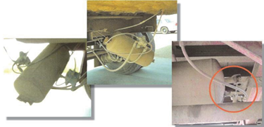
Mechanical Failures Cont.
Loose air tanks
Notes:
SAY: A loose air tank does not cause a failure until it separates from the circuit it supplies. This causes an immediate circuit failure. During a vehicle inspection, push each end of the air tanks to confirm that they are securely mounted.

Slide 143
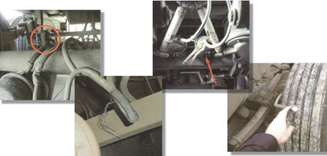
Improper Repairs
Notes:
SAY: Air system failures are sometimes dealt with by blocking off the air lines that supply the failed component. This reduces the braking capacity of the vehicle and is never acceptable. If there are system failures that affect braking ability, the vehicle must be placed out-of-service until appropriate repairs are made.
The first two pictures show air lines that are obstructed by kinking and wiring them closed. In the third picture, a pair of clamping pliers is used to close off the line. In the fourth picture, a coin is used in a swivel fitting to close off a leaking service chamber.

Slide 144
Exercise 5: MPI Air Brake Manual Review
Time: 20 minutes
Notes:
SAY: You will have 20 minutes to complete Exercise 5 in the Exercise Book.
Reference: MPI Air Brake Manual

Slide 145
Summary
You should now be able to:
Inspect and operate a commercial vehicle with air brakes
Notes:
SAY: In this module we have discussed the operating principles of air brakes, components of air brakes, variables that affect vehicle braking, foundation brake operation and adjustment.

Slide 146
Quiz
Lesson 3 Air Brakes Quiz
Time: 30 minutes to complete
Notes:
SAY: Next, we will go back into the class to do the following:
Write the Air Brakes Quiz
Time: 30 minutes
DO: Provide students with a printed copy of the Lesson 3 in-class quiz. Remind students of the scoring and weight of the quiz. Explain what is required for a passing grade. When complete, fill out the assessment tracker for each student and the classroom assessment tracker.

Slide 147
Practical In-Yard Training
Air Brake Inspection In-Yard
Perform a pre-trip inspection that ensures proper operation of the air brakes
Air Brake Adjustment In-Yard
Demonstrate the correct procedure for a single air unit
Identify and adjust air brakes correctly
Notes:
SAY:
You will now head out to the yard where an instructor will spend time demonstrating how to:
Perform a pre-trip inspection that ensures proper operation of the air brakes
Demonstrate the correct procedure for a single unit
Identify and adjust air brakes correctly
You will do the same techniques and practice these procedures as the driver. You may wish to take your exercise book with the procedure job aid. Each time you attempt the activities, your instructor will provide you with a copy of your in-yard assessment which you should review to improve your skills in this area.
DO:
At the end of the classroom session, the instructor and the students will proceed to the yard for the in-yard activities. The instructor will have about 30 minutes in total to demonstrate all of these activities to the student, after which the student will perform the activities. The students will have a minimum of 1 hour to be spent practicing these activities by each trainee in total. Using the air brake inspection list and adjust procedure list from the air brake manual, demonstrate in-yard how to inspect and adjust air brakes.
This time may be split up and used smaller increments throughout the length of the course. Decisions about how to organize yard time will need to flex with each class based on numbers of students, available instructors for proper yard ratio and physical training space. Instructor will evaluate students using the practical assessment sheet. The list may then be shared with the student to improve their performance. Use one practical assessment sheet each time the student performs the activities. Students are encouraged to bring their textbook and/or exercise book with the lists of procedures and checklists during the time they are applying their learning.

Slide 148
Practical In-Yard Assessment
Time: 30 minutes to complete
Notes:
DO:
30 mins for instructor to assess
SAY:
You will now have a practical assessment where your instructor will assess your understanding and skill competency in Air Brake operation through the inspection process. This assessment will count towards your final course mark.
DO:
Using the in-yard assessment, the instructor will grade students on the skill competency for this lesson. A minimum of one hour will be used for in-yard assessment.

