Slide 1
Vehicle Inspections
Lesson 4

Slide 2
Learning Objectives
After completing this lesson, you should be able to:
Inspect and maintain commercial vehicles
Identify the general components of a Class 1 vehicle to conduct daily inspections
Explain the functions of Class 1 vehicle components listed in NSC 13 Schedule 1 to conduct pre- and post-trip inspections
Notes:
DO: Read slide

Slide 3
Inspection Requirements
After completing this section, you should be able to:
Explain the prescribed performance standards that every commercial vehicle must meet while operating on a highway
Inspect the condition of vehicles and operating components
Notes:
DO: Read slide

Slide 4
Why Inspect?
Early detection of problems or defects
Often easier to fix and less costly
Carrier’s legal requirement to have and implement a written maintenance program
Inspection reports serve as communication between drivers, carriers and maintenance departments
Time spent performing vehicle inspection is reported in the log book as on-duty, not driving.
Notes:
SAY: Daily vehicle inspection is important to ensure that problems and defects are detected early, before the vehicle is operated on the highway. Inspections prevent the operation of a vehicle with conditions that are likely to cause or contribute to the severity of a collision. It’s much safer and less expensive to prevent problems than to allow them to happen. It’s less expensive because it costs a lot less to fix a breakdown in the yard than on the road.
Inspection processes and procedures as well as a maintenance program is a legal requirement of the carrier. It ensures there is clear communication within the company about the vehicle’s day-to-day safety.
As time tracking in logs is also a requirement, the time you spend performing a vehicle inspection is part of the on-duty time and should be reported on as on-duty not driving.
DO: Ask students to visit the website for the Commercial Vehicle Safety Alliance and look at the violations related to vehicles from the previous year.
https://www.cvsa.org/news-entry/2018-roadcheck-results/
https://www.cvsa.org/news-entry/2018-brake-safety-week-results/

Slide 5
Compliance with Vehicle Inspections
Ensuring vehicle compliance is done by Manitoba enforcement agencies.
Daily inspections can be conducted by drivers, maintenance staff or yard staff BUT drivers are required to sign the inspection report
Daily inspections are recognized across Canadian jurisdictions, except in rare circumstances.
Notes:
SAY: Commercial vehicle regulatory agencies are responsible for ensuring commercial vehicle compliance with Provincial and Federal Acts and Regulations.
Daily inspections can be conducted by drivers, maintenance staff, or yard staff. If the driver did not conduct the inspection, they are required to sign the inspection report when they receive it.
In all but rare circumstances, all jurisdictions in Canada recognize daily inspections from other Canadian jurisdictions as equivalent. This means that an inspection done in compliance with regulations in one jurisdiction applies to all the other jurisdictions. If you do an inspection in Saskatchewan it would be applicable and aligned with requirements in Manitoba.
Reference: Inspections are listed in Lesson 4 of the Textbook, under Vehicle Inspections.

Slide 6
The Highway Traffic Act, 1997
Manitoba Commercial Vehicle Trip Inspection Regulation Schedule A
Prevents collisions and breakdowns
Daily inspections required for:
Provincially regulated carriers
(Trucks over 4, 500 kg)
Federally regulated carriers
(Trucks over 11, 794 kg)
It’s illegal to drive the vehicle or tow a trailer that has not been inspected in the previous 24 hours.
Notes:
SAY: The Manitoba Commercial Vehicle Trip Inspection Regulations is intended to enable you to identify vehicle problems and defects, and to prevent vehicles from being driven if they are in a state that will likely contribute to a collision or vehicle breakdown.
Provincially regulated carriers (those that operate solely within Manitoba) must complete and keep a record of trip inspection reports on trucks with a registered gross vehicle weight of 4500 kilograms and greater. By regulation, any commercial vehicle weighing 4,500 kg or more must be inspected daily when the vehicle is in use. It’s illegal to drive the vehicle or tow a trailer that has not been inspected in the previous 24 hours.
Federally regulated carriers (those that operate one or more vehicles outside the province of Manitoba) must complete and keep a record of trip inspection reports on trucks with a registered gross vehicle weight of 11794 kilograms and greater. This also includes any trailers or semi-trailers being towed.

Slide 7
Types of Inspections
Some inspections are required by law and other inspections are recommended for best practices and road safety considerations.
Periodic Mandatory Vehicle Inspection Program (PMVI)
On-road Vehicle Inspections
Vehicle Inspection Stations
En route Inspections
Post-trip Inspections
Daily Inspections
Daily, en route and post-trip inspections should be documented in your log book.
Notes:
SAY:
These are the types of inspections that you need to know about and prepare for.
The province of Manitoba has a mandatory safety inspection program. This is called the Periodic Mandatory Vehicle Inspection (PMVI) program for Commercial Vehicles.
On-road inspections are done by enforcement agencies. Inspectors may do an inspection and/or ask for your inspection report.
Inspection stations are setup on the highway and if the lights are flashing, all commercial vehicles or combinations weighing 4,500 kg or more are required to report in.
En route inspections are best practice and may be required by your employer. This type of inspection focuses on your safety and your duty of care as a driver of a commercial vehicle.
Post-trip Inspections are also not specifically required by regulation but it may be part of your company policies to perform a walk around in or to identify issues early and to leave the vehicle safely and securely.
Daily inspections are required by law and the reporting of them is also regulated by the government. While it isn’t specified when and how to do a daily inspection there are best practices that are shared in our training program as well as your employer may have specific inspection procedures and processes to follow.
Daily, en route and post-trip inspections should be documented in your log book.
Reference: Inspections are listed in Lesson 4 of the Textbook, under Vehicle Inspections.

Slide 8
Periodic Mandatory Vehicle Inspection
Sets the standards for owners’ maintenance programs
Provides a commercial vehicle inspection certificate and decal
Does not replace ongoing preventive maintenance carried out by vehicle owners
Notes:
SAY:
A PMVI is issued when the vehicle passes the inspection. The carrier receives a Commercial Vehicle Inspection Certificate with 2 decals. The carrier must put one decal on the windshield and one goes on the inspection certificate.
The PMVI for Commercial Vehicles is not a replacement for the ongoing preventive maintenance carried out by vehicle owners, but rather sets the standards for owners’ maintenance programs.
DO: Optional handouts that provide guidance in identifying defective conditions can be found on the CCMTA website.
Reference: Inspections are listed in Lesson 4 of the Textbook, under Vehicle Inspections.

Slide 9
On-Road Vehicle Inspections
Commercial Vehicle Safety Alliance (CVSA) inspections
Promotes safe operation condition of commercial vehicles
Results are recorded on carrier profile
Certified inspectors of CVSA program are MB Motor Carrier Enforcement Officers, RCMP and local police service
Conducted at random, at roadside or at weigh scales
Notes:
SAY:
On-road inspectors may also inspect vehicles.
CVSA inspections are conducted by individuals who have been certified as inspectors under the CVSA program. The program is designed to promote the safe operating condition of heavy vehicles and their drivers, and is used throughout North America. All of Manitoba’s Motor Carrier Enforcement Officers (MCEOs) are certified inspectors, and so are some members of other agencies such as the RCMP and the Winnipeg Police Service.
The inspections are usually random and may be conducted at weigh scales or at the roadside.
References: Inspections are listed in Lesson 4 of the Textbook, under Vehicle Inspections.
Details on CVSA inspections are found on the MB Motor Carrier website, https://www.gov.mb.ca/mit/mcd/safety_monitoring/cps/index.html

Slide 10
On-Road Vehicle Inspections
May involve:
Complete inspection of the vehicle and driver
Walk around inspection of the vehicle
Inspection of the driver only
Special inspection of one or more components
Complete inspection of the vehicle without the driver
Drivers may also be required to produce documents upon request, such as:
Safety Fitness Certificate
Daily logs
Insurance documentation
Notes:
SAY:
The level of inspection performed may be any one of the following:
Level 1 – complete inspection of the vehicle and driver
Level 2 – walkaround inspection of the vehicle
Level 3 - inspection of the driver only
Level 4 – special inspection of one or more components
Level 5 – complete inspection of the vehicle without the driver
The inspectors confirm all information required to be on a report is accurate and completed in full. You may also be required to produce documents upon request, such as a Safety Fitness Certificate, daily logs, and insurance documentation.

Slide 11
Vehicle Inspection Stations
Who reports to inspection stations:
All commercial vehicles over 4500 kg
When lights are flashing = It’s the Law!
When loaded:
Drive across scale
When empty:
Drive beside scale
Light board will provide instructions.
Notes:
SAY: One of the most common misconceptions regarding vehicle inspection stations is that only large commercial vehicles have to report. The law is that all commercial vehicles or combinations weighing over 4,500 kg are required to report to inspection stations when the lights are flashing.
If you are operating a motor vehicle that is required to report, if the vehicle is loaded, drive slowly across the scale lane. If empty, drive slowly in the lane beside the scale lane. Whether loaded or empty watch the light board for instructions. If the “STOP” light is activated, stop the vehicle and wait for further instructions. If the “BACK UP” light is activated, slowly and safely back the vehicle up keeping in mind there may be other vehicles behind you. If the “PARK” light is activated park the vehicle in the lot and bring all of the vehicle and driver documents to the scale building.

Slide 12
En Route Inspections
Performed at a Rest and Check
Hours or Service regulation
NSC Cargo Securement
Company policy
Pull off the road safely and ensure:
Vehicle is off the road
Enter and exit stop location without backing
Not at the bottom of a hill or on an uphill slope
Adequate acceleration lane
Notes:
SAY:
In addition to an inspection you will perform before you set off on your trip, you are required to monitor the condition of the vehicle(s) for defects while en route.
The perfect time for an en route inspection is when you need to rest and check your cargo. Your vehicle will have been on the road for some time and you will be able to see if everything is still secure and working the way it should.
Your Rest and Check should be scheduled according to National Safety Code (NSC) requirements and your company’s policy.
DO: Have a class discussion about when and how to safely pull off the road for a rest/vehicle check. Write down students responses and then Click to Animate the list.
SAY:
Make sure the vehicle is completely off the road.
You should be able to enter and exit a rest or check stop so that you do not have to back the vehicle.
Do not stop at the bottom of a hill or on an uphill slope.
The stop area should have an adequate acceleration lane to allow you to merge on to the highway at the appropriate speed.
Refer to your exercise book for a list of what to check for en route inspections. You will later be assessed on your en route inspection.

Slide 13
Post-Trip Inspection
Completed at end of shift
Include any defects found during the trip
Check the following:
Vehicle body condition
Exterior lights
Suspension, wheels, tire pressure
Fuel cap, mud flap, leaks
Seats, seat belt
Ensure vehicle floor is clean
Complete log book
Notes:
SAY: Post-trip inspections are completed at the end of the shift. It will identify service or repairs required before the next trip. The report should include any problems discovered during the trip. Postponing inspections can result in problems that are frustrating, time-consuming and costly.
DO: Let the students know that they will be given time to observe as well as complete pre-trip, vehicle check and post-trip inspections during their training.
SAY: Refer to your exercise book for a list of what to check for post-trip inspections. You will later be assessed on your post-trip inspection.

Slide 14
Daily Inspection
Required by law
List of what to inspect in MB regulation
Vehicles not meeting requirements can be taken out-of-service until repairs are made, resulting in fines and points assessed on the Carrier Profile or the driver’s Commercial Driver Abstract.
Notes:
SAY:
Where do you think you can find information about this daily inspection that is required by law?
Manitoba’s vehicle inspection legislation can be viewed on the Manitoba Infrastructure website. Links to this website are found in the front of your textbook.
The specific time of day to perform the daily inspection and complete the report is not specifically stipulated by regulation. It is most commonly performed pre-trip and this is good practice before you head out on the road.

Slide 15
Air Brake Daily Inspection
Warning System Operation
Compressor Operation
Governor Operation
Leak Test
Tractor Protection Valve
Trailer Supply Valve
Pushrod Travel
Brake Performance Test
Notes:
SAY:
When we talk about daily inspections, this also includes an air brake inspection. As this was covered in the last lesson, refer to your Air Brake Manual for the details of the items to be inspected. When its time for in-yard practical training, we will use the inspection defects table that is in your exercise book in conjunction with the Manual.

Slide 16
Exercises: 1 and 2
Time: 30 minutes
Complete Exercise 1: Inspection Reports
Complete Exercise 2: Compliance
Notes:
SAY: You have 30 minutes to complete Exercise 1 and 2 in the Exercise Book.
DO: If time permits, you should review the questions after the students have completed the exercise. Alternatively, you may provide a copy of the Exercise Book Answer Key at the end of the lesson for them to review on their own time.

Slide 17
Daily Inspections
After completing this section, you should be able to:
Conduct daily inspections and identify each of the minor and major defects as listed in the Manitoba Regulations
Conduct regular pre-trip, en-route and post-trip vehicle inspections
Notes:
DO: Read slide

Slide 18
Getting Ready for an Inspection
Steps to take to prepare for any type of inspection:
Correct terrain
Set parking/spring brake
Ensure the engine has been shut off
Chock the wheels
You are accountable and responsible for the safe operation of the equipment.
Notes:
SAY: Before beginning the inspection:
Choose terrain that is as level as possible and park the vehicle safely away from traffic. Set the parking/spring brake. For manual transmissions, place the transmission in low gear.
Ensure that the engine has been shut off unless part of the inspection requires otherwise.
Chock the wheels and ensure the chocks will keep the vehicle from moving, especially for vehicles equipped with air brakes that are released later. The minimum size for square blocks should be 15 by 15 centimetres.
Each driver is responsible and accountable for the safety and operation of their equipment to ensure that it meets mechanical and safety standards. It is essential that you inspect your vehicle before departing on a trip.
You will be required to walk around the entire vehicle you will be driving. You will inspect a number of items both inside and outside of the tractor and trailer. The inspection will take you full circle around the vehicle.

Slide 19
Performing Inspections
Trip inspections are a part of being a responsible driver and part of your Duty of Care.
Choose an inspection procedure
Each regulated inspection item must be inspected
Results of inspection recorded and reported
Time to inspect varies
Always wear Personal Protective Equipment (PPE) when inspecting a vehicle.
Notes:
SAY: You are accountable for the safety and well-being of themselves, co-occupants and the goods you transport, as well as others you share the road with. Trip inspections are a part of being a responsible driver.
Approaching the truck is a good opportunity to assess the overall condition of the truck. You may choose an inspection procedure (for example, circle procedure) that best suits the vehicle and its location. However, whichever procedure is used, each regulated inspection item must be inspected, and where a defect is discovered the defect must be recorded on the report and reported to the carrier.
The amount of time required to complete the trip inspection may vary. Vehicle components, equipment, systems and other features may vary from one vehicle to another.
You must wear the appropriate Personal Protective Equipment (PPE) during inspection activities in accordance to the Occupational Health and Safety Regulations, 1996. Your safety is of the utmost importance.
Below are links to Workplace Health & Safety – Government of Manitoba
https://www.manitoba.ca/labour/safety/
Safe Work Manitoba- https://safemanitoba.com/
DO: Refer to MELT REQUIREMENTS FOR PERMITTED CLASS 1 DRIVING SCHOOLS for PPE requirements

Slide 20
Daily Inspection Requirement
MB Regulation Inspection Schedule A
Copy provided by carrier
Must be carried by driver
Must be presented if requested
Based on NSC Standard 13
Notes:
SAY:
Carriers are required to supply drivers with a copy of the inspection schedule (Schedule A in the Manitoba regulation). You are required to carry and present the inspection schedule or equivalent to an enforcement officer if asked. An electronic copy is acceptable.
The Manitoba government regulation is part of the Highway traffic act and can be found there. You have been provided a copy of Schedule A.
MB Schedule A was based on National Safety Code Standard 13, which is published by the Canadian Council of Transport Administrators (CCMTA).
Some companies, associations and organizations also produce and sell schedules and report forms.
Reference: Schedules may be viewed at:
www.ccmta.ca or https://www.gov.mb.ca/mit/mcd/mce/hta.html
DO: Provide a printed copy of the MB regulation Schedule A

Slide 21
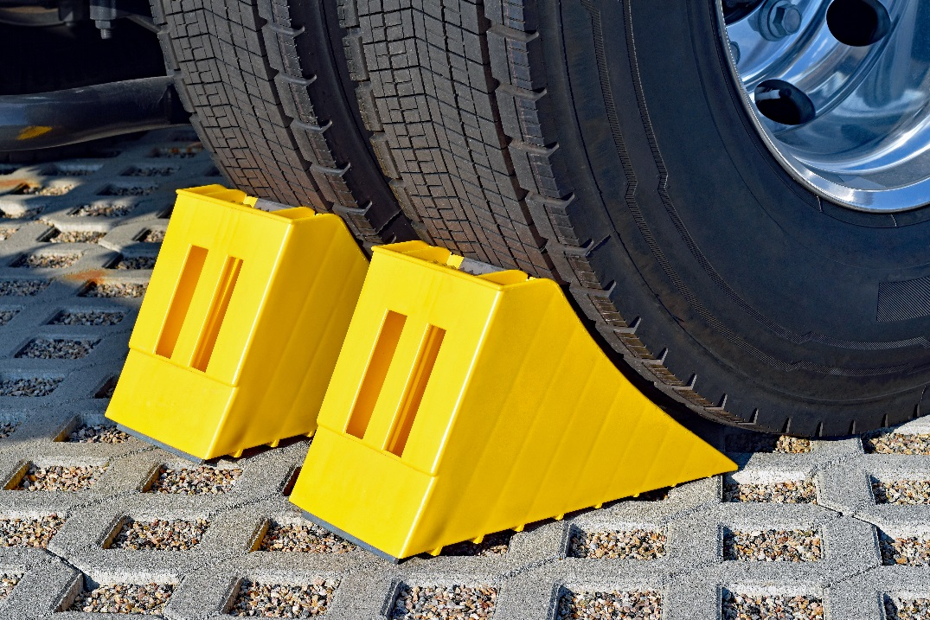
Preparing for an Inspection
Set the parking brake:
When the vehicle is to remain in a position for some time and whenever the driver is not at the controls
Use chock-blocks in addition to the parking brake.
Notes:
SAY: Set the parking brake when the vehicle will remain in a position for some time and whenever you are not at the controls.
Turn off the engine to prevent idling.
If the engine must remain running, place the transmission in neutral, set the parking brake and set the idle to 1000rpms to maintain water temperature (especially in the winter).
To release the parking brake, first cover the service brake, release the parking brake, give full application to the service brake and then put the transmission into gear.
Chock blocks should be used in addition to the parking brake to ensure the vehicle remains in position when you are not in control.
Wheel chocks are wedges of sturdy material placed closely against a vehicle’s wheels to prevent accidental movement. The bottom surface is sometimes coated in rubber to enhance grip with the ground.
Reference: information on chocking the wheels are in Lesson 4 of the Textbook, Vehicle Inspections – The Inspection Process – Chocking the Wheels.

Slide 22
Wheel Chocks
Using wheel chocks:
Always ensure the chock is centered and squared with the tire
Always use wheel chocks in pairs
Wheel chocks must be positioned downhill and below the vehicle’s center of gravity
On a downhill grade - in front of the front wheels
On an uphill grade - behind the rear wheels
On a level grade - position the chocks on the front and back of a single wheel
Notes:
SAY: When using a wheel chock:
Ensure the chock is centered and squared with the tire
Position the chock snuggly against the tire, with about 1 in. (25.4mm) of the chock extending from the edge of the tire
Always use wheel chocks in pairs
Wheel chocks must be positioned downhill and below the vehicle’s center of gravity
On a downhill grade, position the chocks in front of the front wheels
On an uphill grade, position the chocks behind the rear wheels
On a level grade, position the chocks on the front and back of a single wheel.

Slide 23
Wheel Chocking Considerations
Tire size
Smaller tires require smaller chocks, while larger tires require larger chocks
Gross vehicle weight
Heavier vehicles require larger chocks than lighter vehicles
Level or grade of the ground surface
Chocks need to be positioned in different ways
Ensure chocking configuration is correct based on surface grade
Notes:
SAY: Additionally, there are some combinations of conditions that must be considered when using wheel chocks:
Tire size
Smaller tires require smaller chocks, while larger tires require larger chocks
Gross vehicle weight
Heavier vehicles require larger chocks than lighter vehicles
Level or grade of the ground surface
Chocks need to be positioned in different ways depending on if the ground is level or not.
Ensure the chocking configuration is correct based on surface grade

Slide 24
Wheel Chocking Considerations
Radial Tires vs. Bias-Ply Tires
Radial tires deflect more than bias-ply tires
Wrap around the wheel chock, reducing effectiveness
Radial tires should be chocked with larger wheel chocks
Notes:
SAY: Radial tires, by design, deflect more than bias-ply tires. While this flexibility allows the vehicle to move more smoothly, it also allows the tire to wrap around the wheel chock, which reduces the chocks effectiveness. To combat this, vehicles with radial tires should be chocked with larger wheel chocks.
Reference: information on tire types are in Lesson 4 of the Textbook, Vehicle Inspections – The Inspection Process – Chocking the Wheels.

Slide 25
Wheel Chocking Considerations
Tire pressure variance due to environment
Improperly inflated tires can lead to chocking failures
Condition of the ground
Whether the ground is firm, soft, wet, dry, icy, or frozen determines the type of chock to use
Notes:
SAY: It is important to monitor tire pressure, especially in harsh environments. Improperly inflated tires can lead to chocking failures.
Whether the ground is firm, soft, wet, dry, icy, or frozen is a key determination in the type of chock to use. For frozen or icy terrain, choose a chock with a cleated bottom. For extremely wet or muddy terrain, multiple chocks may be necessary to ensure safe chocking.

Slide 26
Inspection Procedure
The Walk-Around Check
Exterior
Right Side of Vehicle
Interior
Under the Hood
Engine Start-Up
Left Side of Vehicle
To avoid injury when entering and exiting the vehicle, always keep at least three points of contact with the cab!
Notes:
SAY:
Do a walk-around before starting any trip. The trip inspection may be done in any order, but make sure you check everything and always make a complete circle around the vehicle.
In the daily walk-around procedure, you will check items in these categories:
Under the Hood
Exterior
Interior (before engine start up)
Engine Start-Up
To avoid injury when entering and exiting the vehicle, always keep at least three points of contact with the cab!
DO:
Click to reveal the first section to inspect: Under the Hood. Ask students to read from their textbook. They should read the item they are inspecting and the details to identify major and minor defects.
Once this section is complete, click to Hide Under the Hood box, and click again to reveal Exterior, Interior and Engine Start-Up. Continue reviewing with the students.
Resources: Instructors may also wish to provide a copy of the National Occupational Standard Commercial Vehicle Operator document at this time, found here:
https://www.cvsa.org/wp-content/uploads/International-Roadcheck-Vehicle-Inspection-Cheatsheet.pdf
The following FAQ can also be reviewed when discussing how to inspect certain items.
https://ccmta.ca/images/pdf-documents-english/nsc_standard_13_QA.pdf

Slide 27
When You Find a Defect
Record
Record immediately
Report
Report to carrier
In-person, by phone, written, electronic
Drive
Continue to drive only if recorded, reported and not a major defect
Major or minor?
Notes:
SAY: Recording Defects: You are required to record a defect on the report immediately after the initial inspection or upon discovery of a defect while travelling or when discovered at the end of a trip or day.
Reporting Defects: Minor defects and major defects, which are listed in the Manitoba regulation Schedule A, must be reported immediately by you or the inspection person to the carrier upon discovery. Depending on your situation, reporting defects to the carrier may be done in person, by phone, via written report or through electronic means.
Driving with Defects: You may continue to drive with a minor defect that is listed on an inspection schedule if you have immediately entered the defect on the daily inspection report and reported the defect to the carrier.
No carrier shall permit a person, and no person shall drive a commercial vehicle on a highway when a major defect that is listed on an inspection schedule is present on the vehicle.

Slide 28
Report Requirements
Must include the following information:
Licence plate or unit number of the vehicle and any trailers being towed by that vehicle
Odometer reading of the vehicle
Carrier or company name
Inspection date and time
Inspection location
Height and width of the vehicle and load
Name of the person conducting the inspection (printed legibly)
Declaration signed by the person conducting the inspection and the person driving the vehicle
Notes:
SAY: All details of the inspection, including any defects, must be recorded on a trip inspection report form, either on paper or electronically. The regulations do not state what type of form must be used; however, whichever form you choose, it must include the following information:
Licence plate or unit number of the vehicle and any trailers being towed by that vehicle.
Odometer reading of the vehicle.
Carrier or company name.
Inspection date and time.
Inspection location.
Height and width of the vehicle and load
Name of the person conducting the inspection (printed legibly).
Declaration signed by the person conducting the inspection and the person driving the vehicle (if different from the person conducting the inspection) stating that the vehicle, and any trailers being towed, have been inspected in accordance with the applicable requirements.

Slide 29
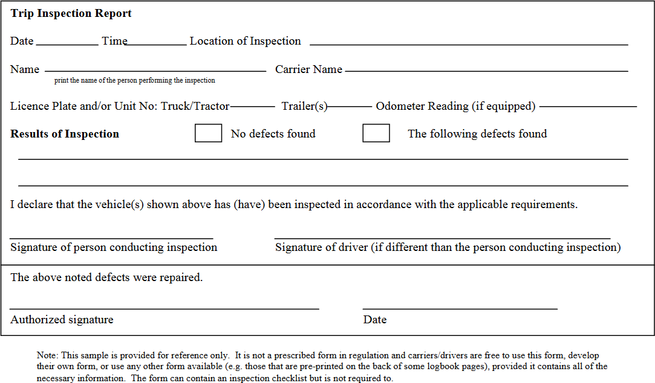
Filling out a Report
Report Documentation
Carrier may combine into schedule document
May be a separate report
Samples provided in textbook and exercise book
Valid for 24 hours
Must be presented to enforcement as requested
May be completed by you or other qualified staff
Notes:
SAY:
Your textbook and exercise book contain a copy of the regulation Schedule A which is the list of defects. Your contains a sample inspection report. These are for reference only. Check with your employer to determine if the company has its own forms for recording vehicle condition. A schedule and an inspection report may be combined on the same document.
Once a daily inspection report has been completed, the trip inspection is valid for a maximum of 24 hours.
On the demand of a peace officer, you must produce the inspection schedule and the written trip inspection report.
Inspection reports may be conducted and signed off by you as the driver or another qualified individual, such as maintenance or yard staff. This person is responsible under law for the inspection and the information contained in the inspection report.
You are not permitted to drive a truck or tow a trailer unless a qualified individual has conducted an inspection of the vehicle within the previous 24 hours.
Vehicles that do not meet the requirements can be taken out-of-service until repairs are made. This can result in fines and points assessed on the Carrier Profile or your Commercial Driver Abstract.
The following documents are samples of inspection reports.
DO: Click to animate, twice, to show 2 samples of inspection reports.
https://www.safetydriven.ca/resource/pre-trip-report/

Slide 30
Upon Completion of Report
Send original report to home terminal within 20 days
Carrier stores the records
Each inspection for each vehicle kept for a minimum of 6 months
Notes:
SAY: Upon completion of a trip inspection form, you must forward the original report to the home terminal of the carrier within 20 days. The carrier is then responsible for storing this record in its principal place of business within thirty days of receiving the report. Each inspection form must be kept in chronological order for each vehicle for at least six months after receiving it.

Slide 31
Exercise: 3 & 4
Time: 30 minutes
Complete Exercise 3: Completing a Report
Complete Exercise 4: Identifying Defects
Notes:
SAY: You have 15 minutes to complete Exercise 3 in the Exercise Book.

Slide 32
Review
Who is required to stop at a vehicle inspection station?
Answer: All commercial vehicles over 4,500kg.
Notes:
Click to reveal answer.

Slide 33
Review
How long is a daily inspection report valid for?
Answer: 24 Hours

Slide 34
Review
Which of these inspections do you need to document in your log book
Pre-trip
Post-trip
En route
Answer: All of them

Slide 35
After-Class Assignment
Review the textbook and supporting materials
Notes:
DO:
Read slide.

Slide 36
Summary
You should now be able to:
Inspect and maintain commercial vehicles
Identify the general components of a Class 1 vehicle to conduct daily inspections
Explain the functions of Class 1 vehicle components listed in NSC 13 Schedule 1 to conduct pre- and post-trip inspections
Notes:
SAY: In this module we have discussed the legislation around your vehicle inspections as well as inspection stations. We discussed at length how to complete your pre-trip, en route and post-trip inspections. You should have a better understanding of what is required of you to ensure the vehicle is in proper working order prior to setting out. You should now understand how to fill out Schedule 1, and document the pre-, post- and en route inspections in your log books.
Next, we will go into the yard and you will complete a Schedule 1 inspection and the appropriate paperwork.
DO:
Regardless of how the schedule and the lessons are taught, students must have completed lessons 1-4 before into a vehicle to perform any driving manoeuvres in Lesson 5.

Slide 37
Practical In-Yard Training
Practical Time In-Yard
Resources to take with you:
Textbook
Exercise book
Notes:
SAY:
You will head out to the yard where an instructor will identify each component and system that needs to be inspected as well as how to identify whether the item has a minor or major defect and then you will do the same inspection.
You may wish to take your textbook with the inspection details as it provides details on what you are looking for when doing an inspection.
You will need your exercise book which has the inspection form and sample report.
DO:
At the end of the classroom session, the instructor and the students will proceed to the yard for the vehicle inspection activities. The instructor will have about 1 hour, 30 minutes to demonstrate the vehicle inspection activities (pre-trip, en route, post trip inspection) to the student, after which the student will perform the activities. The students will have a minimum of 5 hours, 30 minutes to practice the vehicle inspection activities (pre-trip, en route, post trip inspection). This time may be split up and used in 30 minute increments throughout the length of the course as it may be helpful to demonstrate best practices for en route and post-trip in a different session. Decisions about how to organize yard time will need to flex with each class based on numbers of students, available instructors for proper yard ratio and physical training space.

Slide 38
Practical In-Yard Assessment
Practical Time In-Yard
Blank Inspection Report
60 minutes to complete
Notes:
SAY:
You will now have a practical assessment where your instructor will assess your understanding and skill competency. This final in-yard assessment will count towards your final course mark. Each time you attempt the activities, your instructor will provide you with a copy of your in-yard assessment which you should review to improve your skills in this area.
DO:
Instructor will evaluate students using the practical assessment sheet. The list may then be shared with the student to improve their performance. Use one practical assessment sheet each time the student performs the activities. Students are encouraged to bring their textbook and/or exercise book with the lists of procedures and checklists during the time they are applying their learning.
A minimum of one hour will be used for in-yard assessment.

