Slide 1
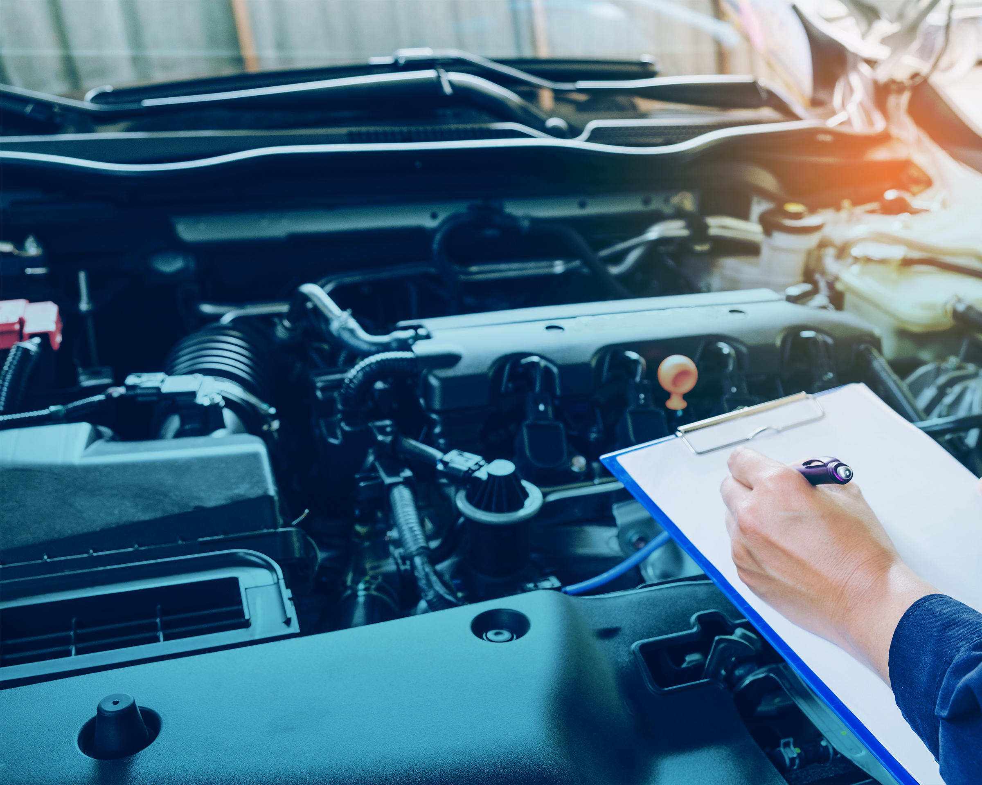
Basic Driving Strategies
Lesson 5

Slide 2
Learning Objectives
After completing this lesson, you should be able to:
Prepare and start to drive a commercial vehicle
Comply with operational regulations that apply to commercial vehicles
Operate a commercial vehicle in a safe manner
Perform basic driving manoeuvres
Notes:
SAY: This lesson is intended to provide you with information about the steps that should be taken prior to driving a commercial vehicle and provide an opportunity to practice these steps.
Upon completing this lesson, you should be able to:
Prepare and start to drive a commercial vehicle
Comply with operational regulations that apply to commercial vehicles
Operate a commercial vehicle in a safe manner
Perform basic driving manoeuvres
DO:
Regardless of how the schedule and the lessons are taught, students must have completed lessons 1-4 before into a vehicle to perform driving manoeuvres in Lesson 5.

Slide 3
Pre-Class Assignment
You will have:
Reviewed the material from the last lesson.
Any questions about Lesson 4?
Notes:
SAY:
After the last class, you were asked to review Lesson 4.
Do you have any questions about the lesson?
Do:
Answer any questions that have come up.

Slide 4
Driver’s “Duty of Care”
  After completing this section, you should be able to:
  Proactively protect other road users from harm
Notes:
SAY: Safety is your most important responsibility. This responsibility is expressed in Canada’s National Occupational Standard (NOS) for truck drivers as having a “duty of care” – to proactively protect other road users from harm.

Slide 5
Driver Readiness
The most important personal demands drivers need to manage are:
Fatigue
Distracted driving
Road rage and anger management
Impaired driving
Before you drive, do a readiness check:
Am I fully rested, energized and able to concentrate?
Am I feeling mentally and physically healthy?
Is my attitude courteous, careful, and considerate?
Am I free from any impairment?
Am I ready to assume my duty of care?
Notes:
SAY: Driving a truck can be a stressful, demanding job. Starting the engine without being mentally and physically prepared for the demands is risky for you and everyone else on the road.
Four of the most important personal demands of the job that you need to manage are:
Fatigue
Distracted driving
Road rage and anger management
Impaired driving
Professional drivers also do a kind of driver readiness check as part of their duty of care to ensure they’re ready to drive:
Am I fully rested and energized?
Am I feeling mentally and physically healthy?
Am I able to concentrate on driving?
Is my attitude courteous, careful, and considerate?
Am I free from any impairment or effects from alcohol, medications, or other drugs?
Am I ready to assume my duty of care as a professional truck driver?
Reference: Personal demands are listed in Lesson 5 of the Textbook, under Driver Readiness.
You may wish to play a video that discusses the impact of these factors on a professional driver’s performance. A video on the MELT curriculum website can be shared with the class:
https://apps.mpi.mb.ca/MELT/videos/Pro%20defensive%20driving.wmv

Slide 6

Fatigue and Driving
Causes of fatigue:
Lack of sleep
Irregular schedules
Driving alone
Overnight driving
Time changes
Driving long distances
Job stress
Medications
Alcohol
Notes:
SAY: Driving while fatigued can make you a hazard on the road. Drowsy driving is as dangerous as impaired driving because it slows your reaction time, decreases awareness and can impair judgment.
Lack of sleep is the most common cause of drowsy driving. Other contributing factors include irregular schedules, driving alone, overnight driving, time changes, driving long distances without rest breaks everyday stresses of the job. Taking medication that increases sleepiness or drinking alcohol also contributes to driver fatigue.
In Canada, you can drive a commercial vehicle under the National Safety Code up to 13 hours a day, but it is recommended not to drive more than two hours without stopping for a rest.
Reference: Textbook: Section 8.

Slide 7
Fatigue and Driving
Warning signs of driver fatigue:
Yawning
Inability to keep eyes focused and head up
Wandering, disconnected thoughts
Not remembering the past few kilometres of driving
Drifting between lanes
Tailgating
Missing traffic signs
Noticing a vehicle that seems to appear out of nowhere
Notes:
SAY: Watch for these warning signs of driver fatigue and the risk of falling asleep:
Yawning
Inability to keep eyes focused and head up
Wandering, disconnected thoughts
Not remembering the past few kilometres of driving
Drifting between lanes, tailgating, or missing traffic signs
Noticing vehicles that seem to appear out of nowhere
If you’re starting to fall asleep at the wheel, stop driving and get some rest. Be honest with yourself, and give yourself a break when you need it.

Slide 8
Fatigue and Driving
Microsleep:
Is a temporary episode of sleep, drowsiness or unconsciousness
Can last from 1 to 30 seconds
Is extremely dangerous when driving
Notes:
SAY: Fatigue slows reaction times, decreases awareness, and can impair judgment. In worst-case scenarios, it causes drivers to fall asleep at the wheel.
Microsleeps are a temporary episode of sleep, drowsiness, or unconsciousness lasting 1 to 30 seconds. Sleep deprivation or long, monotonous tasks can cause microsleeps. Droopy or slowly closing eyes and head nodding are signs of a microsleep. People are often unaware of them, or treat them as a temporary loss of focus, as opposed to actually falling asleep.

Slide 9

Fatigue and Driving
Manage fatigue and avoid microsleeps by:
Getting plenty of sleep before a long trip
Avoiding working all day and then driving all night
Scheduling regular breaks
Travelling with an awake and alert passenger
Manage stress levels
The best way to fight fatigue is to stop driving immediately (pull over) and get some rest!
Notes:
SAY: If you’re starting to fall asleep at the wheel, stop driving immediately (pull over) and get some rest. Be honest with yourself, and give yourself a break when you need it. Better yet, take steps to manage your fatigue and avoid microsleeps altogether:
Get plenty of sleep the night before a long trip, or if that’s not possible, get plenty of sleep the previous night.
Avoid working all day and then driving all night. Stop overnight rather than driving straight through.
Schedule regular breaks (consistent with company policy and Hours of Service regulations – see Section 8). And don’t just sit during your break - stretch or take a walk to get some fresh air.
Travel with an awake and alert passenger. Having someone to chat with helps to keep you alert, and the passenger can watch you for signs of fatigue.
Manage stress levels.

Slide 10

Fatigue, Alertness, & Driver Fitness Video
Notes:
DO: Show the video Fatigue, Alertness, & Driver Fitness (link below).
Link: http://mpiprojects/2820-MELT/ProjectDocuments/Fatique.wmv
Optional: Show additional video.
Link: https://fatiguescience.wistia.com/medias/d8vur5qfru or https://apps.mpi.mb.ca/MELT/videos/Fatique.wmv

Slide 11
Review
What causes fatigue?
Answer:
Lack of sleep
Driving alone
Overnight driving
Time changes
Driving long distances
Job stress
Medication
Alcohol
Notes:
DO: Ask students for possible answers, then click to reveal. Ask students to share their own experiences with driving while tired.
5 minute discussion

Slide 12
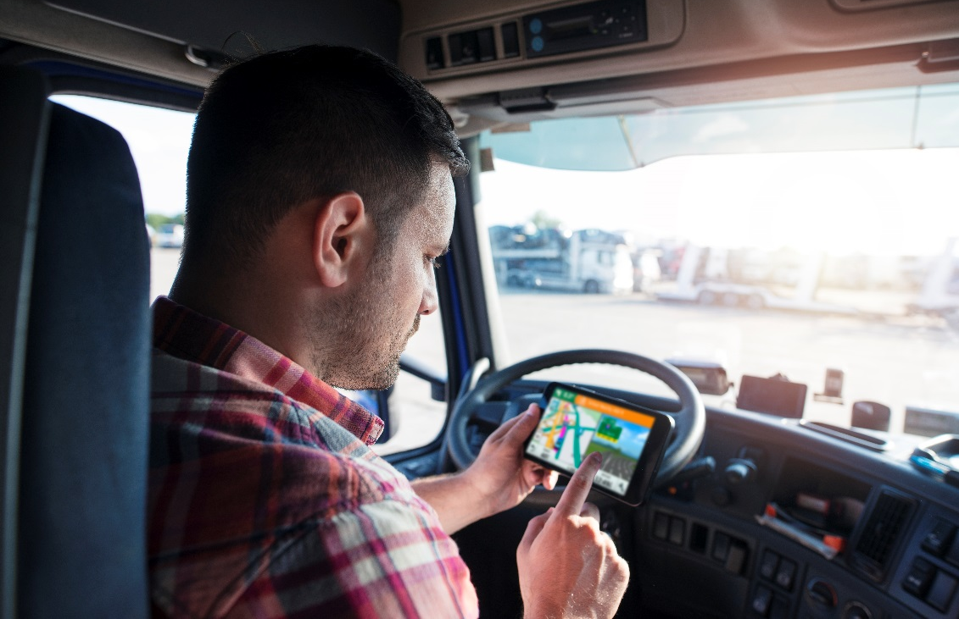
Distracted Driving
There are three kinds of driver distractions:
Visual – taking your eyes off the road
Manual – taking your hands off the steering wheel
Cognitive – taking your mind off driving
Notes:
SAY: Avoiding distractions has always been a challenge for drivers, but today’s busier, faster-paced, wired and connected world places demands on a driver’s attention more than ever.
There are three kinds of driver distractions: visual, manual and cognitive.
At all levels of driver training, you learn that when you’re behind the wheel, you need to focus on driving. It’s easier said than done sometimes, but being distracted is a choice, and something you can take steps to manage. Recognize triggers or temptations that cause you to be distracted, and then set boundaries, practice techniques, and create habits to help you manage the triggers and temptations.
Reference: Distractions are listed in Lesson 5 of the Textbook, under Driver Readiness – Distracted Driving.

Slide 13
Distracted Driving
Distracted driving applies to all vehicles. Distractions can include:
Using cellular phones
Reading printed materials
Writing, printing or sketching
Personal grooming
Using electronic devices such as laptop computers, cameras and portable audio players (e.g., MP3 players)
Does not apply to 2-way radios, handheld radios and affixed or voice-activated GPS units, when used according to regulations.
Notes:
SAY: Distracted driving applies to all vehicles. Distractions can include:
Using cellular phones, reading, writing, printing, grooming, or other electronic devices.
In Manitoba, it is illegal to use a hand-held electronic device while driving. This includes everything from smartphones and iPods to tablets.
Commercial drivers are permitted to use two-way radios or hand-held radios (Citizen’s Band radios) to contact their employer, and in emergency management situations. GPS navigation units can be displayed, but the unit must be affixed to the vehicle and programmed before you begin driving, or the system must be voice-activated.
DO:
Reference:
https://www.mpi.mb.ca/Documents/Distracted-Driving.pdf
Information on distracted driving can be found in Lesson 5 of the Textbook, under Driver Readiness – Distracted Driving.

Slide 14
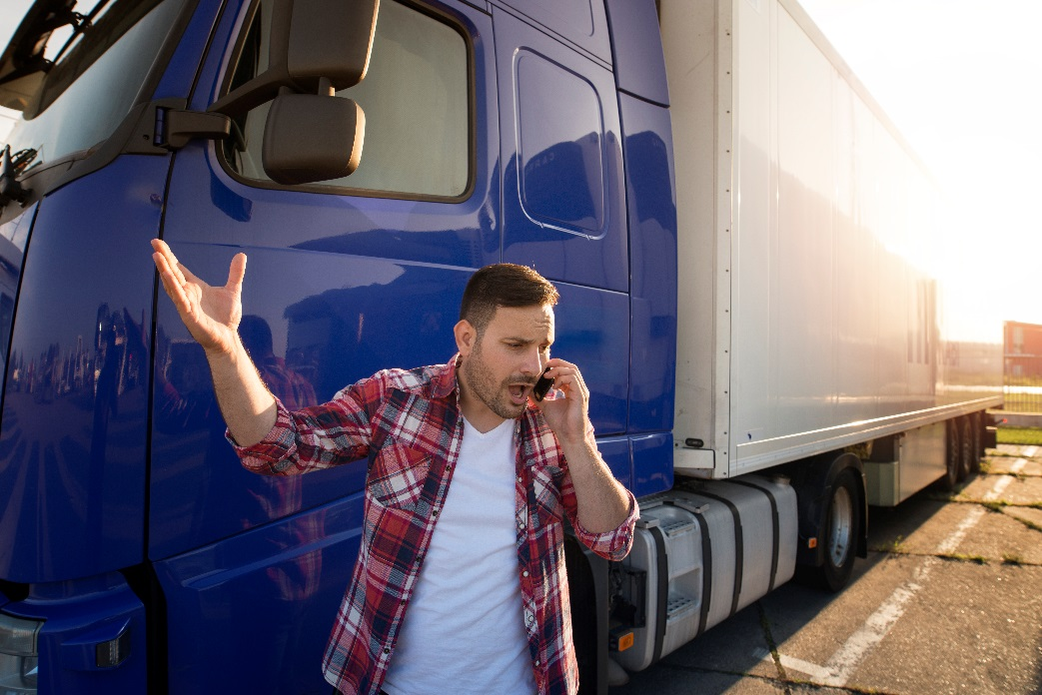
Distracted Driving - Penalties
Using hand-operated electronic device while driving any vehicle results in:
a three-day driver licence suspension (first offence)
A seven-day licence suspension (subsequent offences)
a $672 fine
5 demerits
Notes:
SAY: Distracted Driving or texting and driving is the most commonly term used. However under the law in Manitoba (HTA), it is referred to as “Using hand-operated electronic device while driving.” Other jurisdictions have similar laws as well.
Drivers caught violating this law in Manitoba receive:
Three-day licence suspension for a first offence
Seven-day suspension for subsequent offences.
Upon conviction, they also receive:
$672 fine
Move down five levels on the Driver Safety Scale, which can result in an increase to insurance premiums, and an increase to the cost of your drivers licence.
In serious cases, or when other distractions cause you to violate traffic laws or end up in a collision, you could be charged with a number of offences, including careless driving, dangerous driving or criminal negligence. These can result in more severe penalties (including jail time) and other driving interventions.

Slide 15
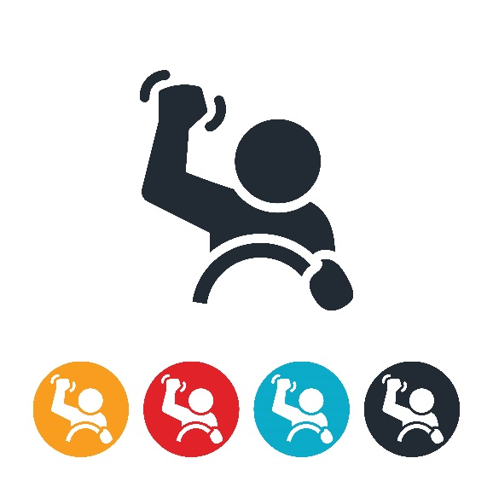
Road Rage and Anger Management
Road rage has several expressions:
Excessive honking at another driver
Verbal abuse or threats
Aggressive or vengeful driving manoeuvres
Preventative actions include:
Driving courteously
Planning your route in advance
Not taking other drivers’ mistakes personally
Notes:
SAY: Sharing the road creates situations that cause stress or frustration, possibly leading to anger or even road rage – an extreme form of aggressive driving or violent behaviour.
Road rage has several expressions:
Excessive honking at another driver
Verbal abuse or threats
Aggressive or vengeful driving manoeuvres
Physical confrontations
There are many preventative actions you can take to avoid frustration and anger on the road:
Plan your route in advance.
Make a conscious decision not to take your problems with you when driving.
Reduce stress by taking breaks, getting fresh air, and breathing deeply and slowly.
Don’t compete, retaliate, or try to “educate” drivers. Leave traffic enforcement to the police.
Don’t take other drivers’ mistakes personally.
Avoid using your horn unless absolutely necessary. If you must use your horn, use a light touch.
Reference: Information on road rage and anger management can be found in Lesson 5 of the Textbook, under Driver Readiness – Road Rage and Anger Management.
You may choose to share the following video or a similar video with students in the classroom to engage in further discussion about road rage and anger management.
https://apps.mpi.mb.ca/MELT/videos/Road%20rage.wmv

Slide 16
Impaired Driving
Impairment can be caused by:
  Alcohol
  Cannabis
  Prescription medicine
  Illegal substances
Impaired drivers are one of the most dangerous risks on the road
  Causing about one third of all traffic deaths in Manitoba
Notes:
SAY: Impaired drivers are one of the most dangerous risks on the road. They cause about one-third of all traffic deaths in Manitoba. Whether the drug is alcohol, cannabis, prescription medicine, or an illegal substance, having any drug in your system when you’re behind the wheel is a risk. The safest level of impairment is zero impairment. Professional drivers manage their social and personal lives so that there is no risk of being impaired when driving.
Reference: Information on impaired driving can be found in Lesson 5 of the Textbook, under Driver Readiness – Impaired Driving.

Slide 17
Impairment is different than BAC
Blood Alcohol Content (BAC) begins with the first drink.
Impairment can be influenced by:
Rate of consumption
Age
Gender
Body weight and type
Food consumption
Medication and drugs
Environment and mood
Fatigue and stress
Only Time can eliminate alcohol from the body!
Notes:
SAY: Alcohol is a depressant and consumption may trigger mood and behaviour changes.
BAC refers to the amount of alcohol present in the bloodstream.
If two people sit down and consume the same amount of alcohol in the same timeframe, one may get up and walk away seemly unimpaired. The other may get up and stumble back down. This is because each person is different and their body type, weight, gender and age affects how their body absorbs the alcohol consumed.
For the purpose of our discussions we will assume each drink consumed is roughly equal to 0.02% BAC.
DO: Go over Basic Driving Strategies, Driver Readiness, Impaired Driving in Text Book, where there is a table from the Canadian Centre on Substance Use demonstrates how BAC changes for a typical person.
SAY: Only time can eliminate alcohol from the body (through your liver, breath, and sweat) . You cannot successfully sleep off a night of heavy drinking in a few hours. The table from the Canadian Centre on Substance Use demonstrates how BAC changes for a typical person. For example, if you go to bed at midnight with a BAC of .25%, and alcohol leaves the system at a rate of approximately 0.015% per hour, you will not be at zero BAC until 5 p.m.

Slide 18
Effects of Alcohol on Driving
Multiple negative effects on vision:
Slower eye refocusing/double vision
Reduced distance judgment
Reduced peripheral vision
Reduced visual acuity (sharpness) and colour distinction
Diminished night vision
Also can have an effect on:
Slower response times
Impaired motor skills
Notes:
SAY: Alcohol has negative impacts on vision, including eye refocusing/double vision, distance judgment (the ability to properly determine safe following distance and gaps), peripheral vision, sharpness of vision, colour distinction, and diminished night vision .
Alcohol also slows your ability to process information and respond to critical driving tasks and your eye, hand, and foot coordination is impaired.

Slide 19
Likelihood of a Crash
The risk of a crash increases with the more alcohol you have in your system:
0.05 – 0.09 BAC
0.10 – 0.14 BAC
0.15+ BAC
11x
48x
380x
The only truly safe BAC is 0.0%!
Notes:
SAY: It is important to understand BAC and its impact on driving at various levels. Driving impaired, even at low levels, is a real gamble. The only truly safe BAC is 0%.
Likelihood of a crash:
As the concentration of alcohol in the bloodstream increases, the body loses more and more of the functions required to drive safely. The increased likelihood of a crash begins long before you feel drunk or severely impaired.

Slide 20
Consequences of Impaired Driving
The consequences for impaired driving can be severe, and include:
Temporary or permanent licence suspensions
Demerits against your Driver Safety Rating
Requirement to complete educational/treatment programs
A criminal record
Fines or imprisonment
Notes:
SAY: The consequences for impaired driving can be severe, and include:
Temporary or permanent licence suspensions
Demerits against your Driver Safety Rating
Requirement to complete educational/treatment programs
A criminal record
Fines or imprisonment
Reference: For full details on impaired driving penalties, see Section 2 of the Professional Driver’s Manual.

Slide 21
Drugs
Drugs can affect driving ability, and can cause:
Hallucinations
Hostility, aggressiveness, and mood changes
Slower thought processes and impaired eye-hand coordination
Vision problems – less ability to track or judge distance
Poor judgment or loss of focus
    If the drugs are illegal, you may also end up with legal problems to deal with as well.
Notes:
SAY: Tranquillizers, antidepressants, sleeping pills, and similar prescription drugs can affect driving ability even if taken in the prescribed dosage. Driving impaired by medication has the same consequences as driving impaired by alcohol. Discuss the possible effects of any medication with your doctor or pharmacist. Always carry prescription drugs in their original containers.
Other drugs may cause several problems for driving:
Hallucinations
Hostility, aggressiveness, and mood changes
Slower thought processes and impaired eye-hand coordination
Vision problems – less ability to track or judge distance
Poor judgment or loss of focus
If the drugs are illegal, you may also end up with legal problems to deal with.

Slide 22
Review
What does BAC stand for?
Answer: Blood Alcohol Content
What lowers BAC levels?
Answer: Time
At what rate does alcohol leave the body?
Answer: 0.015% per hour
Notes:
DO: Click to reveal answers

Slide 23
Exercises 1: Driver Readiness
Complete Exercise 1
Time: 20 minutes
Notes:
SAY: You will have 20 minutes to complete Exercise 1 in the Exercise Book.
Do: Review the answers for each exercise, using the Exercise Book - Answer Key.

Slide 24
Importance of Defensive Driving
  After completing this section, you should be able to:
  Explain a driver’s responsibility to share their workplace with the public, and how the additional size and weight of their vehicle may be perceived by other road users
  Describe basic defensive driving principles
Notes:
DO: Read slide.

Slide 25
Defensive Driving
What is the most influential factor in preventing a collision?
Answer: You
Notes:
DO: Ask students for some possible answers, then click to reveal answer.

Slide 26

SEE
SEE is a useful driving strategy to help in any driving situation. It stands for:
  Search – Identify real or potential hazards or dangerous situations
  Evaluate – Predict likely outcomes and decide which course of action will lead to the desired outcome
  Execute – Put your plan into action
Notes:
SAY: One of the most important aspects of defensive driving is recognizing potential hazards before they become a real hazard.
Early recognition allows the time you need to avoid trouble. It is important that you recognize and become immediately aware of what you see while driving.
There are other useful driving strategies such as defensive driving and SIPDE (Scan, Identify, Predict, Decide, Execute). The name may be different for each strategy, but the concepts are all basically the same:
Gather information by being attentive to your driving and your surroundings.
Make the best decision based on the information.
Execute the decision safely, using your hands-on driving skills.
For all driving manoeuvres in this course, learn to SEE them. You can SEE better by:
Practicing the commentary driving technique
Developing good visual habits and using all your senses
Being aware of driving conditions
Learning how to share the road
Reference: SEE is listed in Lesson 5 of the Textbook, under Now SEE Here – a Fundamental Driving Strategy.

Slide 27
Commentary Driving
Commentary driving is a technique for detecting and managing driving hazards, where the driver verbalizes out loud their observations and interpretations of events developing around and ahead of their vehicle.
It creates awareness of all the things you should be watching for and thinking about.
It helps improve your visual skills.
It helps you resist common distractions.
If practiced with an instructor, it helps the instructor evaluate your driving habits and progress.
Notes:
SAY: You can SEE better by practicing the commentary driving technique.
Commentary driving is a technique for detecting and managing driving hazards, where the driver verbalizes out loud their observations and interpretations of events developing around and ahead of their vehicle.
Commentary driving works because:
It creates awareness of all the things you should be watching for and thinking about.
It helps improve your visual skills.
It helps you resist common distractions.
If practiced with an instructor, it helps the instructor evaluate your driving habits and progress.
DO: Refer students to the example in the textbook, under the caption “How to SEE Better” in Lesson 5. Go over this example.

Slide 28
Visual Search Techniques
Concept of Gates
Helps you manage space around the vehicle when driving
An open gate is an open space to move the vehicle into without interfering with traffic
A closed gate is one where another vehicle occupies the space you are trying to move into
Defensive Drivers
Adjust their speed and positioning to give them two open gates at all times
Notes:
SAY: Another useful driving strategy is the concept of gates.
Gates serve as an escape option if you need to avoid a hazard or collision.
An open gate is an open space you can move your vehicle into without interfering with traffic. A closed gate is a space occupied by another vehicle that you cannot move into without interfering unsafely with that vehicle.
Defensive drivers try to keep at least 2 gates open. This can be difficult as you have no control over the other vehicles around you. The only gate you have control over is the one in front of your vehicle. If you are not able to keep 2 gates open because of heavy traffic or road limitations/restrictions, increase your following distance to offer more space and time to utilize visual search patterns and SEE.
You should glance in your mirrors every 10-15 seconds to help you know what is going on all around you.

Slide 29
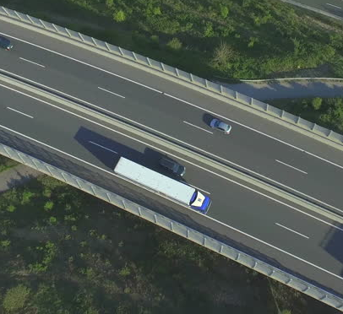
Gates
Green
Open Gate
Yellow
Proceed with Caution
Red
Closed Gate
Open space you can move your vehicle into.
Use if absolutely necessary.
Space occupied by another vehicle.
You need to continually monitor your gates so you know which escape options are available to you.
Notes:
SAY: In the picture, the green gates are considered “open” as the truck has enough space to adjust its speed and use the open gate as an escape option.
The red gate is considered “closed” because of the vehicle traveling along side the truck.
The yellow gate could be used if absolutely needed but you wouldn’t choose that as your first option.
As drivers, you need to continually monitor your gates so you know which escape options are available to you.

Slide 30
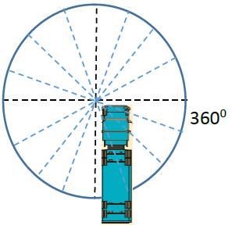
Visual Search Techniques
Make your zone of awareness a full 360˚ area around the vehicle in all directions - like a big bubble of awareness .
Notes:
SAY: You can SEE better by knowing that hazards can come from any direction: ahead, behind, left, right, above or below. Make your zone of awareness a full 360˚ area around the vehicle in all directions - like a big bubble of awareness .

Slide 31
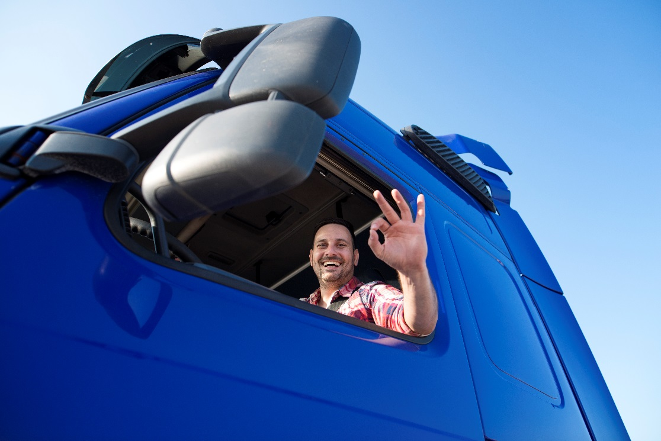
Visual Search Techniques
Here are visual search techniques to practice and use regularly:
Fill the Gap
Sweep
Mirror Check
  Every 10-15 seconds
Gauge Check
Notes:
SAY: You can practice visual search techniques to learn to see everything in the bubble – and to make the bubble bigger. The earlier you detect a potential hazard, the more time you have to deal with it.
Here are visual search techniques to practice and use regularly:
Fill the Gap – Look as far as you can down your lane, then drop your eyes to a reference point 12 seconds ahead of your vehicle, within your driving lane. Then fill in the space between your reference point and the front of your vehicle. Note any potential hazards on the road surface, traffic signs, or other things you may need to respond to.
Sweep – Move your eyes as far left and right as you can, identifying potential hazards.
Mirror Check – Check your mirrors every 10-15 seconds to be aware of your surroundings and gates.
Gauge Check – Monitor your gauges without losing sight of the road. It’s best to wait for a stop or a straight, clear stretch of road. If that’s not possible, take quick glances until you get the reading, instead of one longer glance.

Slide 32
Visual Search Summary
Check your mirrors every 10 to 15 seconds
Check your gates
Note vehicles you are following, or vehicles following you
SEE what's going on around your vehicle
Notes:
SAY: In summary when performing a visual search:
Check your mirrors every 10 to 15 seconds
Check your gates
Make note of any vehicles you are following or who are following you
Notice what's going on around your vehicle
The visual search sequence to practice and use regularly:
Fill the gap
Sweep
Mirror Check
Gauge Check
There will be times where real and potential hazards dictate that you create a different sequence, but learning to use your eyes properly will help you utilize the SEE process effectively and allow more reaction time.
Reference: Visual Techniques are listed in Lesson 5 of the Textbook, under SEE with All Your Senses.

Slide 33
Using Other Senses
Vision is the most important sense you need for driving, but you can use other senses to detect potential hazards:
Sound (horns, train whistles, sirens, children)
  Keep music and radio at a reasonable level
Touch (vibrations)
Smell (rubber, oil, smoke)
  From engine or tires
  From environment
Notes:
SAY: Vision is of course the most important sense you need for driving, but you can use other senses to detect potential hazards:
Sound – Listen for car horns, train whistles, sirens, children playing, etc. Keep music, the radio, and other in-vehicle noises at a reasonable level so you can hear outside noise.
Touch - Vibrations may tell you there’s a vehicle issue, or that road conditions are changing.
Smell – Odours of rubber, oil, or other engine fluids may indicate vehicle issues (engine, tires). Smoke or other smells coming from the environment may indicate low visibility or other hazards ahead.
DO: Refer students to the table under “SEE - Using Other Senses” of the textbook in Lesson 5. Review the examples in the table.
Reference: Visual Techniques are listed in Lesson 5 of the Textbook, under SEE with All Your Senses.

Slide 34
Review
How can you SEE better?
Answer:
Practicing the commentary driving technique
Develop good visual habits
Use all your senses
Be aware of driving conditions
Learn to share the road
Notes:
DO: Ask students to write down how they think they can SEE better.
Once they are finished, click to reveal the answers one at a time.
You can SEE better by:
Practicing the commentary driving technique
Developing good visual habits and using all your senses
Being aware of driving conditions (mentioned in Lesson 6)
Learning how to share the road

Slide 35
Exercise: 2
Time: 20 minutes
Complete Exercise 2: Defensive Driving (SEE)
Notes:
SAY: You will have 20 minutes to complete Exercise 2 in the Exercise Book.
Do: Review the answers for each exercise, using the Exercise Book - Answer Key.

Slide 36
Potentially Hazardous Situations
  After completing this section, you should be able to:
  Identify visual cues and other signs of potentially hazardous traffic situation
Notes:
DO: Read slide.
Reference: Hazardous traffic situations are in Lesson 5 of the Textbook, under SEE and Share the Road.

Slide 37
Parked Vehicles
Parked vehicles pose these potential hazards:
Pedestrians or animals may suddenly emerge from between parked vehicles.
A parked vehicle may suddenly pull out into your path without warning. Watch for these clues:
  Exhaust fumes
  Backing and brake lights turning on
  Front wheels pointing toward traffic
  A person behind the steering wheel
People may open doors of parked vehicles into traffic without looking.
  Drive at least 1.5 metres out from a parked vehicle to avoid an opening door.
Notes:
SAY: Parked vehicles pose these potential hazards:
Pedestrians or animals may suddenly emerge from between parked vehicles.
A parked vehicle may suddenly pull out into your path without warning. Watch for these clues:
Exhaust fumes
Backing and brake lights turning on
Front wheels pointing toward traffic
A person behind the steering wheel
People may open doors of parked vehicles into traffic without looking.
Drive at least 1.5 metres out from a parked vehicle to avoid an opening door.
When passing a stalled or stopped vehicle on the highway, treat it the same as passing a moving vehicle. As you approach from behind, look for any sign the vehicle may move (wheels turning, lights, exhaust) or passengers may exit. As a courtesy, move over one lane. If that’s not possible, slow down and keep the brake covered.
Reference: Hazardous traffic situations are in Lesson 5 of the Textbook, under SEE and Share the Road.

Slide 38
Motorcycles & Cyclists
Motorcycles
Easily hidden in your vehicle’s blind spots
Not easily visible
Turn signals can be hard to see
Move within their lane to avoid road hazards
Cyclists
When passing a cyclist, change lanes like you would for other vehicles
Avoid following cyclists too closely
Notes:
SAY:
Motorcycles are easily hidden in your vehicle’s blind spots. They can even be difficult to spot in a wide-angle mirror.
Motorcycles can be easily victimized by the “right turn squeeze” when positioned between the curb and a truck turning right.
Pay attention for motorcycles when turning left. They may not be easily visible in heavy traffic or low-light conditions. Their size may also make it difficult to judge their speed.
Sometimes a motorcycle’s turn signals can be hard to see. Watch the rider for clues. If the rider does a shoulder check, they may be intending to change lanes or turn.
Motorcycle riders often move within their lane to avoid road hazards like potholes, and to maintain a space cushion from other vehicles.
Cyclists
Cyclists are required to ride close to the right curb, but may need to ride further out to avoid potholes, gravel or sand, ruts, and other surface problems. Be aware of these conditions when you encounter a cyclist.
When passing a cyclist, change lanes like you would for other vehicles.
Avoid catching cyclists in a right turn squeeze.
Before moving away from the curb, check for cyclists riding past your vehicle.
Avoid following cyclists too closely. They do not have brake lights to warn you of a stop.
Be alert for children on bicycles, who may lack experience and knowledge of safe cycling.
Reference: Hazardous traffic situations are in Lesson 5 of the Textbook, under SEE and Share the Road.

Slide 39
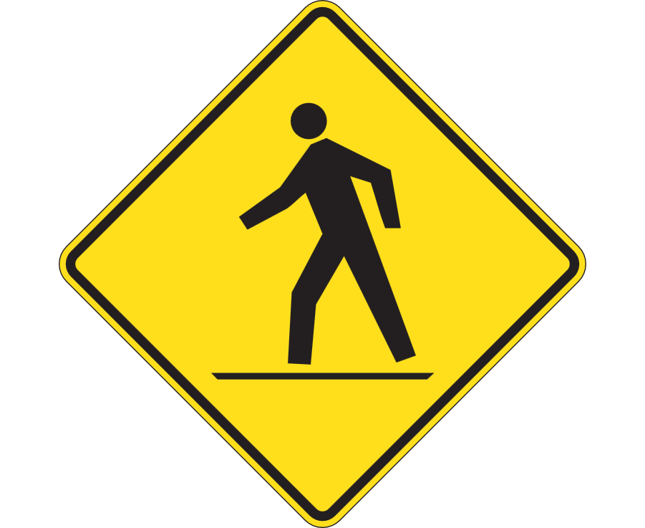
Pedestrians
Always yield to pedestrians
At crosswalks, stop two to three car-lengths back
Never pass another vehicle when approaching a crosswalk
Watch for pedestrians emerging from or between parked cars
Be aware of pedestrians that may take longer to cross
Watch for children
Notes:
SAY:
Always yield to pedestrians. They have the right-of-way at any marked or unmarked crosswalk.
At crosswalks, stop two to three car-lengths back so that traffic in other lanes can see the pedestrian and has time to stop.
Never pass another vehicle when approaching a crosswalk. There is always a chance that the other vehicle is slowing or stopping for a pedestrian.
Watch for pedestrians emerging from or between parked cars. Cover the brake and be prepared to stop.
When turning at an intersection, continually check all around the vehicle, especially the blind spots, for pedestrians.
Watch for pedestrians that may be difficult to see because of dark clothing.
Be aware of pedestrians that may take longer to cross, such as someone with a disability.
Watch for children, who may not be very aware around traffic, and who can act unpredictably. Watch for toys or other objects as warning signs that children are near.

Slide 40
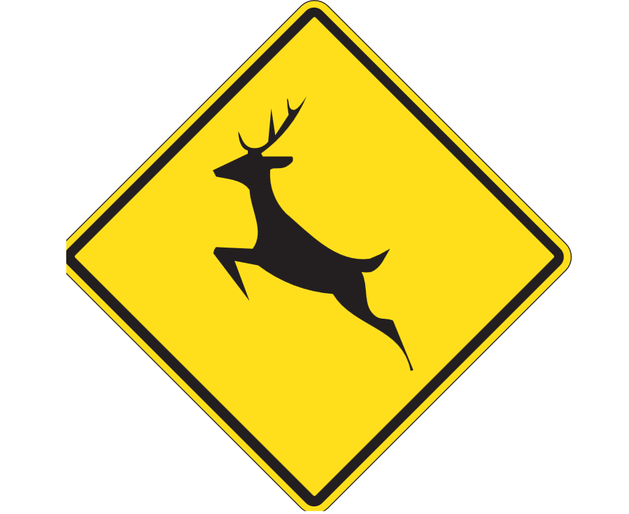
Animals
Reduce your speed, look well ahead, and use caution in areas with wildlife warning signs
Scan the sides of the road and ditches for animals
Be more careful at dawn and dusk, and during spring and autumn
At night, watch for sudden, unusual spots of light on or near the road
Sound the horn in a series of short bursts to scare off animals
If you encounter an animal, brake firmly and don’t swerve to avoid it
Notes:
SAY: Animals
Reduce your speed, look well ahead, and use caution in areas with wildlife warning signs.
Scan the sides of the road and ditches for animals.
Be more careful when animals are most active: at dawn and dusk, and during spring and autumn. During the winter, animals may roam on highways to lick salt off roads.
Animals sometimes move in groups. If you see one animal, there may be more.
At night, watch for sudden, unusual spots of light on or near the road. This may be your headlights reflecting in an animal’s eyes.
Sound the horn in a series of short bursts to scare off animals. Flashing lights and sounding the horn may divert a deer from crossing the road,
Moose are particularly dangerous because of their size. Also, flashing lights and sounding the horn won’t scare a moose off the road. As well, you may not see a moose’s eyes because they are so tall their eyes may be above your headlight beams.
If you encounter an animal, brake firmly and don’t swerve to avoid it.

Slide 41
Startup and Warm-Up Procedures
After completing this section, you should be able to:
  Explain the importance of proper startup and/or warm-up procedures
  Describe the steps involved in getting into and leaving the driver’s seat
Notes:
DO: Read Slide.
Reference: Basic driving maneuvers are in Lesson 5 of the Textbook, under Basic Driving Maneuvers

Slide 42
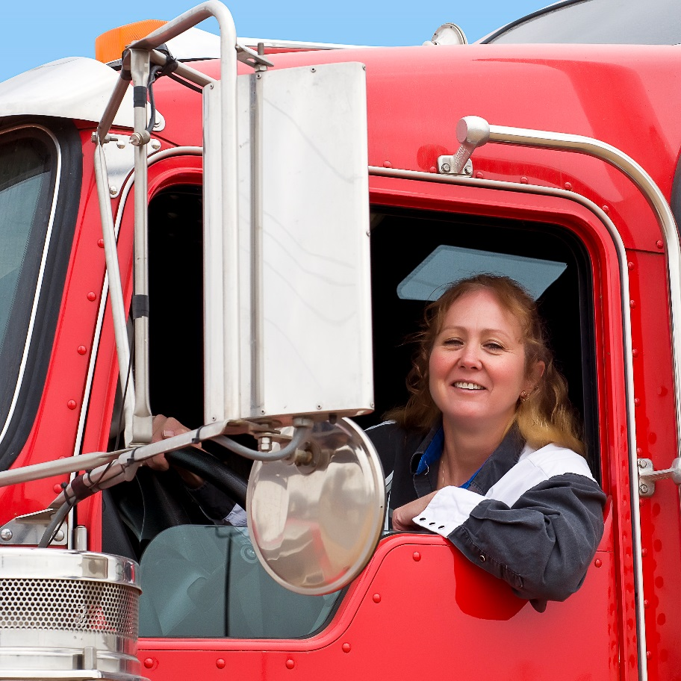
Starting the Vehicle
Enter the cab safely
  Three-point contact
Adjust your seat
  Before you start vehicle
Adjust your mirrors
  To eliminate blind spots and minimize risk around the tractor-trailer
Start your engine
  Once the above adjustments have been made
Notes:
SAY: Whether you are starting a long haul, or returning to the cab after a short break, as a professional driver, you will follow a methodical set of steps from the time they set foot on the running board to when they shift into gear and pull away. It’s like opening your office for business in the morning.
Enter the cab safety- Remember the three-point contact approach for safely entering a cab: always keep at least three points of contact with the cab - one or both feet plus one or both hands (Section 4).
Adjust your seat before you start the vehicle.
Adjust your mirrors- Different vehicles have different mirror configurations. Adjust them to eliminate blind spots and minimize the area around the tractor-trailer where pedestrians and other objects are at the most immediate risk.
Start your engine- With the seat, seat belt, and mirrors all set, you’re ready to start the engine.
We will learn more about these in upcoming slides.
Reference:
Steps on entering and exiting the cab are in Lesson 4 of the Textbook, Vehicle Inspections – The Inspection Process – Entering and Exiting the Cab Safely.
Steps on starting the vehicle are in Lesson 5 of the Textbook.

Slide 43
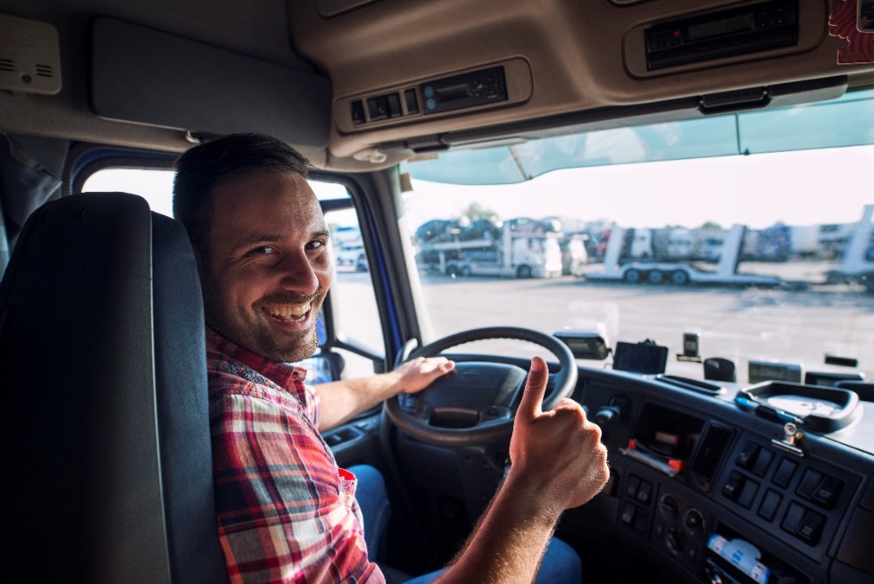
Seat Adjustment
Sit in a neutral posture
Adjust the vertical position
Adjust backward/forward
Fasten seatbelt
  Check that it’s not loose, damaged, or twisted. It needs to fit snugly across the hips and be centred on your shoulder
Notes:
SAY: Adjust your seat before you start the vehicle:
Sit in a neutral posture to support your spine, with your neck and back in an upright position.
Adjust the vertical position first, so that your left foot rests on the floor without pressure on the underside of the leg.
Adjust backward/forward so that your right knee bends slightly as your foot rests on the accelerator.
When attaching your seat belt, check that it’s not loose, damaged, or twisted. It needs to fit snugly across the hips and be centred on your shoulder (never tucked behind your body or under your arm).

Slide 44
Adjust Your Mirrors
Correct mirror adjustment is essential for the safe operation of a commercial vehicle.
Check and adjust each time to have the best possible view around the truck and trailer
  Danger Zone: area where pedestrians and objects are most at risk
  No Zone: blind spots and areas where cars are so close that your ability to manoeuvre is limited
Flat mirrors are for monitoring traffic and checking side and rear clearances and convex mirrors are used to monitor the left and right sides at a wide angle
There is a blind spot immediately below and behind each mirror, directly in front of the vehicle, and directly behind the rear bumper.
Notes:
SAY: Different vehicles have different mirror configurations. Adjust them to eliminate blind spots and minimize the “danger zone” - the area around the tractor-trailer where pedestrians and other objects are at the most immediate risk. In order to have the best possible view around the truck and trailer, ensure you check and adjust all mirrors each time before setting out on the road .
Some instructors may use the term “no zone” – blind spots and areas where cars are so close that your ability to manoeuvre is limited
Flat mirrors to the left and right of the windshield are for monitoring traffic and checking side and rear clearances. There is a blind spot immediately below and behind each mirror, directly in front of the vehicle, and directly behind the rear bumper.
Convex mirrors are located below the outside flat mirrors. They are used to monitor the left and right sides at a wide angle. These mirrors present a view of people and objects that does not accurately reflect their size, distance, and position from the vehicle. Objects will appear smaller and farther away.
Reference: Mirror adjustments are in Lesson 5 of the Textbook, under Basic Driving Maneuvers – Starting the Vehicle – Adjust Your Mirrors.

Slide 45
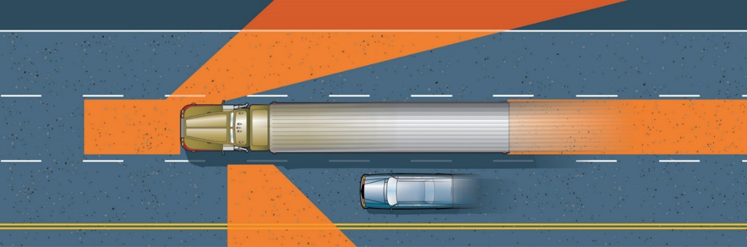
Blind Spots
The areas around your vehicle you cannot see using your mirrors. Turn your head and re-position yourself to get a better view.
The bigger the vehicle – The bigger the blind spots
The smaller the vehicle – the easier it is to lose them in a blind spot
Notes:
SAY: A tractor-trailer has three large blind spots. One of these blind spots is an area alongside your vehicle that you can't see with your mirrors. It's important to check these blind spots to ensure your side gates are open, particularly if you are going to change lanes. You may need to turn your head or re-position yourself to see better.
Blind spots can be problematic for a regular sized vehicle, something to remember: The bigger the vehicle, the bigger the blind spot!

Slide 46
Adjust Your Mirrors
Flat Mirrors
Mounted on the left and right at the front of the windshield
Used to monitor traffic and check clearances on the sides and to the rear of the vehicle
Convex Mirrors
Located below the outside flat mirrors
Used to monitor the left and right sides at a wide angle
Provide a view of traffic and clearances at the side of the vehicle
Objects will appear smaller and farther away.
Notes:
SAY: Flat mirrors to the left and right of the windshield are for monitoring traffic and checking side and rear clearances.
There is a blind spot immediately below and behind each mirror, directly in front of the vehicle, and directly behind the rear bumper.
Convex mirrors are located below the outside flat mirrors. They are used to monitor the left and right sides at a wide angle. These mirrors present a view of people and objects that does not accurately reflect their size, distance, and position from the vehicle. Objects will appear smaller and farther away.
Position them so you can see:
A small portion of the entire side of the vehicle up to the mirror mounts
Approximate location of where rear tires touch the ground
At least one traffic lane on either side of the vehicle

Slide 47
Adjust Your Mirrors
Set the left mirror so you can see:
60 metres (four vehicle lengths) behind the vehicle
The top of the vehicle
A small portion of the sides of the vehicle
The rear tires touching the ground
Set the right mirror so you can see:
The right side of the vehicle along the left inside edge of the mirror
The horizon line three-quarters of the way up the mirror
Notes:
SAY:
Set the left mirror so you can see:
60 metres or four vehicle lengths behind the vehicle
The top of the vehicle
A small portion of the sides of the vehicle
The rear tires touching the ground
Set the right mirror so you can see:
The right side of the vehicle along the left inside edge of the mirror
The horizon line three-quarters of the way up the mirror

Slide 48
Starting Your Engine
If the unit is equipped with glow plugs, wait for the light to go out before starting the engine
Manual transmission:
  Ensure parking brake is applied
  Ensure vehicle is in neutral and the clutch is depressed
If the engine does not start, turn the starter off and try again in 60 seconds
Ensure no warning lights are on, and gauges are reading correctly
Warmup procedures are needed to ensure engine is properly lubricated and pressurized before driving
Always follow the manufacturer’s manual for proper starting and engine warmup procedures.
Notes:
SAY: With the seat, seat belt, and mirrors all set, you’re ready to start the engine.
If the unit is equipped with glow plugs, wait for the light to go out before starting the engine.
For manual transmissions, ensure that the parking brake is applied, the vehicle is in neutral, and the clutch is depressed. For automatics, check the manufacturer’s manual for recommended procedures.
After starting, confirm the oil pressure is good, and ensure no warning lights are on, and check that gauges are reading correctly. All gauges must be functioning; otherwise you must not operate the truck. Engine warmup procedures are needed to ensure the engine is properly lubricated and pressurized before driving.
You should follow your manufacturer’s manual for specific warm up procedures for your vehicle, but in general engine warm up is complete when the temperature reached has reached anywhere from 170-195 degrees F.
Reference: Steps on starting your engine are in Lesson 5 of the Textbook, Basic Driving Manoeuvres – Starting the vehicle.

Slide 49
Basic Driving and Manoeuvres
  After completing this section, you should be able to:
  Explain the importance of following all manoeuvring procedures in order to ensure safety
Notes:
DO: Read slide.

Slide 50
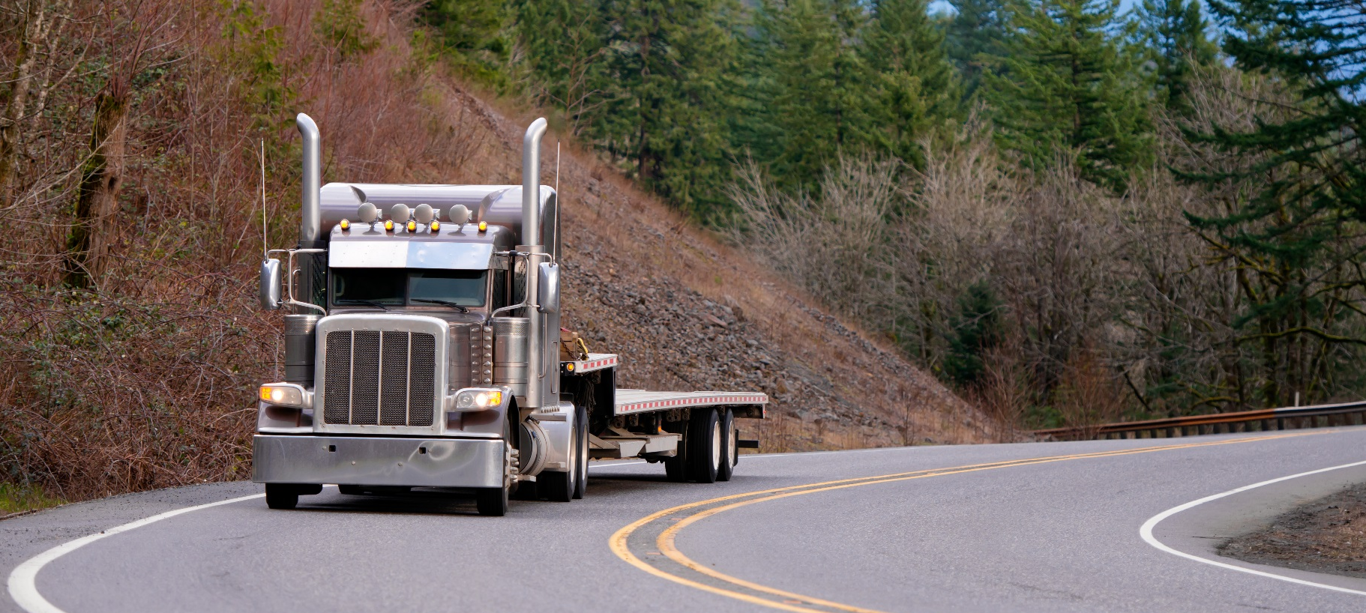
Tractor-Trailer Manoeuvers
Notes:
DO: Play video about intersections, turns, stopping, defensive driving, and merging. The following videos are available on the MELT curriculum website for your use in the classroom:
https://apps.mpi.mb.ca/MELT/videos/Passing%20following.wmv
https://apps.mpi.mb.ca/MELT/videos/Intersections.wmv
Recommendation: Play a video of your choice here to demonstrate turning.
Reference: Information on curves, lane changes and turns are in Lesson 5 of the Textbook, Basic Driving Manoeuvres – Braking.

Slide 51
Shifting Gears, Accelerating and Decelerating
You want to avoid having to change speeds, especially quick changes, as much as possible.
Highway driving: Match the flow of traffic and use cruise control (if road surface and traffic/weather conditions ideal)
In urban areas, anticipate stoppages at intersections.
Look ahead 12 seconds and maintain safe following distance
Clutch pedal positions:
Engaged
Free play
Disengaged
Clutch brake
Notes:
SAY: In general, you want to avoid having to change speeds, especially quick changes, as much as possible. For highway driving, try to match the flow of traffic and use cruise control where appropriate (ideal road surface and traffic/weather conditions).
In urban areas, anticipate stoppages at intersections. Looking ahead 12 seconds down the road and maintaining a safe following distance gives you the necessary space to slow down, accelerate, or change lanes safely and smoothly.
Your truck’s gear lever may have a range control and possibly a splitter. The range control provides a low-range and high-range for each gear. The splitter splits the high-range into “direct” and “overdrive”. Your instructor will provide details on how to use the range control and splitter.
It is also important to know the four clutch pedal positions and how each is used.
Engaged- When the pedal is all the way up (engine/transmission is connected).
Free play- When the pedal is about 1-1.5 inches from the top position (slack in the linkage).
Disengaged- When the pedal is about halfway down (engine/transmission is disconnected).
Clutch brake- When the pedal is pushed all the way to the floor.
DO: Show video below or similar for clutch pedal positions.
Reference: https://www.youtube.com/watch?v=9-KQSxqhQrM
The following slides provide detail on shifting with a standard synchronized transmission. Non-synchronized (double clutching) information can be found in the Shifting Gears, Accelerating and Decelerating section of your textbook. Road test applicants can double clutch, clutch, or not use the clutch as long as the shifting is smooth with no excessive grinding without being assessed marks.
Reference: Information on slowing down is in Lesson 5 of the Textbook, Basic Driving Manoeuvres – Shifting Gears, Accelerating and Decelerating.
See Driving Behind Vehicles in Section 6 for information on safe following distance.

Slide 52
Upshifting
Upshifting Standard Synchronized Transmissions
Check for the gear pattern
Depress the clutch pedal and shift into the
appropriate gear
Depress the foot brake (same time as 2)
Release the parking brake
Release the clutch to the friction point
Remove foot from the brake pedal, and accelerate gradually
Notes:
SAY: Standard Synchronized Transmission
Familiarize yourself with the gear pattern by checking the chart on the gear shift lever or the dash. Check to determine the starting gear recommended under normal circumstances for your truck.
Depress the clutch pedal and shift into the appropriate gear (two and three are interchangeable).
Depress the foot brake (two and three are interchangeable).
Release the parking brake.
Release the clutch to the friction point.
Remove your foot from the brake pedal, place it on the accelerator pedal, and accelerate gradually.
(Steps 7-11 continued on next slide)
Reference: Information on upshifting is in Lesson 5 of the Textbook, Basic Driving Manoeuvres – Shifting Gears, Accelerating and Decelerating.

Slide 53
Upshifting - Continued
Remove your foot from the clutch slowly and place it completely on the floor, while continuing to accelerate.
  Do not ride the clutch!
Accelerate the tractor-trailer to the proper engine speed before attempting to shift
When appropriate to shift gears, depress the clutch pedal and release accelerator at the same time
Shift into the next gear
Smoothly release the clutch and continue to accelerate gradually
Notes:
SAY:
7. Remove your foot from the clutch slowly and place it completely on the floor while continuing to accelerate.
Do not ride the clutch!
8. Accelerate the truck to the proper engine speed before shifting into the next higher gear. With practice, you will learn to feel and hear the proper engine speed for shifting.
9. Depress the clutch pedal and release the accelerator simultaneously.
10. Shift into the next gear.
11. Smoothly release the clutch and continue to accelerate gradually.

Slide 54
Downshifting
Downshifting Standard Synchronized Transmissions
Reduce speed, depress clutch, and release
accelerator.
Shift to next lower gear.
Release clutch smoothly and use accelerator to provide engine power appropriate to terrain.
Repeat these steps to continue downshifting as the proper engine speeds are reached.
To stop completely, apply brake, gradually increasing pressure, and depress clutch after reducing speed to between 8-16 km/h.
    Don’t coast - Always downshift to a stop.
Notes:
SAY:
Reduce speed, depress the clutch, and release the accelerator.
Shift to the next lower gear.
Release the clutch smoothly and use the accelerator to provide engine power appropriate to the terrain.
Repeat these steps to continue downshifting as the proper engine speeds are reached.
To stop completely, apply the brake, gradually increasing pressure, and depress the clutch after reducing speed to between 8-16 km/h.
To avoid damaging the clutch brake, don’t coast to a stop (depressing the clutch at too high a speed and then holding it while braking to a stop). Always downshift to a stop.
Reference: Information on downshifting is in Lesson 5 of the Textbook, Basic Driving Manoeuvres – Shifting Gears, Accelerating and Decelerating.

Slide 55
Braking
When applying brakes
Apply even pressure to the brake pedal
Ease off as the vehicle slows down
Release the pedal to avoid a sudden jerk or rebound
Depress the pedal again to hold the vehicle while it is stopped
Continually monitor your brakes
  If there is a low air pressure warning, stop as soon as possible in a safe place, and increase the air pressure before continuing.
Notes:
SAY:
When applying brakes
Apply even pressure to the brake pedal
Ease off as the vehicle slows down.
Just before the stop, release the pedal to avoid a sudden jerk or rebound.
Depress the pedal again to hold the vehicle while it is stopped.
Continually monitor your brakes
If there is a low air pressure warning, stop as soon as possible in a safe place, and increase the air pressure before continuing.
You will learn to use both your transmission and engine retarder (or “jake brake”) to slow your vehicle, and apply the brakes only when coming to a complete stop.
Reference: Information on braking is in Lesson 5 of the Textbook, Basic Driving Manoeuvres – Braking.

Slide 56
Braking
For braking on downhills:
Before descending, test the brakes.
Look at the air pressure gauge, apply the brakes, and check for abnormal air pressure loss.
Use brakes sparingly.
Downshift before going over the top of the hill, and use engine compression to control your speed on steep grades.
Avoid pumping air brakes.
Be aware that if the trailer hand valve is used too much, the trailer brakes may fail
  This unbalanced braking may cause jackknifing
Notes:
SAY:
For braking on downhills:
Before descending, test the brakes. Look at the air pressure gauge, apply the brakes, and check for abnormal air pressure loss. Do not proceed if there is abnormal pressure loss.
Use brakes sparingly. Downshift before going over the top of the hill, and use engine compression to control your speed on steep grades.
Avoid pumping air brakes. Doing so results in a loss of air pressure.
If the trailer hand valve is used too much, particularly on steep hills, the trailer brakes may fail. Use of the trailer hand valve only is not recommended as it leads to a greater wear on the trailer brakes than the tractor brakes. This causes unbalanced braking between the tractor and the trailer, which could cause the unit to jackknife.
Reference: Information on braking is in Lesson 5 of the Textbook, Basic Driving Manoeuvres – Braking.
See Section 6 for more information on driving on downhills, emergency braking, and loss of brakes.

Slide 57
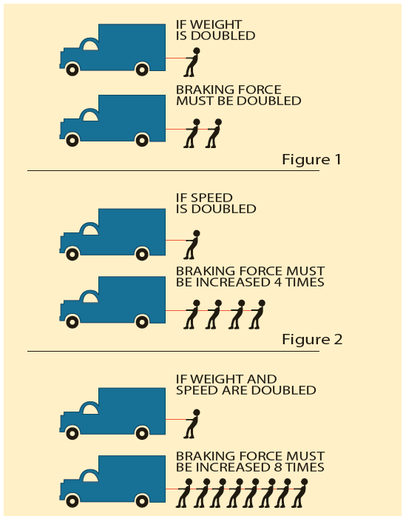
Stopping Distance
Four factors affect stopping time:
Perception Time
Reaction Time
Lag Time
Braking Time
Notes:
SAY: Stopping time is the sum of four factors:
Perception time - time it takes you to realize the need to stop the vehicle. The average perception time is about 0.75 seconds. Perception distance is how far a vehicle travels during perception time.
Driver reaction time - time it takes you to apply the brakes after realizing the need to do so. Normal reaction time is about 0.75 seconds. Reaction distance is how far a vehicle travels during driver reaction time.
Lag time - time for the brakes to respond after you depressed the brake pedal. It takes about 0.4 seconds for the compressed air to flow through the system and apply the brakes. Lag time distance is how far a vehicle travels during lag time.
Braking time - time it takes for the vehicle to come to a complete stop after the brakes are applied.
The 6 parts of braking time is continued on the next slide.
Reference: Information on slowing down is in Lesson 5 of the Textbook, Basic Driving Manoeuvres – Stopping Time and Stopping Distance.

Slide 58
Braking Time
Time it takes to come to a complete stop after the brakes are applied depends on these factors:
Braking force
Brake condition
Traction
Weight
Speed
Grade/Slope
Notes:
SAY: The time it takes for the vehicle to come to a complete stop after the brakes are applied depends on these factors:
Braking force - The stronger the force, the quicker the braking.
Brake condition – All the brakes must work together. If one or more brakes are not properly aligned or maintained, the remaining brakes will have to generate more friction, and it will take longer to stop the vehicle.
Traction - Traction is the friction between the road surface and the tire. Traction depends on several factors: road condition, tire contact with the road surface, tire condition and inflation, and vehicle weight.
Weight - A heavy vehicle, even though it has better traction, needs more time and distance to stop. When the weight is doubled, the amount of force needed to stop the vehicle is doubled, and it will take about twice as long for that vehicle to stop.
Speed - The greater the speed, the more time and distance are needed to stop. For example, doubling the vehicle speed means that four times the braking force is required to bring the vehicle to a stop.
Grade/Slope - Gravity causes longer stopping distances when going downhill, and shorter stopping distances when going uphill.
Reference: Information on slowing down is in Lesson 5 of the Textbook, Basic Driving Manoeuvres – Stopping Time and Stopping Distance.

Slide 59
Exercise: 3
Time: 20 minutes
Complete Exercise 3: Basic Driving Manoeuvres
Notes:
SAY: You will have 20 minutes to complete Exercise 3 in the Exercise Book.
Do: Review the answers for each exercise, using the Exercise Book - Answer Key.

Slide 60
Curves
When large vehicles enter a curve, the rear wheels do not follow the same path. The rear wheels will track closer to the outside of the lane than the front wheels. There are two types of off-tracking:
Low speed off-tracking is common when driving in a city. In slower turns, the rear tires are pulled inward of the steering path.
High speed off-tracking is the effect of outward force. You can see it when a vehicle travels at higher speeds, and the rear tires pull outward from the steering path during a turn.
Notes:
SAY: When large vehicles enter a curve, the rear wheels do not follow the same path as the front because they do not pivot. The rear wheels will track closer to the outside of the lane than the front wheels. This is called off-tracking.
There are two types of off-tracking:
Low speed off-tracking is common when driving in a city. In slower turns, the rear tires are pulled inward of the steering path. The longer the wheelbase of the vehicle or the tighter the turn, the more off-tracking.
High speed off-tracking is the effect of centrifugal (outward) force. You can see it when a vehicle travels at higher speeds, and the rear tires pull outward from the steering path during a turn.
The greater the distance (wheel base) between the front wheels and the rear wheels of the vehicle, the greater the amount of off-tracking.
DO: Refer students to the chart in the Curves section in the Textbook.
Reference: Information on curves is in Lesson 5 of the Textbook, Basic Driving Manoeuvres – Curves.

Slide 61
Driving Through a Curve
    Refer to the chart in Chapter 5 “Curves” section of your textbook.
Notes:
SAY: Accelerate gently through a curve to counter the centrifugal force that could direct you off the highway. Gentle acceleration encourages the wheels to go straight and provides greater control.
DO: Refer students to the chart in the Curves section in the Textbook, and review each section, including Approaching the Curve, Right Curves, Left Curves, and Exiting the Curve.

Slide 62
Lane Changes
Plan the change well in advance
In dense traffic:
  Assess your gaps and gates
  Check for clearance from both windows and mirrors.
  Check for vehicles approaching quickly from behind
Signal your intent before beginning the lane change
Give other motorists time to adjust their positions as required
After completing the lane change, cancel the turn signal
Notes:
SAY: Change lanes only when necessary. If you decide to change lanes:
Plan the change well in advance.
In dense traffic:
Assess your gaps and gates.
Check for clearance from both windows and mirrors.
Check for vehicles approaching quickly from behind that may want to overtake you.
Signal your intent before beginning the lane change, and give other motorists time to adjust their positions as required.
After completing the lane change, cancel the turn signal.
Use the concept of gates to help you manage space around you. Try to avoid having closed gates directly to your left or right. With these gates closed, it’s hard to change lanes safely if needed.
Reference: Information on lane changing is in Lesson 5 of the Textbook, Basic Driving Manoeuvres – Lane Changes.

Slide 63
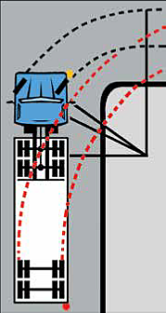
Turns
Always SEE the turn by following these guidelines:
Plan ahead
Use your turn signals
  30 m from intersection (150 m outside city)
Stopping before turning
Account for off-tracking
Manage speed appropriately,
  braking or hard acceleration in a turn can cause jackknifing
Use the hand-over-hand steering technique
Be fully aware of your surroundings
  Look ahead at least 12 seconds when performing a turn
Choose the proper lanes
Notes:
SAY: For any kind of turn, left or right, always SEE the turn by following these guidelines:
Plan Ahead - Determine what you need to do to make a safe turn.
Use Your Turn Signals - Provide appropriate warning, according to driving conditions. As a guide, signal about 30 metres from the intersection (150 metres outside cities, towns, or villages).
Stopping before Turning - If you have to stop at an intersection before turning, stop far enough back to give yourself the space you need to make the turn.
Account for Off-Tracking (refer to visual) – This is when the rear of the vehicle follows a path different from the front. Off-tracking causes you to need a wide area of roadway to turn safely
You often have to enter adjacent lanes, and risk interfering with vehicles in those lanes, running over curbs, or striking fixed objects off the road surface, such as light or sign posts.
Manage Speed Appropriately - Reduce your speed and downshift to the proper gear before you start turning, then “power through” the turn at a controlled and safe speed. This is especially important on slippery/uneven surfaces, because braking or hard acceleration in a turn can cause jackknifing (see Section 6).
Use the Hand-over-hand Steering Technique - As you push the steering wheel up, across, and down with one hand, reach up to the top of the wheel and pull down with the other hand.
Be Fully Aware of Your Surroundings - Continually watch out and be aware of traffic, signals, signs, pedestrians in all directions. Look ahead when performing a turn – at least 12 seconds down the intended lane of travel as you turn.
Choose the Proper Lanes - take extra care to avoid interfering with other traffic.
Reference: Information on turns is in Lesson 5 of the Textbook, Basic Driving Manoeuvres – Turns.

Slide 64
Choose the Proper Lanes
Whenever possible, turn from the proper lanes.
If you have to drive over a lane or centre lines to negotiate sharp turns, take extra care to avoid interfering with other traffic
If an intersection has two turn lanes side-by-side, use the right-most lane for left turns, and the left-most lane for right turns.
Notes:
SAY:
Whenever possible, turn from the proper lanes. If you have to drive over a lane or centre lines to negotiate sharp turns, take extra care to avoid interfering with other traffic
If an intersection has two turn lanes side-by-side, use the right-most lane for left turns, and the left-most lane for right turns. This gives you a larger turning arc and keeps other vehicles visible in your rear-view mirror.
Reference: Information on turns is in Lesson 5 of the Textbook, Basic Driving Manoeuvres – Turns.

Slide 65
Turning Manoeuvres
There are specific manoeuvres to use for specific turning situations:
Button Hook: the only room available to manoeuvre is in the intersection
Extended Approach: turning from a busy street to one with ample room
Lane Straddling: turning into a street that’s very narrow
  Avoid using this manoeuvre unless no other option is available.
    Refer to the chart in Chapter 5 “Turning Manoeuvres” section of your textbook.
Notes:
DO: Refer students to the chart “Turning Manoeuvres” in Chapter 5.
SAY: There are specific manoeuvres to use for specific turning situations:
Button Hook: For turning when the only room available to manoeuvre is in the intersection
Extended Approach: For turning from a busy street to one with ample room to manoeuvre.
Lane Straddling: For turning into a street that’s very narrow or has limited space.
Avoid using this manoeuvre unless no other option is available.
Reference: Diagrams on turning manoeuvres are in Lesson 5 of the Textbook, Basic Driving Manoeuvres – Turning Manoeuvres.

Slide 66
Left Turn Manoeuvres
When you have to make a left turn, always:
Approach in the lane closest to the centre line or median.
Signal left, and continually check mirrors and watch for traffic around you.
If you have to yield for vehicles or pedestrians, keep your wheels straight to avoid being pushed into oncoming traffic if you’re struck from behind.
Notes:
SAY:
In general, try to avoid having to make left turns. But when you have to make a left turn, always:
Approach in the lane closest to the centre line or median.
Signal left, and continually check mirrors and watch for traffic around you.
If you have to yield for vehicles or pedestrians, keep your wheels straight to avoid being pushed into oncoming traffic if you’re struck from behind.
DO: Refer students to the chart “Left Turn Manoeuvres” in Chapter 5.

Slide 67
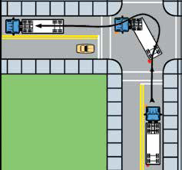
Left Turn – Button hooks
    Refer to the chart in Chapter 5 “Left Turn Manoeuvres” section of your textbook.
Notes:
DO: Refer students to the chart “Left Turn Manoeuvres” in Chapter 5.
SAY:
With Left Button Hooks:
Ensure no traffic is beside you.
When the tractor is in the intersection, steer right. Just as the trailer enters the right lane, and when it’s safe, steer quickly left.
Continue scanning the intersection and watching the trailer to avoid jumping the median curb or colliding with stopped traffic.
Be careful at the sharpest point of the turn in relation to the trailer, because left rear view mirror vision will be limited.
Steer into the lane closest to the centre line or median and the trailer will follow.

Slide 68
Left Turn – Extended Approach
    Refer to the chart in Chapter 5 “Left Turn Manoeuvres” section of your textbook.
Notes:
DO: Refer students to the chart “Left Turn Manoeuvres” in Chapter 5.
SAY:
With Extended Approach:
Scan the intersection for any potential dangers and take the necessary precautions.
Drive straight into the intersection, and start turning when your vehicle is well into the intersection. Check the left mirror and make sure the wheels do not run into traffic or over the median.
Continue turning until the vehicle is around the corner and end the turn in the lane closest to the centre line or median.

Slide 69
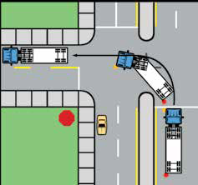
Left Turn – Lane Straddling
    Refer to the chart in Chapter 5 “Left Turn Manoeuvres” section of your textbook.
Notes:
DO: Refer students to the chart “Left Turn Manoeuvres” in Chapter 5.
SAY:
With Lane Straddling:
Move into the lane to your right only enough to make the turn safely. Watch the trailer to keep it within 1.5 m of the centre line or median.
As you enter the intersection, steer left, watching for potential dangers. Steer to avoid jumping the curb with your tractor wheels. Also watch the trailer to avoid colliding with something or jumping the curb on the median.
The critical point is when the tractor is at the sharpest point of the turn in relation to the trailer, as the left rear view mirror vision is limited.
Steer into the lane closest to the centre line and the trailer will follow. The turn should be completed in this lane.

Slide 70
Right Turn Manoeuvres
For all right turn manoeuvres:
Approach in the curb lane or the lane furthest to the right
Signal right, check mirrors, and continually watch for traffic
Watch for anyone trying to squeeze through on the right side
Look for obstructions in the intended lane of travel
Treat any obstructions as an extension of the curb
Do not change gears from the start of the turn until the left rear tire of the trailer safely clears the tightest point of the turn
Notes:
SAY:
For all right turn manoeuvres:
Approach in the curb lane or the lane furthest to the right.
Signal right, check mirrors, and continually watch for traffic around you.
Watch for anyone (vehicles, bikes, pedestrians) trying to squeeze through on the right side.
Look for obstructions in the intended lane of travel, such as parked cars. Treat any obstructions as an extension of the curb.
Do not change gears from the start of the turn until the left rear tire of the trailer safely clears the tightest point of the turn.
DO: Refer students to the chart “Right Turn Manoeuvres” in Chapter 5.

Slide 71
Right Turn – Button hooks
Notes:
DO: Refer students to the chart “Right Turn Manoeuvres” in Chapter 5.
SAY:
With Right Button Hooks:
As you approach the intersection, ensure no traffic is beside you.
When you are close to the intersection, steer left. Watch the trailer. As it starts to pull away from the curb, steer quickly right.
Continue scanning the intersection and watching the trailer to avoid jumping the curb (but stay within 1.5 metres of the curb).
Be careful at the sharpest point of the turn in relation to the trailer, because right mirror vision will be limited.
Steer into the curb lane and the trailer will follow. Complete the turn in this lane.

Slide 72
Right Turn – Extended Approach
Notes:
DO: Refer students to the chart “Right Turn Manoeuvres” in Chapter 5.
SAY:
With Extended Approach:
Scan the intersection for any potential dangers and take the necessary precautions.
Drive straight into the intersection, and start turning when your vehicle is well into the intersection.
Use the right mirror to check the trailer position - avoid jumping the curb while staying within 1.5 metres of the curb.
Continue turning until the vehicle is around the corner and end the turn in the lane closest to the curb.

Slide 73
Right Turn – Lane Straddling
Notes:
DO: Refer students to the chart “Right Turn Manoeuvres” in Chapter 5.
SAY:
With Lane Straddling:
When safe, move into the lane to your left only enough to make the turn safely.
As you enter the intersection, steer right, watching for potential dangers.
Use the right mirror to check the trailer position - avoid jumping the curb while staying within 1.5 metres of the curb.
Be careful at the sharpest point of the turn in relation to the trailer, because right mirror vision will be limited.
Steer into the curb lane and the trailer will follow. Complete the turn in this lane.

Slide 74
Exercises: 4 and 5
Time: 30 minutes
Complete Exercise 4: Curves, Lane Changes & Turns
Complete Exercise 5: Turning Manoeuvres
Notes:
SAY: You will have 30 minutes to complete Exercise 4 and 5 in the Exercise Book.
Do: Review the answers for each exercise, using the Exercise Book - Answer Key.

Slide 75
Review
Whose responsibility is it to ensure everything regarding the vehicle is in proper working order?
Answer: The driver
Notes:
In the review slides, click to reveal the answers.

Slide 76
Review
To prevent falls or injuries, drivers must maintain ______ point contact when entering or exiting the cab.
Answer: 3
Notes:
DO: Click to reveal the answers.

Slide 77
Review
Proper mirror adjustments allow for what?
Answer: Better view of ‘no zones’ and ‘danger zones’.
Notes:
DO: Click to reveal the answers.

Slide 78
After-Class Assignment
You will:
Complete any questions that you haven’t finished in the Exercise Book.
We will review any questions you have at the beginning of next class.
Notes:
DO: Read slide. You may choose to show this video about collision prevention for review:
https://apps.mpi.mb.ca/MELT/videos/Determining%20preventability.wmv

Slide 79
Summary
You should now be able to:
Prepare and start to drive a commercial vehicle
Comply with operational regulations that apply to commercial vehicles
Operate a commercial vehicle in a safe manner
Perform basic driving manoeuvres
Notes:
DO: read slide

Slide 80
Quiz
Lesson 5 Quiz
30 minutes to complete
Notes:
SAY:
You will have 30 minutes to complete the lesson quiz.

Slide 81
Practical In-Cab Training
Practical Time In-Cab
30 minutes in-yard observing
30 minutes in-yard demonstrating
30 minutes in-cab observing
19 hours in-cab demonstrating
(in total)
Notes:
SAY:
The Practical Training and Assessment for Lesson 5 Basic Driving Strategies includes a demonstration of basic driving manoeuvres, starting the vehicle, shifting gears, accelerating, decelerating, braking, curves, lane changing, and turns.
You will now head out to the yard where an instructor will spend time demonstrating how to perform these activities and manoeuvres then you will do the same techniques and practice the manoeuvres as the driver. You may wish to take your exercise book or textbook with the procedure job aid. Each time you attempt the activities, your instructor will provide you with a copy of your in-yard assessment which you should review to improve your skills in this area.
DO:
At the end of the classroom session, the instructor and the students will proceed to the yard for the in-yard and in-cab activities. The instructor will have about 30 minutes in-yard first, then 30 minutes in-carb to demonstrate all of these activities to the student, after which the student will perform the activities. The students will have a minimum of 30 minutes to demonstrate their learning in-yard before they go in-cab and on-road. This time may be split up and used smaller increments throughout the length of the course. Decisions about how to organize yard time will need to flex with each class based on numbers of students, available instructors for proper yard ratio and physical training space. Instructor will evaluate students using the practical assessment sheet. The list may then be shared with the student to improve their performance. Use one practical assessment sheet each time the student performs the activities. Students are encouraged to bring their textbook and/or exercise book with the lists of procedures and checklists during the time they are applying their learning.

Slide 82
Practical In-Cab Assessment
Practical In-Cab Assessment
Time: 30 minutes to complete
Notes:
SAY:
You will now have a practical assessment where your instructor will assess your understanding and skill competency. This assessment will count towards your final course mark.
DO:
Using the in-yard assessment, the instructor will grade students on the skill competency for this lesson. A minimum of 30 minutes will be used for in-yard assessment.

