Slide 1
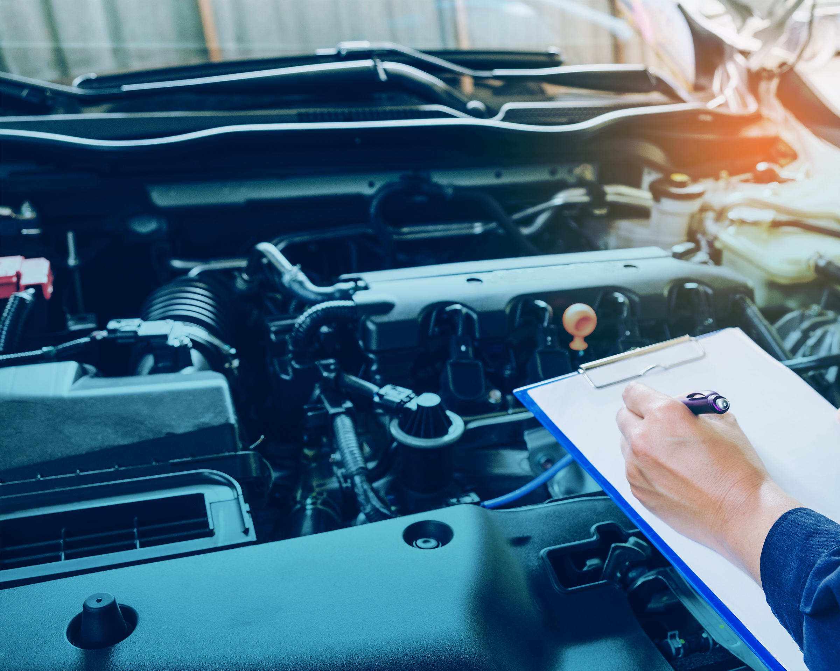
Professional Driving Techniques
Lesson 6

Slide 2
Learning Objectives
After completing this lesson, you should be able to:
Apply defensive driving techniques
Recognize common situations that lead to collisions
Understand the habits that are key to preventing collisions
Notes:
SAY: Read slide

Slide 3
Pre-Class Assignment
You will have:
Reviewed the textbook and other materials.
Any questions about Lesson 5?
Notes:
SAY:
After the last class, you were asked to review the material from Lesson 5.
Do you have any questions about that lesson?
Do: Answer any questions that may come up.

Slide 4
Awareness on the Road
  After completing this section, you should be able to:
  Explain the location and proper use of truck emergency runaway lanes
  Describe the considerations of crossing at railroad crossings
  Explain the importance of being fully alert when driving
  Recognize common situations that lead to collisions
  Describe methods to practice collision avoidance
Notes:
SAY: Read slide

Slide 5
Situations That Can Cause Collisions
There are many situations that can cause collisions:
Driving Behind Vehicles
Driving Ahead of Vehicles
Intersections
Merging, Entering, and Exiting
Railway Crossings
Mountain Driving and Grades
Driving in Difficult Weather Conditions
Driving on Gravel
Notes:
SAY: These are some situations that can cause collisions. We will be discussing these in more detail.

Slide 6
Determining Safe Following Distance
Collisions with vehicles ahead of you often results from following too close.
Use this formula to calculate safe following distance:
Length of your vehicle in metres divided by 3 = x
(where x is the number seconds of safe following distance)
  Example: What is the safe following distance for a 21 metre vehicle?
Notes:
SAY: Collisions with vehicles ahead of you are often caused by following too close.
A safe following distance can be determined by the number of seconds between when the vehicle ahead passes a stationary object (such as a power pole) and when you arrive at it.
Use this formula to calculate a safe following distance:
Length of your vehicle in metres divided by 3 = x seconds for a safe following distance.
No matter how long the vehicle, always keep at least 4 seconds of following distance
ASK: What is the safe following distance for a 21 metre vehicle?
DO: Write this example on the board/chart paper: 21/3 = 7 seconds.
Reference: Safe following distances are listed in Lesson 6 of the Textbook, under Advance Driving Manoeuvres.

Slide 7
Additional Following Distance
Increase your following distance even more:
When following:
Oversize vehicles
Dangerous goods carriers
Vehicles that stop frequently
Motorcycles or bicycles
Vehicles being driven erratically
Emergency vehicles
In these situations:
Poor visibility, snow, or rain
Mechanical problems
Slippery and/or wet conditions
Where traffic intersects, merges, or converges
OR
Notes:
SAY:
Increase your following distance when following:
Oversize vehicles that obscure your vision
Dangerous goods carriers
Vehicles that stop frequently, such as delivery vans, school buses, etc.
Motorcycles or bicycles
Vehicles being driven erratically
Emergency vehicles
Or in these situations:
Poor visibility, snow, or rain
Mechanical problems
Slippery and/or wet conditions
Where traffic intersects, merges, or converges
Reference: Following distances are listed in Lesson 6 of the Textbook, under Advance Driving Manoeuvres.

Slide 8
Why Are You Passing?
Ask yourself these questions:
What will I gain by passing?
Is it worth the risk?
Is the pass necessary?
Will I have to exceed the speed limit to pass?
Notes:
SAY: Passing a slower vehicle is acceptable if done safely and within the speed limit. But before you decide to pass, consciously ask yourself (like commentary driving – see Section 5):
What will I gain by passing?
Is it worth the risk?
Is the pass necessary?
Will I have to exceed the speed limit to pass?
You may decide you don’t need to pass after all.
Pass on two lane roads only when absolutely necessary. Choose a safe place with good visibility and the right traffic conditions to allow a safe gap.

Slide 9
Driving Ahead of Vehicles
Most motorists would rather drive in front of a big truck rather than behind. These drivers will take unnecessary risks such as:
Tailgating (driving too close behind another vehicle)
Follow the leader (series of vehicles pass at the same time)
To mitigate the risk:
Be aware of tailgaters
Increase your following distance
Stay as far right in the lane as safely possible to allow them to pass
Never do a “brake check” as a warning to a tailgater
Notes:
SAY: Other drivers should use safe following distances when travelling behind you, but they often don’t. Most motorists would rather drive in front of you than behind you. Some drivers take unnecessary risks, such as tailgating or following the leader.
A tailgater is someone driving too close behind your vehicle. Tailgaters may dart out to make a pass, or pop in and out to assess whether to pass. Bad weather often attracts more tailgating, because the tailgaters want to use your vehicle as a kind of beacon or protective shield from the conditions.
Following the leader is when a series of vehicles pass you at the same time, even when the second and subsequent vehicles have extremely limited visibility.
You can’t control how closely other vehicles follow you, but you can take measures to mitigate the risks:
Be aware of tailgaters.
If you have a tailgater, increase your following distance from the vehicle ahead to give yourself more time to react, if needed.
Make it easier for the tailgater to pass safely. Stay as far right in the lane as safely possible, and be patient. If you are driving at the speed limit, try slowing down slightly. Even if slowing down doesn’t stop the tailgating, it is better to be tailgated at a lower speed.
Never do a “brake check” (a sudden application of the brake) as a warning to a tailgater to pass or back off. This may cause the tailgater to panic, and dangerously swerve or brake suddenly.

Slide 10
When Being Passed
Mitigate the potential hazards and make it easier for other vehicles to pass:
Maintain your lane position, either in the centre of the lane or slightly to the right to allow the passing vehicle extra clearance
Maintain or reduce your speed
After they pass, slow down to ensure a safe following distance behind them
Depending on the situation, braking may be necessary
If the passing vehicle driver decides to abort the pass and return behind you, give them space to pull back into the lane safely
Notes:
SAY: When you’re being passed:
Maintain a lane position in the centre or slightly to the right of the lane, to give the passing vehicle enough clearance.
Maintain or reduce your speed.
If the passing vehicle cuts in too quickly after the pass, slow down (brake if necessary) to ensure a safe following distance.
If the passing vehicle driver decides to abort the pass and return behind you, give them space to pull back into the lane safely.
Avoid flashing your lights or hazards as a signal that the passing vehicle can safely cut back into the driving lane. The lights may blind or confuse the driver; truck drivers will understand what you mean, but not the average motorist.
If you’re being passed on a multi-lane highway, avoid edging too far to the other side and encroaching on the other lane.

Slide 11
Review
How do we measure space?
Answer: In seconds
How do you determine your following distance in a truck?
Answer: Total length to the nearest metre divided by 3
Notes:
DO: Click to reveal answers, one at a time.

Slide 12

Intersections
Plan ahead for intersections:
Gradually slow down and cover the brake
Always be prepared to stop
Scan the area
Never assume other drivers will obey rules of right of way
Look left and right twice
Ensure no approaching vehicle is about to turn left
Cross only when safe
Once past the intersection, check mirrors again
Always remember pedestrians!
Notes:
SAY: Whether you are stopped at an intersection or have the right of way, follow these steps when crossing:
As you approach, gradually slow down and cover the brake.
Always be prepared to stop because of visibility problems, traffic, surprises, anything.
Scan the area to determine the “point of no return,” at which you won’t stop if the lights turn amber. Deciding factors include: speed, road conditions, visibility, and traffic volume to the front, rear, and side.
Never assume other drivers will obey rules of right of way.
Look left and right twice for traffic indicators and controls, pedestrians and other vehicles. Look around any obstructions like mirror arms.
Ensure no approaching vehicle is about to turn left in front of you.
Cross only when safe, even if you have the right of way. Again, don’t assume other drivers will obey rules of right of way.
Once past the intersection, check mirrors again for any change in traffic patterns behind you.
Always remember pedestrians: if a vehicle is stopped at an intersection, always assume they may be waiting for a pedestrian or other traffic to cross. Never pass a vehicle that stopped at a crosswalk (marked or unmarked) to allow a pedestrian to cross the road.

Slide 13
Entering and Merging
Entering a roadway from the curb
Signal your turn well in advance and check mirrors
Stop before entering a cross street, proceed with caution
Stay in lane nearest the curb until you reach appropriate speed
Merging onto Major Roadways
Traffic on the roadway must cooperate- neither line of traffic has the right of way (shared responsibility)
Signal, check mirrors and check your gap often
Adjust speed and timing as needed (DO NOT stop abruptly)
Merge when safe and legal, maintain speed, turn off signal
Notes:
DO: Refer students to the textbook on Merging, Entering, and Exiting to review this section together.
SAY: When entering a roadway from the curb or loading zone
Signal your turn well in advance, check mirrors, and look directly out the windows to ensure the path is clear before proceeding.
If entering from an alley, side street, driveway, or terminal, stop before entering a cross street and proceed with extreme caution.
Stay in the lane nearest the curb until you reach appropriate speed.
When merging onto major roadways
Merging (when two roadways join into one) is a shared responsibility. Traffic on the main roadway must cooperate to allow space for merging vehicles to enter; neither line of traffic has the right of way.
Signal your turn well in advance, check mirrors, and look directly out the windows to ensure the path is clear.
Check your gap often and adjust speed and timing as needed.
Do not stop or abruptly reduce your speed.
When it is safe and legal, merge into the gap after you pass the solid white line of the acceleration lane.
Maintain your speed with the traffic flow and turn off the signal.
Reference: merging, entering and exiting information is listed in Lesson 6 of the Textbook, under Advance Driving Manoeuvres.

Slide 14
Exiting
Exiting major roadways
Plan ahead. Signal your turn and be in the proper lane well before you reach the exit.
Move into the deceleration lane as soon as space is available and use that lane to decelerate, not the regular lane.
When you have exited, turn off the turn signal.
If you miss your exit, do not stop.
Be aware of weave zones (entrance and exit are in the same lane)
Weave zones require caution and co-operation because of the mix of exiting vehicles slowing down and entering vehicles speeding up.
Notes:
DO: Refer students to the textbook on Merging, Entering, and Exiting to review this section together.
SAY: When exiting a major roadway:
Plan ahead. Be in the proper lane well before you reach your exit.
Signal your turn well in advance of the exit.
Move into the deceleration lane as soon as space is available, if there is one.
Decelerate in the deceleration lane, not the regular lane. If the deceleration lane is too short, start reducing speed in the regular lane.
When you have exited, turn off the turn signal.
If you miss your exit, do not stop. Continue to the next exit and plan how to return to your route. Do not stop and reverse on the highway, the emergency stopping lane, or shoulder.
Some interchanges have weave zones, where the entrance and exit are in the same lane and close together. Weave zones require caution and cooperation because of the mix of exiting vehicles slowing down and entering vehicles speeding up.
Reference: merging, entering and exiting information is listed in Lesson 6 of the Textbook, under Advance Driving Manoeuvres.

Slide 15
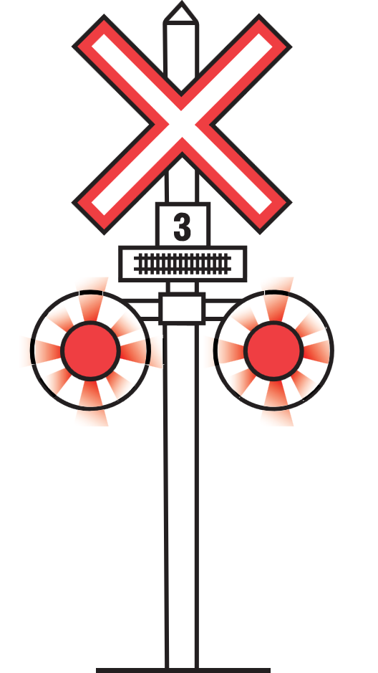
Railroad Crossings
Reasons railroad crossing can be hazardous:
Longer vehicles need more time to clear a crossing
Heavier vehicles need more room to stop before a crossing
Larger vehicles are more likely to derail a train if there is a collision
Notes:
SAY: Trains represent one of the most dangerous hazards on the road. A truck-train collision can have terrible consequences because of a train’s size, speed, and cargo. Trucks are big too, so there’s a greater risk of derailment than for a car-train collision.
Trucks need extra time and distance to stop at and then clear a crossing. A typical tractor-trailer needs at least 14 seconds to clear a single track and more than 15 seconds to clear a double track.
It’s easy to misjudge the speed and distance of an approaching train. Never try to beat a train to the crossing.
DO:
Select one of the following to play and/or discuss in class:
Link: https://www.operationlifesaver.ca/initiatives/campaigns/train-to-drive/training-for-professional-drivers/
Alternate Link: https://www.operationlifesaver.ca/blog/november-2013/driving-instructors-–-make-rail-safety-part-of-your-drivers-programs!/
Alternate Link: https://www.operationlifesaver.ca/resources/resource-items/professional-drivers/pro-drivers.pdf/

Slide 16
Railroad Crossings
Controlled crossing:
Has a flag person, stop sign, crossing gate or an electric or mechanical signaling device
Uncontrolled crossing:
No stop sign or traffic light
Cross at your own discretion
Vehicles required to stop at uncontrolled crossings:
School buses
Vehicles carrying explosives, or designed to carry flammable liquids or gas, whether the vehicle is loaded or empty
Notes:
SAY:
A controlled crossing has a flag person, stop sign, crossing gate or an electric or mechanical signaling device. All vehicles are required to stop at controlled railway crossings if signaled to do so.
An uncontrolled crossing has no stop sign or traffic light. You cross at your own discretion.
For uncontrolled railway crossings, only certain vehicles are required by regulation to stop:
School buses
Vehicles carrying explosives as cargo or part of their cargo
Vehicles designated for carrying flammable liquids or gas, whether the vehicle is loaded or empty
Reference: Railway crossings are listed in Lesson 6 of the Textbook, under Advance Driving Manoeuvres – Railway Crossings.

Slide 17
Uncontrolled Crossings
Pay extra attention when you cross railway tracks, especially in rural areas because:
Approach grades may be steeper, rough or uneven
Brush and trees can obstruct your vision
Snow banks may be higher
    Be especially careful at night.
    Crossing trains may be difficult to see in the dark.
Notes:
DO: Refer students to the textbook on Railway Crossings to review procedures for crossing railway tracks.
SAY: Uncontrolled railway crossings require extra caution, especially in some rural areas, because:
Approach grades may be steeper, rough or uneven.
Thicker vegetation can obstruct your vision.
In winter, snow banks may be higher.
Be especially careful at night. Crossing trains may be difficult to see in the dark.
Reference: Crossing procedures are listed in Lesson 6 of the Textbook, under Advanced Driving Manoeuvres – Railway Crossings - Crossing Procedures

Slide 18
Approaching and Stopping Procedure
Slow down, shift to a lower gear
Listen for warning bells /whistles
Test your brakes
Obey traffic signs, signals, and gates
Check for traffic behind you
If a train is coming, stop 5 - 15 m from the gate
Shift into neutral and use your emergency brake
Notes:
DO: Refer students to the textbook on Railway Crossings to review procedures for approaching and stopping at railway tracks.
SAY:
Always slow down and check for trains, whether the crossing is controlled or uncontrolled. Don’t rely completely on the train signals – it’s possible they won’t come on because of some unrepaired malfunction.
Remember: anytime is train time. When approaching a familiar crossing that normally never has a train on it, you should still be alert for a train since schedules can change.
Listen for warning bells and whistles. Turn off, or down, distracting noise from fans, heaters, or the radio. Opening the window helps you hear.
Shift to a lower gear if you have a manual transmission, and test your brakes.
Obey traffic signs, signals, gates, or anyone directing traffic at a crossing.
Check for traffic behind you.
If a train is coming, stop 5 to 15 metres from the gate.
While stopped, shift into neutral and use your emergency or service brake.
Note: Make sure there is enough room on the other side of the track for the whole unit to clear, including any overhang. Trains are about a metre wider than the rails on both sides.
Reference: Railway Approaching and Stopping Procedures are listed in Lesson 6 of the Textbook, under Advanced Driving Manoeuvres – Railway Crossings – Approaching and Stopping Procedure

Slide 19
Crossing Procedure
Always use extreme caution, take your time and be 100% sure
Double check that you have a clear view at least 300 metres in both directions
  If more than one track there may be more than one train
Be extra careful during bad weather or difficult conditions
Never drive through or around closed/opening/closing crossing gates
Never shift gears while crossing
Do not cross when signals are flashing
  If the crossing lights begin to flash after starting, keep going
  If you see the train but it’s stopped or far from the crossing, the law allows you to cross but do so with extreme caution!
Notes:
SAY: When you are ready to cross:
Always use extreme caution.
Take your time. Be 100% sure it’s safe before crossing any railway track.
Check and double check at least 300 metres in both directions that no trains are approaching.
If there is more than one track, there may be more than one train. Wait for a train to pass by far enough so that you have a clear view of the other tracks.
Be extra careful when crossing tracks during bad weather, or any other difficult conditions.
Never drive through, around or under a crossing gate or barrier when it’s closed, closing or opening. Wait until the gate is completely open.
Select a gear that will let you cross the track without shifting. To avoid the risk of stalling, never shift gears while crossing.
Do not cross when signals are flashing. You may not see a train, but it may be approaching at high speed and just not yet visible.
If the crossing lights begin to flash after starting, keep going. It is safer to continue than to back up.
NOTE: If you do see the train and it’s stopped or not close to the crossing, the law allows you to cross. Do so with extreme caution only. Be absolutely certain you can cross safely.

Slide 20
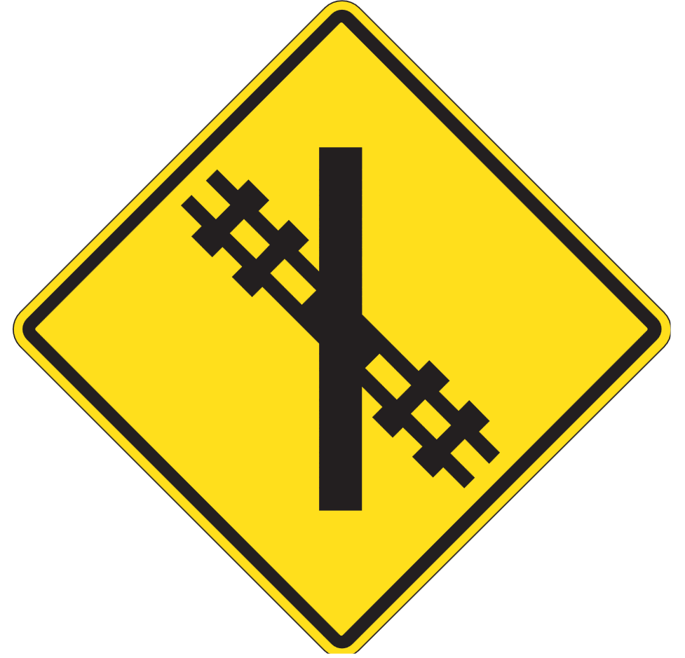
Stalling on the Tracks
Vehicle stalled or stuck on the tracks
Get out of the vehicle immediately
If a train is coming, move away from the track in the direction of the approaching train
Contact the railway company if the emergency number is posted or call 911.
Notes:
SAY: If you stall or get stuck on a crossing, get out of the vehicle immediately. If a train is coming, move away from the track in the direction of the approaching train. This will reduce the chance of being struck by flying debris if the train hits the vehicle, because the momentum of the train striking the vehicle will sweep the debris forward. Contact the railway company if its emergency number is posted or call 911.
The phone numbers to call for repairs or other non-emergency issues are listed in your textbook.
Canadian Pacific (CP): 1-800-551-2553
Canadian National (CN): 1-800-665-0581 or 1-800-465-9239
Reference: Crossing procedures are listed in Lesson 6 of the Textbook, under Advanced Driving Manoeuvres – Stalling on the Tracks

Slide 21
Railroad Crossings Discussion
What are some common driver errors at railway crossings?
What else should drivers do or be aware of?
Notes:
DO: Allow for a 10 minute discussion with students. After getting some answers from students, refer to the section below for possible answers.
SAY: (Possible answers) - Because of its size, it is easy to misjudge the speed and distance of an approaching train.
Trying to beat a train to the crossing. Many vehicles have been hit by the train or have run into the side of it when trying to get across the tracks ahead of an approaching train.
Immediately proceeding across the tracks after the train clears without first checking for other trains. You must be patient and wait for a train to proceed a sufficient distance to allow for good visibility in both directions.
Crossing tracks while the flashing signals are operating. If the signals are on and there is no train in sight, it may be approaching at high speed but is not yet visible, or possibly there could be a malfunction in the system.
Not being prepared to stop. The signals may be malfunctioning in the off position and a train may be approaching the crossing – always be prepared to stop when approaching a railway crossing, even one where signals are present but not activated.
You should reduce speed and be especially observant if weather conditions or sight observations limit visibility of the rail.
Some tracks may have curves and may be hidden behind trees or hills which would make a train approaching a high speed difficult to see and react to ahead of time.
Always use extreme caution. Take your time. Be 100 % sure it is safe before crossing any railway track whether signalized or not.

Slide 22
Exercise 1: Advanced Driving Manoeuvres
Complete Exercise 1
Time: 15 minutes
Notes:
SAY: You will have 15 minutes to complete Exercise 1 in the Exercise Book.
Do: Review the answers for Exercise 1, using the Exercise Book - Answer Key.

Slide 23
Mountain Driving & Grades – Uphill
Before driving uphill:
Move to the right and maintain a safe speed
Shift one range at a time to maintain a safe speed, when necessary
Monitor the engine temperature frequently to detect dragging, pulling and overheating
Turn on engine fan override before ascending but do not operate for extended periods
Never pass a vehicle going uphill or downhill on a two-lane highway.
Notes:
SAY: Before driving uphill:
Move to the right and maintain a safe speed.
When shifting, shift one shift range at a time to maintain a safe speed, when necessary.
Monitor the engine temperature frequently for dragging, pulling, or overheating.
Never pass a vehicle when you are travelling going uphill or downhill on a two-lane highway.
Turn on the engine fan override before ascending to start the cooling process early. Do not operate the fan for extended periods. It was designed for intermittent use only.

Slide 24
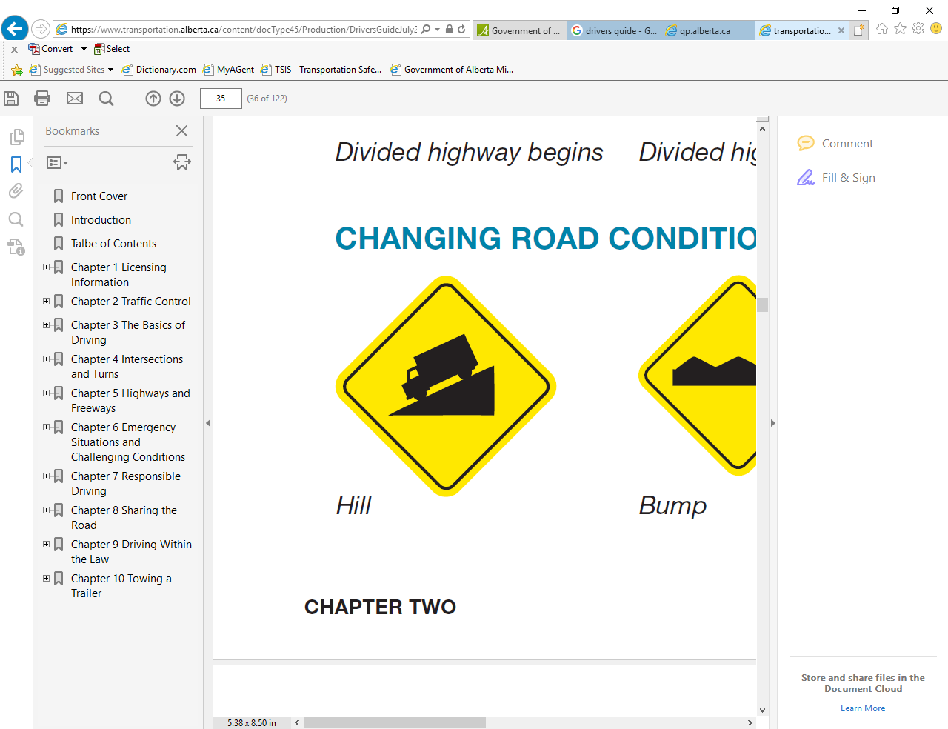
Mountain Driving & Grades – Downhill
Before driving downhill:
Check system air pressure and cover brake
Select a lower gear to descend the hill
Stay to the right while proceeding down the grade
Maintain a safe vehicle speed
Use the snub method for downhill braking
  Apply the brakes firmly until you drop 5 km/h below the safe or posted speed, then release the brakes, and repeat as needed.
Notes:
SAY:
Before descending, check the system air pressure and cover the brake.
Select a lower gear that allows you to descend without using service brakes.
Stay to the right and maintain a speed that allows you to stay in control without overheating the brakes or depleting the air pressure.
Brake moderately or intermittently to prevent over speeding.
If you pass the safe or posted speed, use the snub method of braking:
Apply the brakes firmly until you drop 5 km/h below the safe or posted speed, then release the brakes, and repeat as needed.
With an automatic transmission, do not exceed the top speed of the selected gear. This keeps the automatic transmission from upshifting.

Slide 25
Mountain Driving and Grades- Runaway Lanes
Runaway lanes are an additional lane on downhill sections, usually on roads preceded by a mandatory brake check.
They are used as a path to help vehicles slow down and stop if the brakes fail.
Notes:
SAY: Runaway lanes are an additional lane on downhill sections, usually on roads preceded by a mandatory brake check. They are used as a path to help vehicles slow down and stop if the brakes fail.

Slide 26
Stopping and Parking on Hills
Check for following traffic using side mirrors
Downshift, if necessary
Apply brakes lightly at first, and then apply brakes with firm, even pressure
Depress the clutch as you near a stop
Allow extra room between vehicles for safety
Turn wheels
Set parking brake
Notes:
SAY: Stopping and Parking on Hills
Check your side mirrors for following traffic, then signal to pull over.
Downshift, if necessary, to reduce speed in preparation to stop.
Apply brakes lightly at first (going downhill, you should probably tap the brakes with your right foot a couple of times) and then apply firm, even pressure for a smooth stop.
Depress the clutch as you near a stop. When stopped, shift to low gear or reverse for manual transmissions, and neutral for automatic transmissions.
Allow extra room between vehicles.
Turn wheels into the curb downhill, away from the curb uphill. Make gentle contact with the curb. If there’s no curb, turn the wheel to the right, uphill or downhill. According to Manitoba law, the wheels of a parked vehicle must be no more than 50 cm from the curb.
Set the parking brake and turn off the ignition.
See Braking in Section 5 for more information on braking on downhills.

Slide 27
Starting on Hills
On a gentle grade, the normal starting procedure may work. Otherwise, do this:
Depress clutch
Shift into appropriate gear
Release parking brake
Release clutch slowly to the friction point while gradually depressing the accelerator
Starting on an upgrade in a truck with standard transmission can be difficult.
Notes:
SAY: Starting a manual transmission truck uphill can be a challenging manoeuvre, especially in heavy traffic. On a gentle grade, the normal starting procedure may work. Otherwise, do this:
Depress the clutch and shift into the appropriate gear.
Release the parking brake.
Release the clutch slowly to the friction point while gradually depressing the accelerator.

Slide 28
High Risk Driving Situations
High-risk driving situations are reality. This section provides advice on:
Skidding
Jackknifing
Tire Blowout
Loss of Visibility
Emergency Braking
Loss of Brakes
Emergency Evasive Action
Oncoming Vehicles
Notes:
SAY: Hopefully, you won’t encounter very many high-risk driving situations in your career, but the reality is you very likely will. The last part of this section provides advice on:
Skidding
Jackknifing
Tire Blowout
Loss of Visibility
Emergency Braking
Loss of Brakes
Emergency Evasive Action
Oncoming Vehicles

Slide 29
Driving to Conditions
Conditions that affect driving include:
Light
Weather
Road
    Your ability to adjust to these conditions increases your chances of avoiding a collision.
Notes:
SAY: Conditions that affect any driving situation include:
Light
Weather
Road
You may need to change your driving to suit these conditions. The changes can be minor, to very serious. They may require little to no adjustments, or on the other extreme, you may need to get off the road completely until the conditions return to safe and favourable.

Slide 30
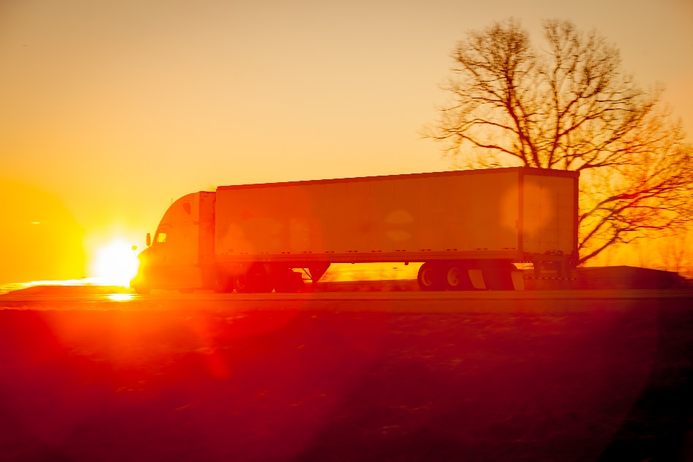
Light Conditions
The first consideration of safe driving is to see and be seen.
The following light conditions are a key consideration:
Night driving
Glare from the sun
Sunrise and sunset
Notes:
SAY: The first requirement of safe driving is to see and be seen. The ability is affected by light condition. The presence of natural or artificial light; you can have too little light, or too much light.
Remember: In Manitoba, you are legally required to use headlights:
Anytime between 30 minutes before sunset to 30 minutes after sunrise
In conditions of poor visibility (less than 60 metres)
Reference: Light Conditions are listed in Lesson 6 of the Textbook, under Driving in Difficult Weather Conditions - Night or Low-Light Conditions.

Slide 31
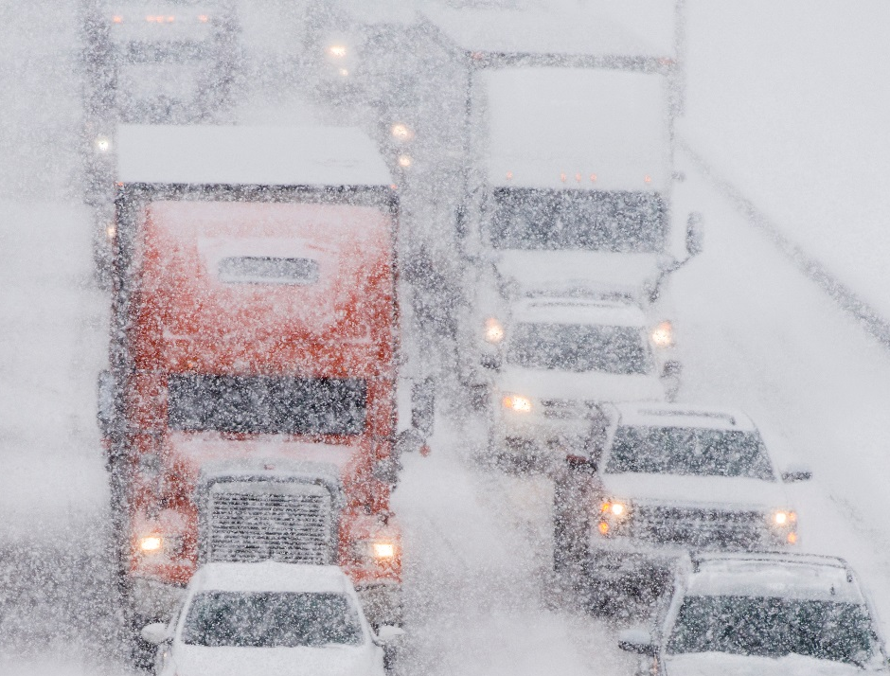
Weather Conditions
Weather conditions can affect traction, visibility and control of your vehicle.
Some examples of bad weather include:
Rain
Snow
Ice
High heat
Wind
Notes:
SAY:
Winter brings many potential driving hazards: snow, ice, extreme cold that causes mechanical failure and dangerous conditions, and more.
Bad weather can affect traction, visibility and vehicle control. Icy roads are perhaps the most dangerous winter hazard.
For example:
Rain and snow can cause traction problems
Icy roads are perhaps the most dangerous winter hazard
Adverse weather can obscure your vision with rain, snow, fog or road splatter, as well, steam up glass with interior vapour.
Other drivers find it harder to see you, and pedestrians hide behind umbrellas so they fail to see cars approaching.
High winds make steering difficult and cause vehicles to veer to the wrong side of the road.

Slide 32
Weather Conditions Discussion
How would you deal with less than ideal conditions when driving?
Notes:
DO: Allow for a 10 minute discussion with students. Ask student. how they would deal with less than idea conditions when they are driving?
DO: Direct students to the Textbook for various conditions.
Reference: Difficult weather conditions are listed in Lesson 6 of the Textbook, under Driving in Difficult Weather Conditions.

Slide 33
Driving on Gravel
They differ from pavement because they tend to be narrower, provide less traction and visibility is poorer due to churned up dust.
When driving on gravel roads:
Reduce speeds and increase following distance
Accelerate slowly
Make slower approaches
If you lose traction, avoid skidding by:
  Easing off the accelerator
  Looking in the desired direction
  Steering to the desired direction
  Gently applying brakes as needed
Avoid overtaking other vehicles
Notes:
SAY: Gravel roads are common in Manitoba. Driving on them is not the same as driving on paved roads:
They tend to be narrower and have soft shoulders.
They provide less traction.
Vehicles driving on them churn up dust and spray rocks.
For these reasons, when driving on gravel roads:
Reduce speeds and increase following distance. Be extra cautious in slippery conditions.
Accelerate slowly to get a sense of how your vehicle handles on a gravel road.
Make slower approaches to railway crossings, intersections, uphill sections, or hazards.
If you lose traction, avoid skidding by:
Easing off the accelerator
Looking in the desired direction
Steering to the desired direction
Gently and smoothly applying brakes as needed once the vehicle has regained traction
Avoid overtaking other vehicles unless absolutely necessary.
When passing oncoming vehicles, slow down and move to the right as far as you can safely go. Once you’ve passed, gradually re-centre the truck and return to normal (safe) speed.
Gravel roads are hard on trucks. If you drive on them often, your vehicle may require more frequent servicing. Gravel roads can clog the air filter and radiator with dust, increasing the risk of overheating the engine. Dust can also stick to the grease between moving parts, causing more friction and wear.
Reference: Information on driving on gravel is in Lesson 6 of the Textbook, under Driving in Difficult Weather Conditions – Driving on Gravel

Slide 34
Exercise 2 & 3:
Complete Exercise 2: Mountains & Hills
Complete Exercise 3: Driving to Conditions
Time: 15 minutes
Notes:
SAY: You will have 15 minutes to complete Exercise 2 & 3 in the Exercise Book.
Do: Review the answers for Exercise 2 & 3 using the Exercise Book - Answer Key.

Slide 35
High-Risk Driving Techniques
After completing this section, you should be able to:
  Explain the appropriate responses to emergency situations
Notes:
DO: Read slide.

Slide 36
High-Risk Driving Situations/Techniques
Skidding occurs when tires lose traction with the road surface, causing you to lose control. Skidding can be caused by slippery conditions or:
Tire failure due to under inflation or sudden deflation
Faulty brakes
Driving too fast on curves, or rough or slippery surfaces
Travelling too fast on a water-covered road, which results in hydroplaning
Notes:
SAY: Skidding occurs when tires lose traction with the road surface, causing you to lose control of steering, braking, decelerating, and accelerating.
Skidding can be caused by slippery conditions or:
Tire failure, resulting from under inflation or sudden deflation from a blowout
Faulty brakes
Driving too fast on curves, or rough or slippery surfaces
Travelling too fast on a water-covered road, which results in hydroplaning
You can prevent skidding by planning ahead, watching carefully, and driving according to conditions, especially on unfamiliar roads.
If you start to skid, regain control by turning your wheels in the direction that the rear is skidding. Be careful not to oversteer. When you feel that the vehicle has regained traction, straighten the wheels.
Frequently a skid in one direction is followed by one in the opposite direction (as a result of oversteering while trying to correct the first skid). As the vehicle fishtails in the opposite direction, steer in the direction of the new skid.
Reference: Skidding is mentioned in Lesson 6 of the Textbook, under Professional Driving Techniques – High-Risk Driving Situations/Techniques.

Slide 37
Jackknifing
There are two kinds of jackknifing:
Tractor jackknife
  Tractor rear skids sideways
Trailer jackknife
  Rear of the trailer swings either left or right
Recovery / Steering
  Is dependent on which component is doing the skidding
Notes:
SAY: Jackknifing is when a tractor-trailer folds into an “L” or “V” shape (like closing a jackknife). There are two distinct kinds of jackknifing:
In a tractor jackknife, the tractor rear skids sideways. You must react quickly, because it takes less than two seconds for a tractor-trailer to jackknife to 15 degrees, which is impossible to recover from. If sudden acceleration is causing the skid, ease up on the accelerator and steer to safety. Using the brakes will not help to prevent sliding, so don’t apply them.
In a trailer jackknife, the rear of the trailer swings either left or right. If this happens, release the brakes immediately and gently accelerate to allow the trailer to correct itself. Keeping the wheels rolling will help you regain control. Steer gently and let your speed drop.
Reference: Jackknifing is mentioned in Lesson 6 of the Textbook, under Professional Driving Techniques – High-Risk Driving Situations/Techniques.

Slide 38
Jackknifing
To prevent jackknifing:
Know the weight, height, and loading position of your cargo
Be aware that a light or empty vehicle will slide more easily
Increase following distance
Extend your braking distance over the longest possible area
Avoid braking on curves
Avoid swerving and braking at the same time
Do not use engine retarders when roads are slippery
      Turn your wheels in the same direction the rear of the vehicle is skidding.
Notes:
SAY: To prevent jackknifing:
Know the weight, height, and loading position of your cargo.
Be aware that travelling with a light or empty vehicle will make it slides more easily and may cause a jackknife to occur.
Increase following distance.
Extend your braking distance over the longest possible area.
Avoid braking on curves.
Avoid swerving and braking at the same time.
Do not use engine retarders when roads are slippery.
Steering
Turn your wheels in the same direction the rear of the vehicle is skidding. Be careful not to oversteer. You will be able to feel when the vehicle regains traction. Then, straighten the wheels.
Reference: Jackknifing is mentioned in Lesson 6 of the Textbook, under Professional Driving Techniques – High-Risk Driving Situations/Techniques.

Slide 39
Tire Blowout
Control of your vehicle will become difficult when a tire blows out.
When a blowout occurs:
Stay calm and take your foot off the accelerator pedal and allow the engine to slow you down
Grip the steering wheel firmly and steer your vehicle straight down the centre of your lane
When you have the vehicle under control and speed is reduced, apply the brake with gentle and steady pressure
Carefully steer to the shoulder or safe location and stop.
Turn on the hazard lights.
Notes:
SAY: If a tire has an air leak, you may feel the vehicle begin to pull and vibrate as you hold the steering wheel. If this air leak is not corrected soon, the tire will become flat. If one of your front tires blows, there will be a strong pull in your steering towards the side with the blowout. A back tire blowout may or may not cause the back end to swerve or ‘fish-tail’. A flat tire acts as a brake and the tractor-trailer will pull hard to that side. You will have to grip the wheel firmly to maintain steering control.
When a blowout occurs:
Take your foot off the accelerator and allow the engine to slow you down.
Grip the steering wheel firmly and steer your vehicle straight down the centre of your lane.
Do not apply the brakes immediately. Wait until you have the vehicle under control at a low speed, then apply the brake with gentle and steady pressure.
Carefully steer to the shoulder or other safe location and stop.
Turn on the hazard lights and place warning devices on the road (see Section 10).
Reference: Tire blowouts are mentioned in Lesson 6 of the Textbook, under Professional Driving Techniques – High-Risk Driving Situations/Techniques.

Slide 40
Loss of Visibility
Causes of a sudden loss of visibility:
Headlights fail
  Immediately hit the dimmer and check high beams, signal right, slow vehicle quickly and safely, steer to the shoulder, stop and turn on hazards
Hood flies up
  Look out side windows, apply steady brakes, signal right, steer to shoulder, stop and turn on hazards
Mud or slush on the windshield
  Turn on wipers and wash, look out side windows, apply steady brake
  If wipers or washer fails signal right, steer to the shoulder, stop and turn on hazards
Place warning devices on the road once stopped.
Notes:
SAY: Several things can happen to cause a sudden loss of visibility – your headlights could fail, your hood could fly up, mud and slush might get splashed on the windshield, etc. Suddenly you can’t see where you are going and you must stop as quickly as practical before losing steering control or hitting something.
What can you do in each situation?
DO: Refer students to “Loss of Visibility” section of the Textbook in lesson 6.
SAY:
If the headlights fail:
Immediately hit the dimmer switch to see if the high-beams work.
Signal a right turn.
Slow your vehicle quickly but safely. You want to reduce your speed before any steering error causes a collision.
Carefully steer to the shoulder or other safe location and stop.
Turn on the hazard lights and place warning devices on the road (see Section 10).
If the hood flies up:
Look out the left and right windows to keep your sense of direction and road position.
Apply brakes moderately.
Signal a right turn.
Carefully steer to the shoulder or other safe location and stop.
Turn on the hazard lights and place warning devices on the road (see Section 10).
If mud or slush splashes on the windshield:
Turn on wipers and washers.
Look out side windows and apply brakes moderately.
If the windshield wipers have failed or you have no washer fluid, signal a right turn.
Carefully steer to the shoulder or other safe location and stop.
Turn on the hazard lights. If you will remain stationary more than momentarily, place warning devices on the road (see Section 10).
Reference: Loss of visibility is mentioned in Lesson 6 of the Textbook, under Professional Driving Techniques – High-Risk Driving Situations/Techniques.

Slide 41
Emergency Braking
Non-ABS Brakes:
Threshold braking
  Applying steady brake pressure right up to the point of almost locking the wheels (skidding)
  Back off just enough to prevent a skid
  Is NOT pumping the brakes
ABS Brakes:
Primary purpose is to prevent skidding
ABS brakes do threshold braking for you.
  ABS sensors monitor each wheel and lessen brake pressure just before a wheel starts to skid.
If you need to brake suddenly, press hard and hold the brake.
Notes:
SAY: Emergency braking with non-ABS brakes requires a sensitive touch on the brake pedal, using a technique called threshold braking.
Threshold braking means applying steady brake pressure almost to the point of locking the wheels (skidding), and backing off just enough to prevent the skid. It’s not easy to do; it requires a quick foot and good sense of feel to keep the brake pressure maximized without locking the wheels. Once mastered, threshold braking will stop you faster than any other technique.
Threshold braking is not “pumping the brakes.” Pumping the brakes with no feel for what the wheels and brakes are doing is counterproductive in a situation where maximum braking effort is needed.
ABS brakes do threshold braking for you. ABS sensors monitor each wheel and lessen brake pressure just before a wheel starts to skid. It’s primary purpose is to prevent skidding, even on slippery surfaces
To allow ABS brakes to work when you need to brake suddenly, press hard and hold the brake. Don’t worry what it feels or sounds like, just focus on steering to safety. Release the brake only when you no longer need to brake. Do not pump ABS brakes. Doing so defeats the computer’s efforts to sense a wheel skid.
Reference: Emergency Braking is mentioned in Lesson 6 of the Textbook, under Professional Driving Techniques – High-Risk Driving Situations/Techniques.

Slide 42
Automatic Traction Control
Automatic traction control (ATC)
Used to prevent wheel spin due to acceleration
Additional warning light to indicate when the ATC is working
Traction Control & Anti-Lock braking systems are paired together as they help improve the vehicle’s stability by working in tandem
Notes:
SAY: A Traction Control System is used to prevent wheel spin from occurring due to acceleration. This usually happens on a slippery surface, such as snow or a pool of water, where the wheels are not able to generate enough traction to move the vehicle.
Traction Control systems and Anti-Lock braking systems are paired together as they help improve the vehicle's stability by working in tandem. The major difference between an ABS and a Traction Control system is that while ABS stops the wheel from spinning while braking, Traction Control stops the wheel from spinning while the vehicle is accelerating. A Traction Control System is also known as an Anti-Slip Regulation (ASR).
The Traction Control system (TCS) uses wheel speed sensors to measure the vehicle's speed with the rate at which the drive wheels are spinning, to detect if there is any slip occurring between the tire and the road. If a slip is detected between the road and the wheel, the Traction Control system ensures that only the minimum amount of torque is supplied to the slipping wheel to generate the required amount of friction for the vehicle to move.
The primary input of the TCS is the wheel speed sensor. These sensors continuously monitor the speed of each driven wheel and send the data to the ABS and Traction Control System ECU. When a slip is detected between the tire and the road, the TCS regulates brake pressure on the slipping wheel. This process of slowing down the wheel helps it regain traction. Simultaneously, torque is shifted through the differential to the opposite wheel that has a better traction when compared to the slipping wheel.
The brake pressure is applied by routing the pressure from the ABS pump and through the ABS modulator. The pressure to applied is regulated through a high pressure accumulator. The TCS includes an extra solenoid valve in the ABS modulator, for each individual drive wheel's brake circuit. This arrangement allows the system to apply brake pressure to slow down the spinning wheel in order to regain traction. The continuous usage of brakes in TCS generates a lot of heat in the brake calipers. To prevent overheating of these calipers, TCS automatically discontinues after a certain length of time.
If both the driven wheels are losing traction, the TCS slows both the slipping wheels equally to slow them down until they regain traction. Otherwise, the systems send a signal to the Powertrain Control Module (PCM) to reduce the engine torque to the wheels until traction is regained.
When the TCS is activated in a vehicle, it is shown to you through the instrument cluster. In a lot of performance vehicles, there is an option of switching on/off the Traction Control System. When this system is disabled, a warning light glows to notify you that the TCS is switched off. Switching off the TCS does not switch of the ABS in the vehicle, even though they are inter-related.
There is an additional ATC warning light on the dash to indicate when the ATC is working and when it needs to be repaired.

Slide 43
Electronic Stability Control Systems
Electronic Stability Control (ESC) systems are more advanced than ATC
Detects loss of steering control and automatically applies the brakes to offset over or understeering
Monitor rollover and yaw (jackknife)
Greater ability to handle multiple, programmed situations
Systems correct unusual vehicle behaviours
  Take over if the vehicle does not react correctly
Requires vehicle inspection to ensure system is in safe operating condition
Notes:
SAY: New trucks are equipped with Electronic Stability Control (ESC), which detects loss of steering control and automatically applies the brake to offset oversteering or understeering. ESC can help drivers reduce the risk of vehicle instability while in a slippery curve, or because of a sudden brake application.
ESC systems are more advanced than ATC systems. While using the same wheel speed sensors and ATC valves, the sensors monitor rollover and yaw (jackknife) and the computer has a greater ability to handle multiple, programmed situations.
ESC replaces and incorporates the functions of ATC. The Stability Control Systems’ warning light replaces the ATC warning light.
These systems correct unusual vehicle behaviour. They may respond by cutting back engine power, applying the retarder, or applying individual brakes in any location. No new driving techniques are required. The systems simply take over if the vehicle does not react correctly.
While regulations govern the legislative requirements for vehicle inspections, industry best practices require vehicles to be inspected often throughout the shift to ensure that mechanical components continue to work properly. These inspections must be done before, during and after each trip. Each inspection has a different purpose.
These periodic inspections ensure the brake system is in safe operating condition and reduces the chance of a collision caused by mechanical failure.

Slide 44
Loss of Brakes
How to handle the emergency situation:
Apply steady pressure to the brake pedal
Downshift to the lowest gear possible
Select a path to bring the vehicle to a stop on the shoulder
Stop as far to the right as possible
Place warning devices on the road
If loss of air drops below 70 psi, it is likely the spring brakes have started applying. If you don’t get to a safe spot to park before air pressure drops between 20 to 45 psi, you may be stranded in the driving area of the highway.
Notes:
SAY: You are driving down the highway, you step on the brake pedal to slow down or stop – and there is no response or a sudden evacuation of air. This is definitely an emergency situation.
With a loss of brakes, you should:
Apply steady pressure to the brake pedal to avoid wasting air volume.
Downshift to the lowest gear possible. If the way ahead is clear, allow engine compression to slow you down and stay on the road.
As you slow down, select a path to bring the vehicle to a stop on the shoulder or as far to the right as practical.
Once stopped, place your emergency devices to warn other traffic of your position.
Note: If loss of air drops below 70 psi, it is likely the spring brakes will start applying. If you don’t get to a safe spot to park before air pressure drops between 20 to 45 psi, you may be stranded in the driving area of the highway.
If you must leave the road quickly to avoid a collision, select the path that will most likely minimize injury and property damage, in that order. Look for something to sideswipe, like a roadside bank, snow bank, guardrail, even parked cars – anything that will slow you down. If you must go into a ditch, do so at an angle to reduce the chance of a rollover.

Slide 45
Emergency Evasive Action
With little time to react, you have three options:
Controlled emergency braking
Quick steering, with or without braking
Riding right off the road
The best option depends on:
The distance to the object
Your speed
The quality of your tires
Road conditions
Notes:
SAY: Sometimes emergency situations are unavoidable. Perhaps a distracted pedestrian will cross the street in front of you, unaware that you are coming. Or suddenly you find a vehicle mistakenly in your lane and driving straight at you.
In these situations, you have little time to react. In general, you have three options:
Controlled emergency braking –Note that slamming on the breaks is generally not a safe option. While it may work in some high-risk situations, sudden breaking in a vehicle without anti-lock brakes can lock the wheels and cause loss of control.
Quick steering, with or without braking – This can be an effective option, but of course in a big, heavy truck, you are limited in your ability to swerve sharply to avoid an object or to leave the pavement with any great amount of control.
Riding right off the road - If it’s not immediately obvious that you can stop in time, steer your vehicle to a safe path. (The next section on Oncoming Vehicles provides more details.)
The best option depends on:
Your speed
The distance to the object
The quality of your tires
Road conditions – wet, dry, slippery, etc.
Reference: Emergency Evasive Action is mentioned in Lesson 6 of the Textbook, under Professional Driving Techniques – High-Risk Driving Situations/Techniques.

Slide 46
Oncoming Vehicles
If an oncoming vehicle is in the wrong lane, it will be easier to react correctly if you can determine why:
A problem in their lane
Faulty driving manoeuvres / loss of control
Centrifugal force on curves
To avoid a head-on collision:
Read the road ahead
Ride to the right
Reduce speed
Ride right off the road
Notes:
DO: Refer students to the “Oncoming Vehicles” section of lesson 6 in the textbook.
SAY: If an oncoming vehicle is in the wrong lane, it will be easier to react correctly if you can determine why it’s happening:
A problem in their lane - Trouble in a driver’s own lane such as a construction barrier, animal, pedestrian, or bicycle may cause a driver to swerve left.
Faulty driving manoeuvres - Through an error in judgment, a driver may enter your lane. For example, a driver may make a wide right turn or misjudge the distance required to pass a vehicle.
Centrifugal force on curves - Centrifugal force keeps a vehicle in a straight line on curves.
Loss of Control - Drivers can lose control of a vehicle for many reasons, including:
The driver overcorrecting after the right wheel drops off the pavement edge
Loss of visibility or the centre line is obscured or worn away
Falling asleep at the wheel, drug or alcohol impairment
Tire blowout or skidding
Poor road conditions or potholes
Poor judgment
To avoid a head-on collision:
Read the Road Ahead - Be aware of oncoming traffic and try to anticipate what is causing a vehicle to cross the centre line and enter your lane.
Ride to the Right - Don’t crowd the centre line. Leave plenty of room. If there are two lanes available to you going in the same direction, use the right lane. In urban areas, the right lane generally moves quicker because vehicles turning right normally cause less delay than those turning left.
Reduce Speed - When you see a threat developing with an oncoming vehicle in your lane, reduce your speed immediately. If necessary, sound the horn and flash your lights to let the oncoming vehicle know you are there.
Ride Right Off the Road - If you take the actions above and the vehicle is still coming head-on, you have only one option left: to ride off the road to the right. This option will, in almost all cases, be better than a head-on collision. If you have to do this:
Stay calm.
Look at the whole scene to assess the best escape path
(steps on next slide)
Look and steer in the direction you want to go.
Steer firmly and as gradually as possible (don’t oversteer) to clear the obstruction.
If a collision is unavoidable, try to hit the object or vehicle at an angle rather than head-on to lessen the impact. Never try to out-guess the other driver by pulling to the left.
Reference: Steps on reacting to an oncoming vehicle in the wrong lane is mentioned in Lesson 6 of the Textbook, under Professional Driving Techniques – High-Risk Driving Situations/Techniques – Oncoming Vehicles.

Slide 47
Escape Path
Look at the whole scene to assess the best escape path (do not focus on obstructions):
Is the escape path free of hazardous obstacles?
Are clearances sufficient for the vehicle?
Will an off-road surface still permit steering control?
Will the path be clear or occupied by someone/something else when you arrive?
Notes:
SAY: If you take the actions above and the vehicle is still coming head-on, you have only one option left: to ride off the road to the right. This option will, in almost all cases, be better than a head-on collision. If you have to do this, look at the whole scene to assess the best escape path (do not focus on obstructions):
Is the escape path free of hazardous obstacles?
Are clearances sufficient for the vehicle?
Will an off-road surface still permit steering control?
Will the path be clear or occupied by someone/ something else when you arrive?
DO: Remind students about the concept of gates and how that would be applied when looking for an escape path.
Reference: Escape path is mentioned in Lesson 6 of the Textbook, under Professional Driving Techniques – High-Risk Driving Situations/Techniques – Oncoming vehicles – Ride Right off the Road.

Slide 48
Exercise: 4
Complete Exercise 4: High Risk Situations & Techniques
Time: 15 minutes
Notes:
SAY: You will have 15 minutes to complete Exercises 4 in the Exercise Book.
Do: Review the answers for Exercise 4 using the Exercise Book - Answer Key.

Slide 49
After-Class Assignment
You will:
Review the materials and textbook on Lesson 6 topics.
Prepare to discuss questions you have at the beginning of next class.
Notes:
SAY: When you have time after class, please review the materials and bring any questions you have to the start of the next lesson.

Slide 50
Summary
You should now be able to:
Apply defensive driving techniques
Recognize common situations that lead to collisions
Understand the habits that are key to preventing collisions
Notes:
DO: read slide

Slide 51
Quiz
Lesson 6 Quiz
Time: 30 minutes to complete
Notes:
DO:
SAY:
You will have 30 minutes to complete the lesson quiz.

Slide 52
Practical In-Cab Training
Practical Time In-Cab
30 minutes in-yard demonstrating
30 minutes in-cab observing
20 hours in-cab demonstrating
(in total)
Notes:
SAY:
You will now head out to the yard where an instructor will spend time demonstrating the professional driving techniques. You will do the same techniques and practice the manoeuvres as the driver. You may wish to take your exercise book with the procedure job aid. Each time you attempt the activities, your instructor will provide you with a copy of your in-yard assessment which you should review to improve your skills in this area.
DO:
At the end of the classroom session, the instructor and the students will proceed to the yard for the in-yard and in-cab activities. The instructor will have about 30 minutes to demonstrate these activities to the student, after which the student will perform the activities. The students will have a minimum of 30 minutes in-yard and 20 hours in-cab in total, to be spent practicing these activities by each trainee in total. This time may be split up and used smaller increments throughout the length of the course. Decisions about how to organize yard time will need to flex with each class based on numbers of students, available instructors for proper yard ratio and physical training space. Instructor will evaluate students using the practical assessment sheet. The list may then be shared with the student to improve their performance. Use one practical assessment sheet each time the student performs the activities. Students are encouraged to bring their textbook and/or exercise book with the lists of procedures and checklists during the time they are applying their learning.

Slide 53
Practical In-Cab Assessment
Practical Time In-Cab
Time: 30 minutes to complete
Notes:
SAY:
You will now have a practical assessment where your instructor will assess your understanding and skill competency. This assessment will count towards your final course mark.
DO:
Using the in-yard assessment, the instructor will grade students on the skill competency for this lesson. A minimum of 30 minutes will be used for in-yard assessment.

