Slide 1

Backing and Coupling
Lesson 7

Slide 2
Learning Objectives
After completing this lesson, you should be able to:
Explain the different backing techniques
Demonstrate backing and parking manoeuvres with a tractor-trailer
Safely perform tractor-trailer coupling and uncoupling tasks
Notes:
SAY: This lesson is intended to provide you with the knowledge of proper backing techniques for the different types of backing: straight line, offset (left and right) and landing dock.
Upon completing this lesson, you should be able to demonstrate:
An understanding of the theory behind different backing techniques
backing manoeuvres with a tractor-trailer
Tractor-trailer coupling and uncoupling tasks
DO: During this lesson manoeuvres will be explained, demonstrated and then performed by the student.

Slide 3
Pre-Class Assignment
You will have:
Reviewed the textbook and course materials.
Any questions about Lesson 6?
Notes:
SAY: You were asked to review the materials at the end of the last lesion.
Are there any questions that came up?
DO: Go over any questions about Lesson 6.

Slide 4
Backing Concepts
After completing this section, you should be able to:
Describe the importance of following proper manoeuvring procedures
Describe the importance of attentiveness and care when backing
Explain the correct straight line backing procedures
Explain the correct offset backing to a left side and right side spot procedures
Explain the correct alley dock backing to the left side and the right side procedures
Notes:
Do: Read slide.

Slide 5

Backing Concepts
Backing is:
A hazardous movement
Only done when absolutely necessary and with caution
The driver’s full responsibility
When backing :
    Stop, get out and visually recheck areas behind, above, below, around (walk around)
    Check for clearance, obstacles, obstructions and hazards
    Clear any obstructions or hazards
Notes:
SAY: Backing a tractor-trailer is:
A hazardous manoeuvre
Should only be done when absolutely necessary
Do not rely on a guide. You are responsible for all movements of the vehicle.
When backing:
Stop, get out (walk around) and visually recheck the areas behind, above, below and around the entire unit.
Check for clearance, obstacles, obstructions or hazards beside, behind, or under the vehicle.
Take actions to clear any obstacles or hazards.

Slide 6
Backing Check
Before backing a tractor-trailer, it is important to ask yourself the following questions:
Is it NECESSARY?
Is it LEGAL?
Is it SAFE?
Notes:
SAY:
Before backing a tractor-trailer, ask yourself:
Is it necessary?
Is it legal?
Is it safe?

Slide 7
Backing Manoeuvres
Four types of backing manoeuvres:
Straight line
Offset
Parallel Parking*
Alley dock
Notes:
SAY: There are four different backing manoeuvres that you may encounter: straight, offset (backing left side and right side), parallel, alley dock (left side and right side).
Reference: Backing manoeuvres can be found in Lesson 7, under Backing and Coupling.

Slide 8
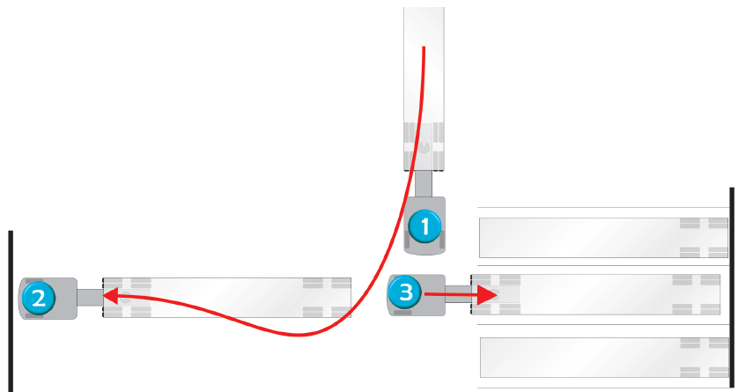
Straight Line Backing
Notes:
SAY:
Straight line backing is used when approaching the target space from either direction.
DO: Refer students to the Straight line Backing procedure in Lesson 7 of the textbook.
DO: You may play a video on backing at any point throughout this lesson. We recommend videos from J.J. Keller, one from your own library, or a suitable alternative.

Slide 9
Straight Line Backing Procedure
Check mirror set up
Open windows and turn off any audio devices
Position vehicle, and shift into neutral, apply parking brake and activate hazard lights
Walk around vehicle, checking for clearance, hazards etc.
Release parking brake, sound horn and
re-check for obstacles using mirrors
Shift into reverse, in the lowest gear possible
Begin backing at walking pace, covering the brake and repeatedly checking the mirrors
Listen carefully
Gently stop when you reach desired position
Notes:
SAY: This manoeuvre is used when approaching the target space from either direction. Before positioning the vehicle in front of the target space:
Check your mirror setup.
Open windows and turn off any audio devices.
Position the vehicle:
1.5 vehicle lengths from the target space
Aligned straight to the target space
Front wheels straightened
Shift into neutral, apply the parking brake, and activate the hazard lights.
Exit the vehicle and walk around the vehicle to check for clearance, and obstacles or hazards beside, behind, or under the vehicle. Take actions to clear any obstacles or hazards.
Re-enter the vehicle, release the parking brake, and sound the horn.
Use your mirrors to re-check for obstacles.
Shift into reverse, in the lowest gear possible.
Begin reversing at a walking pace, covering the brake and repeatedly checking the mirrors.
Pull up as often as needed to adjust angles to align the vehicle with the target space.
Exit the vehicle as often as needed to examine your positioning and alignment.
Listen and watch carefully for any indication of conflict or impending collisions (horn, shouts, someone banging on the side of the vehicle, etc.).
Gently stop when you reach the desired position.

Slide 10
Steering Technique #1
Steer in the:
  Opposite direction of where you want the trailer to go
  Other direction to maintain the arc of the tractor and trailer
  Inside of the arc to straighten the tractor
Continually adjust the tractor-to-trailer angle to continue in a straight line to the dock
Pull forward as often as necessary to either readjust the tractor-trailer angle, or to adjust the angle of the trailer to the dock
Notes:
SAY:
How to manoeuvre the vehicle:
Steer in the opposite direction of where you want the trailer to go.
Steer in the other direction to maintain the arc of the tractor and trailer.
Steer to the inside of the arc to straighten the tractor.
Continually adjust the tractor-to-trailer angle to continue in a straight line to the dock.
Pull forward as often as necessary to either readjust the tractor-trailer angle, or to adjust the angle of the trailer to the dock.

Slide 11
Steering Technique #2
Place your hands on the bottom of the steering wheel
Move your hand in the same direction you want the trailer to go
The truck must follow an S-shape to bring the trailer around smoothly
Notes:
SAY:
Another manoeuvring approach is to:
Place your hands on the bottom of the steering wheel
Move your hand in the same direction that you want the trailer to go.
The truck must follow an S-shape to bring the trailer around smoothly.

Slide 12
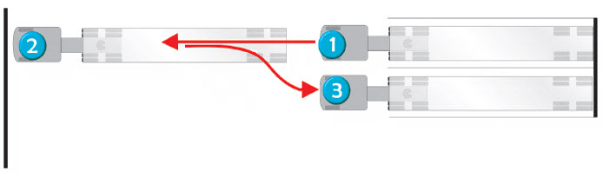
Offset Backing
Notes:
SAY: You will sometimes be required to move from one loading dock to an adjacent one along the same wall. It resembles backing in for parallel parking, without having to fit between vehicles behind and ahead of you, but with the added complexity of aligning the tractor and trailer.
DO: Refer students to the Offset Backing procedure in Lesson 7 of the textbook.

Slide 13
Offset Backing Procedure
Drive forward 1.5 vehicle lengths, shift into neutral, apply the parking park, and turn on the hazard lights
Walk around vehicle, checking for clearance, hazards etc.
Release the parking brake and sound the horn
Use your mirrors to re-check for obstacles
Shift into reverse, in the lowest gear possible
Reverse at idle speed, and begin steering:
  Left side offset: steer right
  Right side offset: steer left
At the correct point, steer in the opposite direction
Steer as required to straighten the truck and trailer
Notes:
SAY: Other than the steering direction, the procedure is the same for both left side and right side offset backing:
Drive forward 1.5 vehicle lengths.
Shift into neutral, apply the parking park, and turn on the hazard lights.
Exit the vehicle and walk around the vehicle to check for clearance, and obstacles or hazards beside, behind or under the vehicle. Take actions to clear any obstacles or hazards.
Re-enter the vehicle, release the parking brake and sound the horn.
Use your mirrors to re-check for obstacles.
Shift into reverse, in the lowest gear possible.
Reverse at idle speed, and begin steering:
For a left side offset, steer right to move the trailer to the left.
For a right side offset, steer left to move the trailer to the right.
Check both mirrors for positioning.
At the correct point, steer in the opposite direction to align the trailer with the target space. Continue checking both mirrors for positioning.
Steer as required to straighten the truck and trailer, and align to the target space.
Gently stop when you reach the desired position.

Slide 14
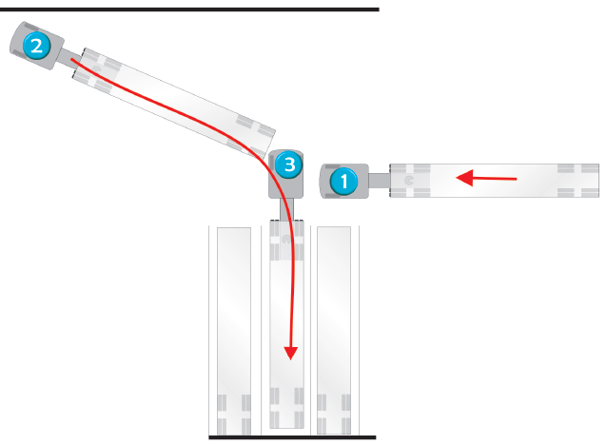
Alley Dock Backing
Notes:
SAY: This method is used when there is not enough space to do straight line backing.
This is the most difficult and potentially most dangerous backing manoeuvre. It’s especially challenging if you are backing to the right side, because you can’t clearly see the target space and you have to use your right side mirrors. No matter which side you use, it’s best to avoid this manoeuvre if possible.
DO: Refer students to the Alley Dock Backing procedure in Lesson 7 of the textbook.

Slide 15
Alley Dock Backing Procedure
Position vehicle
Secure vehicle and activate hazards
Walk around vehicle
Release parking brake and sound horn.
Check your mirrors for obstacles
Shift into reverse, in lowest gear possible
Reverse at walking pace, and begin steering
Steer in opposite direction to align trailer
Gently stop when you reach desired position
Notes:
SAY:
Other than the steering direction and which mirrors to check, the procedure is the same for both left side and right side backing:
Before starting the manoeuvre, shift into neutral, apply the parking park, and turn on the hazard lights.
Exit the vehicle and walk around the vehicle to check for clearance, and obstacles or hazards beside, behind or under the vehicle. Take actions to clear any obstacles or hazards.
Re-enter the vehicle, release the parking brake and sound the horn.
Use your mirrors to re-check for obstacles.
Shift into reverse, in the lowest gear possible.
Reverse at a walking pace, and begin steering:
For left side backing, steer right to move the trailer to the left.
For right side backing, steer left to move the trailer to the right.
Check both mirrors for positioning.
At the correct point, steer in the opposite direction to align the trailer with the target space.
For left side backing, steer left.
For right side backing, steer right.
To align the tractor with the trailer, continue steering in the same direction, but more tightly.
Continue checking both mirrors for positioning.
Pull up as often as needed to adjust angles to align the vehicle with the target space.
Steer as required to straighten the truck and trailer, and align to the target space.
Gently stop when you reach the desired position.

Slide 16
Alley Dock Backing – Right Side
Difficult to see where you are going
Uses the right side mirror including convex mirror
Requires you to stop often and get out to check position
This type of backing is the most difficult and potentially the most dangerous. Avoid if possible!
Notes:
SAY: For right side alley dock backing, it’s more difficult to see where you are going. Use your passenger-side mirrors and exit the vehicle to check your position . No matter which side you use, it’s best to avoid this manoeuvre if possible.

Slide 17
Exercise 1: Manoeuvre Basics
Time: 15 minutes
Complete Exercises 1
Notes:
SAY: You will have 15 minutes to complete Exercise 1 in the Exercise Book.

Slide 18
Coupling and Uncoupling
After completing this section, you should be able to:
Describe the factors that influence successful coupling and uncoupling of a tractor-trailer
Explain the procedure for coupling and uncoupling a tractor-trailer
Notes:
DO: Read slide.

Slide 19
Coupling and Uncoupling
Importance of weight transference:
Weight of trailer is transferred to tractor when coupled through fifth wheel
Trailers may have sliding tandem axles to assist in transferring weight to achieve even distribution of weight
Notes:
SAY:
When connecting a tractor to a trailer the draw bars or coupling devices must be in accordance with The Highway Traffic Act and its regulations.
When a coupling device is used an auxiliary safety chain or metal cable of equal strength to the coupling device must also be used to prevent separation in the event of the coupling device failing.
If you are coupling or uncoupling at night or in reduced light conditions, you must use work lights for your own protection.

Slide 20

Coupling and Uncoupling
5th Wheel position and its importance:
May be stationary or adjustable
Sliding the fifth wheel will change weight distribution
Moved forward - more of the load is shifted to the steering axle
Moved backwards - weight shifts to the drive axles
Too much weight shifted forward – loss of traction on rear axles
Notes:
SAY: The position of the fifth wheel plays an important role in tractor weight distribution. We will talk more about weight distribution in Lesson 9: Cargo Securement.

Slide 21
Coupling a Tractor-Trailer
Inspect space
Secure the vehicle
Inspect the truck
Inspect the trailer
Align truck and trailer
Engage the fifth wheel
Conduct a tug test
Confirm the fifth wheel is locked
Connect air and electrical lines
Raise landing gear
Test the connections
Test brakes
Notes:
DO: Refer students to the Fifth Wheel Coupling section of Lesson 7 in the Textbook. Elaborate on each step.
If you have a video to demonstrate the steps, play it here.
SAY: When coupling and uncoupling, you need to enter and exit the cab multiple times. Always practice safe entries and exits (see Section 4), shifting into neutral, braking, and chocking as appropriate.
Coupling a truck and trailer is a 12-step process:
Inspect the space
Secure the vehicle
Inspect the truck
Inspect the trailer
Align the tractor and trailer
Engage the fifth wheel
Conduct a tug test
Confirm the fifth wheel is locked
Connect air and electrical lines
Raise the landing gear
Test the connections
Test the brakes

Slide 22
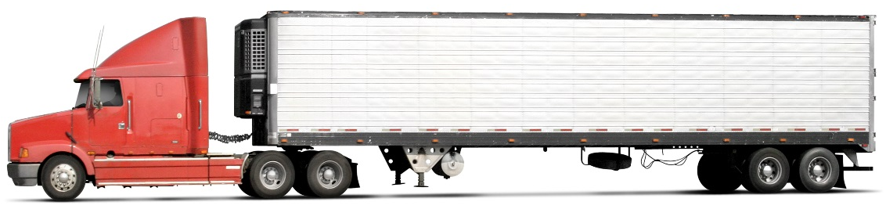
Uncoupling a Tractor-Trailer
Inspect the location
Park the tractor-trailer in a straight line
Apply the spring parking brakes on the tractor and trailer
Adjust the suspension
Lower the landing gear
Disconnect electrical connections and air lines
Release the fifth wheel coupler lock
Disengage the fifth wheel
Check that the landing gear are stable and secure
Slowly drive forward until the tractor is clear of the trailer
Notes:
SAY: Uncoupling a trailer is a 10-step process:
Elaborate on each step.
If you have a video to demonstrate the steps, play it here.
Inspect the location.
Park the tractor-trailer in a straight line.
Apply the spring parking brakes on the tractor and trailer.
Adjust the suspension:
Lower the landing gear:
Disconnect electrical connections and air lines
Release the fifth wheel coupler lock.
Disengage the fifth wheel:
Check that the trailer and the landing gear are stable and secure.
Slowly drive forward until the tractor is clear of the trailer.

Slide 23
Review
Prior to backing, the driver should walk around the vehicle and check for what?
Answer: Obstacles, Hazards and Clearance
Notes:
Click to reveal answers.

Slide 24
Review
What are the 3 types of backing manoeuvers you may encounter?
Answer: Offset, Alley Dock and Straight
Notes:
Click to reveal answers.

Slide 25
Review
When uncoupling a tractor-trailer, how should the trailer be parked?
Answer: In a straight line
Notes:
Click to reveal answers.

Slide 26
Exercise 2: Coupling and Uncoupling
Time: 15 minutes
Complete Exercises 2
Notes:
SAY: You have 15 minutes to complete Exercise 2 in your Exercise Book.

Slide 27
Summary
You should now be able to:
Explain the different backing techniques
Demonstrate backing and parking manoeuvres with a tractor-trailer
Safely perform tractor-trailer coupling and uncoupling tasks
Notes:
SAY:
You should now be able to:
Explain the different backing techniques
Demonstrate backing and parking manoeuvres with a tractor-trailer
Safely perform tractor-trailer coupling and uncoupling tasks

Slide 28
Practical In-Yard Training
In-Yard Observations:
You will observe the instructor demonstrate:
  Three backing techniques
  Coupling/uncoupling manoeuvre
Practice:
You will practice:
  Three backing techniques
  Coupling/uncoupling manoeuvre
Notes:
SAY:
You will now head out to the yard where an instructor will spend time demonstrating how to perform these manoeuvres then you will do the same techniques and practice the manoeuvres as the driver. You may wish to take your exercise book with the procedure job aid. Your instructor will assess your understanding. This assessment will count towards your final course mark.
DO:
At the end of the classroom session, the instructor and the students will proceed to the yard for the backing activities.
The instructor will have about 3 hours in total to demonstrate all of these backing manoeuvres to the student.
The students will have a minimum of 20 hours (student) to be spent practicing these 3 backing manoeuvres.
May be split up and used in 30 minute increments throughout the course.
Decisions about how to organize yard time will need to flex with each class based on numbers of students, available instructors for proper yard ratio and physical training space.
Instructor will grade students using the checklist.
Instructor Demonstration : 3 hours.
Student Practice: 20 hours
Student Assessment: 1 hour

Slide 29
Practical In-Yard Assessment
In-Yard Observations:
You will observe the instructor demonstrate:
  Three backing techniques
  Coupling/uncoupling manoeuvre
Assessment:
You will perform and be assessed on:
  Three backing techniques
  Couple/uncoupling manoeuvres.
Notes:
DO:
Student in-yard assessment: 1 hour.
Instructor will grade students using the yard assessment form for this lesson. A minimum of one hour will be used for in-yard assessment. Students are encouraged to bring their textbook and/or exercise book with the lists of procedures and checklists during the time they are applying their learning.

