Slide 1
Trip Planning and Hours of Service
Lesson 8

Slide 2
Learning Objectives
After completing this lesson, you should be able to:
Record and maintain a log of your hours of driving
Explain hours of service regulations
Demonstrate an understanding of driver and owner responsibilities regarding hours of service
Explain the difference between on/off duty in a commercial driving capacity
Demonstrate understanding of related rules and regulations regarding hours on/off work and work cycles.
Complete basic math calculations required for commercial vehicle operation
Notes:
DO: Read slide

Slide 3
Pre-Class Assignment
You will have:
Reviewed the textbook and answered the questions in the Exercise Book.
Any questions about Lesson 7?
Notes:
SAY: After the last class, you were asked to complete the Lesson 7 Exercise Book.
Do you have any questions about those exercises?
Do: Review the answers for each exercise, using the Exercise Book - Answer Key.

Slide 4
Trip Planning
After completing this section, you should be able to:
Identify and describe the basic purpose, importance and proper condition of the vehicle related documents
Identify special requirements relating to a vehicle, load, routing or commodity
Identify sources of reliable information about weather and road conditions
Determine allowable axle weights, basic vehicle dimension and axle spacing requirements
Complete calculations to identify compliance with vehicle requirements
Explain the training required by law to perform duties properly and safely
Notes:
DO: Read slide

Slide 5
Trip Planning
What are the pro’s of trip planning?
Work/life balance
Effective and efficient travel
Laws
Notes:
SAY: Roads are monitored and controlled by governments to ensure safety and minimize inconvenience to the travelling public. Planning your route ahead will allow you to reach your destination effectively and efficiently. It is important for you to have a plan before heading out, as well as an awareness of regulations and travel restrictions. Pre-trip preparation includes being aware of general weight and size laws of jurisdictions you will be travelling through, knowledge of permits required, road bans and road restrictions, or local bylaws regarding loading and unloading cargo.

Slide 6
Things to Consider
Personal
Paperwork
Route &
Schedule
Personal identification
Sleeping arrangements
Electronic devices, books or entertainment
Vehicle documents
Vehicle weight or dimension restrictions
Driver documents
Shipping/cargo documents
Road restrictions
Driving conditions
Notes:
DO: Trip planning is more than a vehicle inspection; the vehicle inspection is about making sure the vehicle is safe, while trip planning is about having all the things you need to get your job done right.
There are three main tasks in trip planning:
Packing for your personal needs – clothes, food, medicine, etc.
Getting paperwork in order
Planning the itinerary – the route and the schedule
Reference: Considerations on trip planning are listed in Lesson 8 of the Textbook, under Trip Planning.

Slide 7
Personal Needs
What you might need:
Clothes
Food and drink
Toiletries
Arrangements for sleeping
Cash and cards
Personal identification
Medications
Eyewear
Electronic devices (i.e. cell phone)
Books or other entertainment – for rest periods
Notes:
SAY: There’s a lot to do to prepare properly for a long haul. Don’t forget to include everything you need as a person, as opposed to a professional driver, to get through the trip:
Clothes – to match the weather, job tasks, safety requirements, and the length of the trip
Food and drink - preferably a healthy mix to keep you properly fuelled up
Toiletries – to keep feeling fresh and presenting yourself as a professional driver
Arrangements for sleeping – is your sleeper berth fully equipped for a good sleep? Or do you have other arrangements made?
Cash and cards – to cover expected and unexpected expenses
Personal identification – driver’s licence, health card, passport, or other items you need
Medications – if you’re on medications, stay on schedule, and bring your prescriptions with you.
Eyewear – If you wear prescription glasses, bring a spare set.
Cell phone or other electronic devices – to stay connected
Books or other entertainment – for rest periods
Each employer has their own policies about what is a company expense versus a personal expense. Be aware of your employer’s policy and be prepared.

Slide 8
Paperwork and Documentation
Vehicle Documents
Driver Documents
Shipping/Cargo Documents
Bills of lading
Way bills
Weigh slips
Cargo packaging
Delivery instructions
Driver’s licence
Medical certification
Safety Fitness Certificate
Passport
Registration/ Insurance
Hours of Service record
Permits
Trip Inspection Report
Log book
Periodic Mandatory Vehicle Inspection certificate
Notes:
SAY: You must ensure all required paperwork is in the truck. The documentation that is required to be in the vehicle or to be carried by the driver can vary by the type or intended use of the vehicle and may differ between carriers. Document requirements may also vary by jurisdiction, so if travelling across provincial or national borders, you must be aware of documentation requirements.
Upon demand by police officer, police constable or other authorized official, you must produce for inspection any of these documents if asked.
You may be required to carry and produce the following documentation:
Safety Fitness Certificate
Registration/ Insurance
Hours of Service Record
Permits (for exceeding maximum dimensions or weight)
Driver’s licence
Passport
Medical certification
Log Book
Periodic Mandatory Vehicle Inspection certificate
Bills of lading (required if carrying dangerous goods)
Way bills
Weigh slips (not required by legislation)
Cargo packaging
Delivery instructions

Slide 9
Shipping & Cargo Documents
Types of shipping/cargo documents:
Bills of lading: contract between shipper and customer
Waybills: used with the bills of lading (invoice)
Location of documentation during trip:
A Transport of Dangerous Goods (TDG certificate) must be carried within your reach when you’re in the cab
It must be on the driver’s seat, or in a pocket on the driver’s door when you’re not in the cab
Dangerous goods have specific rules on shipping documents
Specialized information and instructions
Warnings and hazards
24-hour number for technical information
Document storage location
Shipping documents must include the shipper, carrier, customer, goods being shipped and the route.
Notes:
SAY: There are two shipping documents that verify your loads, where and when it’s going, and who it’s for:
A bill of lading is the contract between the shipper and the carrier to ship goods to a customer.
A waybill may be used with the bill of lading (invoice). It lists the goods being delivered. It can be used as an invoice for the customer.
These documents specify:
The shipper, the carrier(s) used by the shipper, and the customer receiving the goods
All the goods being shipped
Where the cargo was picked up and delivered, and the route used for shipping
Make every reasonable attempt to know what you’re carrying and confirm that information on shipping documents matches the load. It is in your best interest to keep these documents organized and in the cab.
DO: Refer students to the chart on Shipping documents for dangerous goods in Lesson 8, under Paperwork/Documentation - Driver Documents, and go through the different situations.
SAY: When it comes to dangerous goods, there are strict rules on document storage.
A Transport of Dangerous Goods (TDG certificate) must be carried within your reach when you’re in the cab
It must be on the driver’s seat, or in a pocket on the driver’s door when you’re not in the cab
Any other documents must be stored in the cab as well
Dangerous goods have specific rules on shipping documents
Specialized information and instructions
The name and class of goods (following standardized classifications – see Section 10 for details)
Warnings and information about the particular hazards of the shipment (for example, a poisonous gas is toxic if inhaled)
The “24-hour number” to get technical information on dangerous goods
Document storage location
Permits for Equivalent Level of Safety
Shipping documents must include the shipper, carrier, customer, goods being shipped and the route.

Slide 10
Route and Schedule
Planning your route and schedule includes:
Safety
Hours of service regulations
Fuelling, rest time, and meals
Delivery deadlines
Speed and efficiency
Vehicle weight or dimension restrictions
Daily or seasonal road restrictions
Weather, traffic, and other driving conditions
You are required to record the height and width of your vehicle and load in the daily vehicle inspection report.
Notes:
SAY: There are many considerations for planning your route and schedule:
Safety
Hours of service regulations
Fuelling, rest time, and meals
Delivery deadlines
Speed and efficiency
Vehicle weight or dimension restrictions
Daily or seasonal road restrictions
Weather, traffic, and other driving conditions
Your role in trip planning may vary according to carrier. Some carriers provide you with designated route information; others require you to do it.
You are required to record the height and width of your vehicle and load in the daily vehicle inspection report.
SAY: The size and weight of your vehicle are key factors for route planning. The Motor Carrier Division of Manitoba Infrastructure maintains current information on road restrictions, weight limits, bridge clearances and much more in the Truck Weight Limit Map and information Guide.
DO: Provide students website: Vehicle Weights and Dimension Limits in Manitoba, located on the Manitoba Infrastructure – Motor Carrier website.
Reference: Truck Weight Limit Map and information Guide: https://www.gov.mb.ca/mit/mcd/resources/twlm.html
Reference: Vehicle Weights and Dimension Limits in Manitoba: https://www.gov.mb.ca/mit/mcd/resources/pdf/mb_vehicle_weights_and_dimensions_guide.pdf
Reference: Planning your route and schedule is in Lesson 8 of the Textbook, under Trip Planning – Route and Schedule.

Slide 11
Calculating Travel Time
Distance = Speed X Time
i.e. 80 km x 9 hours = 720 km
Average Speed = Distance ÷ Time
i.e. 720 km ÷ 9 hours = 80 km
Trip Time = Distance ÷ average speed
i.e. 720 km ÷ 80 km = 9 hours
Notes:
SAY: For calculating travel time, formulas are often used by truck drivers to determine the distance, average speed, and trip time:
Distance = Speed multiplied by time
80 km x 9 hours = 720 km
Average Speed = Distance divided by time
720 km / 9 hours = 80 km
Trip Time = Distance divided by average speed
720 km/ 80 km = 9 hours

Slide 12
Vehicle Height, Width and Length
Plan for places where your truck may not fit:
Bridges, underpasses, and tunnels
Fire escapes and doors in alleyways
Tree limbs or low wires
Roofs, canopies, signs, and other overhead structures
Clearances for low or narrow spaces are not always posted.
Notes:
SAY: Trucks and their loads are wide, tall and long. And they have mirrors, clearance lights and other protrusions. You have to plan for places along the route where your truck may not fit:
Bridges, underpasses, and tunnels
Fire escapes and doors in alleyways
Tree limbs or low wires
Roofs, canopies, signs, and other overhead structures at service stations and stores
Clearances for low or narrow spaces are not always posted.
Packed snow, debris, uneven roads, or road resurfacing may reduce clearance.
Don’t forget about the clearance below you to avoid undercarriage damage, or even bottoming out. The risks are greatest when you have a heavy load that lowers the truck, or you’re at a railway crossing, or travelling on soft, uneven road surfaces.
Reference: Planning for vehicle height, width and length is in Lesson 8 of the Textbook, under Trip Planning – Route and Schedule.

Slide 13
Over-Dimensional Loads
Vehicle size is limited by regulation
Permits can be issued for oversize vehicles
Must meet safety regulations
Require warning signage
Notes:
SAY: Vehicle size is limited by regulation, but permits can be issued for oversize vehicles, as long as they meet safety regulations.
These vehicles require warning signage, specified by the permit:
The sign must be either 180 cm x 30 cm or 245 cm x 30 cm.
The letter font must be 20 cm high with a 3 cm stroke.
The words “WIDE LOAD”, “LONG LOAD”, “OVERSIZE LOAD”, or the letter “D” can be used.
The “D” sign has a white letter on a red and white striped background. The others have black letters on a yellow background.

Slide 14
Vehicle Weight
Highways rated for truck traffic have three weight classifications:
RTAC (Road Transportation Association of Canada)
Class A1
Class B1
Vehicle weight is measured in two ways:
Tare weight: Vehicle weight when empty
Gross vehicle weight (GVW): Tare weight + cargo load weight
Notes:
SAY: Maximum weight standards are regulated to ensure public safety and to protect infrastructure. These standards are set according to your vehicle configuration, road classifications, and jurisdiction.
Highways rated for truck traffic have three weight classifications:
RTAC (Road Transportation Association of Canada)
Class A1
Class B1
RTAC highways allow the heaviest loads, followed by Class A1, then Class B1. Note that a highway’s classification can change from one part of the highway to another.
Vehicle weight is measured in two ways:
Tare weight is the vehicle’s weight when empty
Gross vehicle weight (GVW) – Tare weight plus the weight of the cargo load
The load weight is GVW minus tare weight.
Trailers with sliding axles can change the way weight is distributed on the trailer. When sliding an axle, you must ensure that wheelbases and overhangs (distance from the back of the container to the rear axle group) comply with regulations.

Slide 15
Road Restrictions
Purpose: To protect driver safety and prevent road damage
Road access may be restricted because of construction, maintenance, or the season:
Spring road restrictions
Winter weight allowance
Municipal weight restrictions
Restrictions may change with 48 hours’ notice
Restrictions can apply to vehicle dimension, weight, or both
Notes:
SAY: To protect driver safety and prevent road damage, road access may be restricted because of construction, maintenance, or the season (especially spring). Restrictions can apply to vehicle dimension, weight, or both, depending on the situation.
Spring Road Restrictions: Spring thaw can cause roads to soften, requiring temporary weight restrictions. They usually begin in early March, starting in warmer southwest Manitoba, and last anywhere from two to six weeks.
Manitoba Infrastructure issues restriction orders on its website every Tuesday and Friday by 12:30 p.m. during the ban. Orders come into effect at Thursday midnight for the Tuesday order and Sunday midnight for the Friday order. Restrictions may change with 48 hours’ notice.
For example, a return to cold weather can cause the ban to be lifted.
Winter Weight Allowances: Manitoba winters can sometimes be difficult to appreciate, but one benefit for you is the freezing temperatures strengthen roads enough to allow for increased maximum weights.
These allowances typically occur from November 16 to March 14. In southwest Manitoba, the season is usually shorter: December 1 to the end of February. Orders are issued using the same schedule as spring restrictions.
Municipal Weight Restrictions: Municipal roads are the responsibility of each municipality, who can set out their own weight limits.
Weights can be restricted at any time by Minister’s order.
Reference: Planning for road restrictions is in Lesson 8 of the Textbook, under Trip Planning – Route and Schedule.

Slide 16
Weather and Road Conditions
Road conditions in Manitoba
Manitoba Road and Traveller Information
Call 511
Follow @MbGovRoads
Weather conditions in Manitoba/Canada
Environment Canada website/app
Local news and radio
Notes:
SAY:
Getting up to date information on the driving conditions is critical to trip planning. The following resources will be useful for taking note of weather and road conditions in Manitoba.
DO:
Load this website and show the links to the various resources. https://www.gov.mb.ca/mit/roadinfo/canadaroads.html

Slide 17
Other Trip Planning Considerations
Ports of Entry
Stop and prove the carrier has authority to operate in the jurisdiction
Inspections and weighing may take place
Roadside Safety Inspections – drivers may be put out of service for:
Hours of service violation
Failed vehicle safety requirement
Leaking hazardous materials
Preparing for the Destination
Notes:
SAY: Ports of entry are locations where you must stop and prove that the carrier has authority to operate in the jurisdiction. Inspections and weighing may take place at a port of entry. You must follow directions and ensure that they are carrying all required documents.
Roadside safety inspections can be conducted at weigh stations, ports of entry, special safety inspection facilities, or a suitably safe area. You must produce your driver’s licence, driver’s logs, and cargo documents. Cargo may be inspected, even if sealed. Inspectors will provide a new seal and you should document both the old and new seal numbers. You may be immediately put out of service for:
Hours of service violation
Failed vehicle safety requirement
Leaking hazardous materials
Preparing for the Destination – The facilities at your destination may not be designed specifically for loading and unloading tractor-trailers. Know in advance what to expect and be prepared .

Slide 18
Trip Planning Tools and Resources
There are several other tools available to help you plan your route and schedule:
Dispatching system
GPS
CB (Citizen Band)
Notes:
SAY: Several other tools are available to help you plan your route and schedule:
Dispatching Systems - You can use dispatch systems for transporting goods. Carriers may have their own policies and procedures for devices and working with dispatch personnel.
Maps/Global Positioning Systems (GPS) – You should know how to read traditional maps, and how to program and read GPS devices. If using GPS, be sure to follow Manitoba’s Distracted Driving Law (see Section 5).
Two-Way or Hand-Held Radios – As mentioned in Section 5, you can use two-way radios or hand-held radios, such as those commonly referred to as CB (Citizen’s Band) radios, when escorting oversized vehicles, to contact your employer, or when participating in search, rescue and emergency management situations.
DO: Hand out Manitoba Truck Weight Limit Map and Information Guide

Slide 19
Exercise 1: Trip Planning
Complete Exercise 1
Time: 15 minutes
Notes:
SAY: You will have 15 minutes to complete Exercise 1 in the Exercise Book.
Do: Review the answers for Exercise 1 using the Exercise Book - Answer Key.

Slide 20
Hours of Service
After completing this section, you should be able to:
Explain that the Hours of Service regulations apply to operating any commercial vehicle
Explain that driving a commercial vehicle is prohibited after accumulating 13 hours of driving in a day
Notes:
DO: Read slide

Slide 21
Regulations for Hours of Service
There are federal and provincial regulations for HoS:
Federal legislation applies if you operate outside Manitoba
Entire fleet is affected
Manitoba legislation applies to carriers and drivers operating within Manitoba
Violating these regulations can result in :
Fines
Being taken out of service
A lower safety rating for the carrier
Demerits on your driver safety record
Notes:
SAY: There are federal and provincial regulations for HoS:
Federal legislation (the Commercial Vehicle Drivers Hours of Service Regulation) applies if you operate extra-provincially (outside Manitoba) on a continuous and regular basis. This regulation applies to an operator’s entire fleet if at least one vehicle operates extra-provincially.
Manitoba legislation (Drivers Hours of Service Regulation) applies to carriers and drivers operating typically within Manitoba.
Violating these regulations can result in fines, being taken out of service, a lower safety rating for the carrier (and possibly a facility audit), and demerits on your driver safety record.
Reference: Regulations for HoS is in Lesson 8 of the Textbook, under Trip Planning and Hours of Service.

Slide 22
Regulation Exemptions
HoS regulations apply to all regulated trucks except:
Two or three-axle trucks used by the driver/owner for their:
Farming operations
Forestry operations
Fishing operations
Emergency vehicles / Disaster relief trucks
Commercial vehicles driven for personal use:
The vehicle has been unloaded, and any trailers have been unhitched
The distance travelled does not exceed 75 km per day
Odometer reading is logged at the beginning and end of the use
Notes:
SAY: HoS regulations apply to all regulated trucks with these exemptions:
Two or three-axle trucks used by the driver/owner for their farming, forestry, or fishing operations
Emergency vehicles
Trucks used for disaster relief
Commercial vehicles driven for personal use if all of the following apply:
The vehicle has been unloaded
Any trailers have been unhitched
The distance travelled does not exceed 75 km per day
The driver logs odometer readings at the beginning and end of the personal use.
For intra-provincial operators, Manitoba regulations do not apply to personal use vehicles, limited-use regulated vehicles under 6,800 kg, and farm trucks.
Reference: HoS exemptions can be found in Lesson 8 of the Textbook, under Trip Planning and Hours of Service.

Slide 23
On and Off Duty
After completing this section, you should be able to:
Explain that on-duty means when driving, in care and control of a vehicle, and performing other types of work
Explain that in normal conditions drivers must take 10 hours off-duty each day, and have one 24-hour period off-duty within the previous 14 days
Explain that driving a commercial vehicle is prohibited after being on-duty for 14 hours in a day
Explain that a work shift begins when drivers return to on-duty after being off-duty for at least 8 consecutive hours
Explain that a new cycle can start only after taking the required minimum number of hours off-duty (“reset”)
Explain the difference between Cycle 1 and Cycle 2
Notes:
DO: Read slide

Slide 24
On and Off Duty
On-Duty: When a driver is working or is required by a carrier to be available for work
Limited by days, shifts, and cycles
Off-Duty: Any period other than on-duty time
Notes:
SAY: The regulations classify driver time as either on-duty or off-duty.
On-duty time is when you are working or are required by a carrier to be available for work. Off-duty time is any period other than on-duty time.

Slide 25
Examples of On-Duty Work Tasks
Time: 10 minutes
Make a list of 5 non-driving tasks that you think would be considered “on-duty”
Notes:
DO:
Have the class work in groups of 2 or 3.
Have them make a list of 5 tasks that would be considered On-Duty tasks. Time: 5 minutes.
When time has elapsed, ask the groups to share one task on their list, and then list off any from this list that were not covered by the groups:
Inspecting, servicing, repairing, conditioning, or starting your truck
Travelling as a co-driver (excluding time spent in the sleeper berth)
Loading, unloading, or inspecting a load
Waiting for servicing, loading, unloading, dispatching, or vehicle/load inspections
Delays en route caused by a collision or other unplanned occurrence or situation
Performing any work for any motor carrier
Resting in or occupying a commercial vehicle for any other purpose except:
Travelling as an off-duty passenger (as defined by regulation)
Sleeper berth time
Spending time in a stationary commercial vehicle while off-duty
Time: 5 minutes.
Total time: 10 minutes.

Slide 26
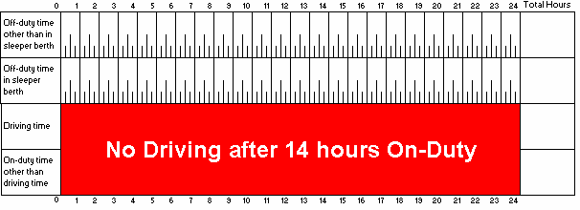
Daily, Shift, and Cycle Limits
Daily Limits (consecutive 24 hour period):
Can drive 13 hours maximum
Can be on-duty 14 hours maximum
Must take 10 hours off-duty time
Eight consecutive hours
Two hours must be taken in periods of at least 30 minutes
Notes:
SAY: On-duty hours are limited by days, shifts, and cycles.
For the purpose of daily limits, a day is any consecutive 24-hour period determined by the carrier.
In a day, you:
Can drive 13 hours maximum
Can be on-duty 14 hours maximum
Must take 10 hours off-duty time, which must include eight consecutive hours. The other two hours must be taken in periods of at least 30 minutes.
Reference: Daily, shift and cycle limits can be found in Lesson 8 of the Textbook, under Trip Planning and Hours of Service.

Slide 27
Daily, Shift, and Cycle Limits
You can defer up to two hours of off-duty time to the following day, if:
The deferred time is not part of the eight consecutive hours of off-duty time on Day 1
The deferred time is added to the eight consecutive hours of off-duty time on Day 2
Total off-duty time in the two days is 20 hours minimum
Total driving time in the two days is 26 hours maximum
You must not drive after 13 hours of driving in a work shift.
Notes:
SAY: You can defer up to two hours of off-duty time to the following day, if:
The deferred time is not part of the eight consecutive hours of off-duty time on Day 1
The deferred time is added to the eight consecutive hours of off-duty time on Day 2
Total off-duty time in the two days is 20 hours minimum
Total driving time in the two days is 26 hours maximum
Reference: Deferral rules can be found in Lesson 8 of the Textbook, under Trip Planning and Hours of Service – Daily Limits.

Slide 28
Daily, Shift, and Cycle Limits
Splitting Off-Duty Time:
For both single and team drivers:
Must follow daily limits rules (see above)
Total time immediately before and after each split off-duty period cannot exceed 16 hours
None of the daily off-duty time can be deferred to the next day.
Single
2 hours min
At least 10 hours total
Team
4 hours min X 2
At least 8 hours total
Notes:
SAY: If you operate a vehicle equipped with a sleeper berth, you have the option of splitting your daily off-duty time into two periods of qualifying sleeper berth time (time spent resting in the sleeper berth).
For a single driver:
Each of the two periods must be at least 2 hours.
The total of the two periods must be at least 10 hours.
For driver teams:
Each of the two periods must be at least 4 hours.
The total of the two periods must be at least 8 hours.
To switch back to a regular shift, the driver must take 8 consecutive hours off-duty.
For both single drivers and driver teams:
Drivers must follow daily limits rules (see above).
The total time in the periods immediately before and after each split off-duty period:
Cannot exceed 13 hours driving time
Cannot include driving time after the 14th hour of on-duty time
Cannot exceed 16 hours
None of the daily off-duty time can be deferred to the next day.

Slide 29
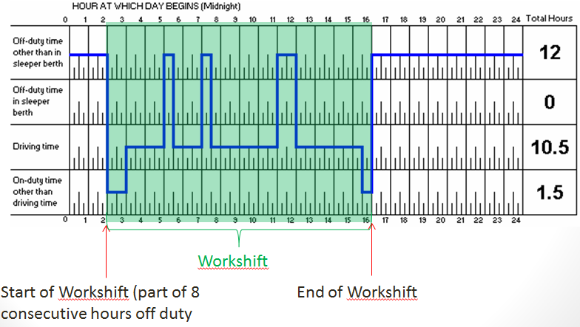
Shift Limits
Work Shift Definition
The time after your 8 consecutive hours off when you are on the job
Notes:
SAY: A shift is a period of time when you are on the job. A shift can last up to 16 hours. There must be eight hours of off-duty time between shifts.
In a shift, you:
Can drive 13 hours maximum
Can be on-duty 14 hours maximum
Cannot drive after 16 hours from the start of a shift

Slide 30
Cycle Limits
Cycle Definition
A series of shifts and off-duty time
70 hrs on-duty
7 consecutive days
Cycle 1
120 hrs on-duty
14 consecutive days
Cycle 2
Must take minimum of 24 hours consecutive off-duty time before 70th hour of on-duty time
Notes:
SAY: A cycle is a series of shifts and off-duty time. There are two lengths of cycles: Cycle 1 is seven consecutive days; Cycle 2 is 14 consecutive days.
In Cycle 1 (7 days), you:
Can have 70 hours of on-duty time maximum
In Cycle 2 (14 days), you:
Can have on-duty time of 120 hours maximum
Must take a minimum of 24 consecutive hours of off-duty time before the 70th hour of on-duty time
Other rules:
You can switch cycles if you reset your accumulated hours to zero:
A Cycle 1 driver can reset by taking 36 consecutive hours off-duty
A Cycle 2 driver can reset by taking 72 consecutive hours off-duty
You cannot move from one cycle to the other without resetting your accumulated hours.
You must take at least 24 consecutive hours off-duty every 14 days, whether you are in Cycle 1 or 2.
You cannot drive unless you have taken at least 24 consecutive hours off in the preceding 14 days.

Slide 31
Mandatory 24 Hours Off Duty
Sunday | Monday | Tuesday | Wednesday | Thursday | Friday | Saturday
24 hrs Off-Duty
On-Duty
On-Duty
On-Duty
On-Duty
On-Duty
On-Duty
On-Duty
On-Duty
On-Duty
On-Duty
On-Duty
On-Duty
On-Duty
24 hrs Off-Duty
On-Duty
On-Duty
On-Duty
On-Duty
On-Duty
On-Duty
Notes:
DO: Calendar displays blank – click to reveal after explaining the situation.
SAY:
You can switch cycles if they reset their accumulated hours to zero:
A Cycle 1 driver can reset by taking 36 consecutive hours off-duty
A Cycle 2 driver can reset by taking 72 consecutive hours off-duty
You cannot move from one cycle to the other without resetting your accumulated hours.
You must take at least 24 consecutive hours off-duty every 14 days, whether you are in Cycle 1 or 2.
You cannot drive unless you have taken at least 24 consecutive hours off in the preceding 14 days.
DO: Tell students the scenario then ask them how much time is the driver required to be off-duty.
Click to reveal the answer.
SAY: You are on-duty for 14 days, but do not reach the Cycle 1 or Cycle 2 limit. In this case how many off-duty hours are taken before driving again?

Slide 32
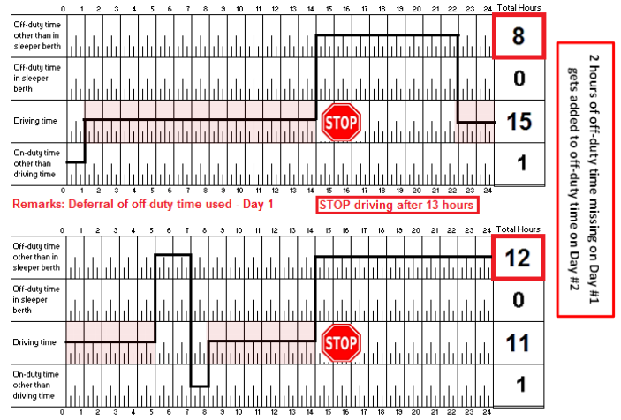
Off Duty Time Deferrals
Notes:
DO: Walk through the deferral scenario using this log as an example.

Slide 33
HoS Limit Exemptions and Overtime
HoS can be extended in the following situations:
Emergencies
Adverse Driving Conditions
Not extended more than 2 hours
Winter Road Permits
Overtime requirements vary due to your employer’s policy on:
Mileage
Hours of Service
Notes:
SAY: HoS can be extended in the following situations:
Emergencies - You may require more driving time to provide safety to occupants and other drivers in an emergency. You must stop at the first safe place.
Adverse Driving Conditions - You can extend driving time and reduce off-duty time because of bad weather or road conditions if:
Driving, on-duty, and elapsed time in the cycle are not extended more than two hours
You still take the required eight consecutive hours of off-duty time
The trip could have been completed under normal driving conditions
The conditions were unknown by you or the carrier before the driver began driving.
Winter Road Permits – These permits allow you to extend the 13 hours driving and 14 hours on-duty limits when driving on winter roads, for up to 5 hours after leaving the winter road system to reach the home terminal or a safe place to rest. You must take at least eight consecutive hours of off-duty time before exceeding these limits.
SAY: What constitutes overtime can vary due to the overtime policies of different companies. Some companies base overtime on mileage, while others base it on hours of service. Confirm what constitutes as overtime with your operator.

Slide 34
Log Books
After completing this section, you should be able to:
Maintain a complete, legible, and accurate driver’s daily log (in a written or electronic format) that fully complies with the regulations
Explain that the “home terminal” is determined by the employer and is normally associated with the location where a worker begins to drive a commercial vehicle
Notes:
DO: Read slide

Slide 35
Daily Logs
Information required:
Name of driver(s) / carrier and your signature (end of day)
Date, cycle being followed, start / end times
Distance covered (odometer reading)
Log grid (hours spent for each duty status)
Remarks (deferring off-duty time)
Supporting documents (bills of lading, shipping documents, fuel and accommodation receipts)
You are required to have the current day’s daily log, and records of total on-duty/off-duty hours of each of the preceding 14 consecutive days.
Notes:
SAY: You are required by regulation to record your on-duty and off-duty time in a daily log.
Information required in daily logs include:
Basic information identifying you, your truck and your carrier, your signature (at the end of the day)
The date, the cycle, driving start and end times
Distance covered (odometer readings) for the day
A log grid indicating hours spent for each duty status:
Off-duty time (not sleeper berth time)
Sleeper berth time
Driving time
On-duty time (non-driving)
A Remarks section, where you record:
Explanations for off-duty deferrals (and indication if the referral is for Day 1 or Day 2)
Limit exemptions (for emergencies, adverse driving conditions, or winter road permits)
Geographical location of each change of duty status
Supporting documents may include:
Bills of lading
Shipping documents
Fuel and accommodations receipts for expenses incurred en route.
You are required by regulation to have in your possession the current day’s daily log, and records of total on-duty and off-duty hours of each of the preceding 14 consecutive days. Within 20 days of completing the daily log, you must forward the original copy, along with supporting documents, to the home terminal of the carrier.
Daily logs must be retained by the carrier for six months after the day they were recorded.
Reference: Daily log rules can be found in Lesson 8 of the Textbook, under Trip Planning and Hours of Service – Completing Daily Logs.

Slide 36
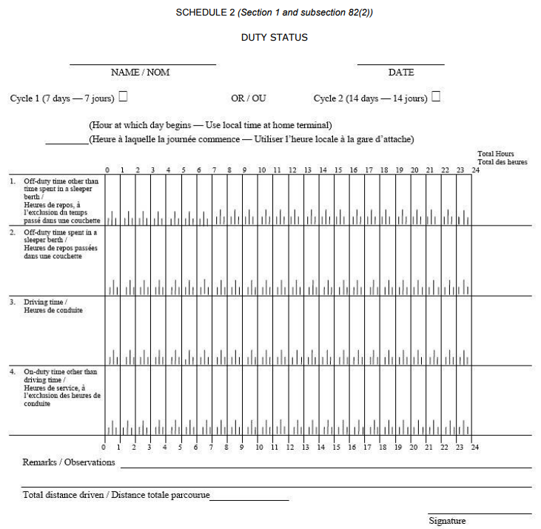
Filling out Grid Log
Mark beginning and end time
Draw continuous line between time markers
From the start to the end of the 24-hour period
Record location information where status change occurs
Notes:
SAY: You are also required to fill out a log grid (Schedule 2 of the federal Hours of Service Regulations).
The grid must be completed as follows:
For each duty status,
Mark the beginning time and the end time, and
Draw a continuous line between the time markers;
From the start to the end of the 24-hour period
Record the name of the municipality or give the location on a highway or in a legal sub-division and the name of the province or state where a change in duty status occurs.
If you are engaged in making deliveries in a municipality that result in a number of periods of driving time being interrupted by a number of short periods of other on-duty time, the periods of driving time may be combined and the periods of other on-duty time may be combined.
Enter on the right of the grid the total number of hours of each period of duty status, which total must equal 24 hours.
The log page for off-duty time must not include any information for a day other than “off-duty time other than time spent in a sleeper berth”.
The you must sign the log book to indicate the accuracy of the information recorded.
Reference: A sample log grid entry can be found in Lesson 8 of the Textbook, under Trip Planning and Hours of Service – Completing Daily Logs – Sample Log Grid Entry.

Slide 37
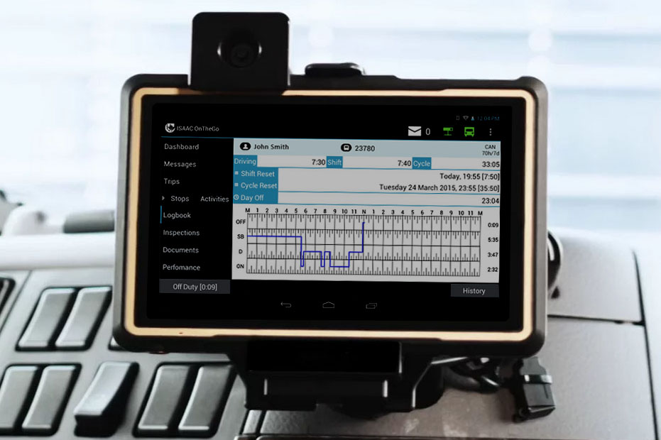
Electronic Recording Device
Must be capable of displaying:
Driving times and other on-duty times for each day
Total on-duty time remaining
Total on-duty time accumulated in the cycle
Changes in duty status and time at which each change occurred for each day
Times and dates on which the device has been disconnected and reconnected
Notes:
SAY: You can use an electronic onboard recording device instead of manually filling out a log book. The device must provide all information required by regulation.
Blank paper logs must be kept in the vehicle in case the electronic device malfunctions.
An onboard recording device must be capable of displaying:
Driving times and other on-duty times for each day the device is used
Total on-duty time remaining and the total on-duty time accumulated in the driver’s cycle
Changes in duty status and the time each change occurred for each day the device is used
Times and dates when the device was disconnected and reconnected
Reference: Electronic recording devices can be found in Lesson 8 of the Textbook, under Trip Planning and Hours of Service – Completing Daily Logs.

Slide 38
The 160 km Radius Rule
The driver is exempt from having to maintain a log if:
Operates within a 160 km radius of the home terminal
There’s no limit on the distance as long as it’s within the radius
Returns to the home terminal daily (minimum of 8 hours off-duty
Maintains records of shift start and end times and total on-duty hours for each day (intra-provincial)
Is not driving under a permit
Notes:
SAY: You are exempt from having to maintain a log if:
You operate within a 160 km radius of the home terminal (there’s no limit on the distance driven, as long as it’s within the radius).
You return to the home terminal daily for a minimum of eight hours off-duty.
The operator maintains records of shift start and end times and total on-duty hours for each day (this applies to intra-provincial carriers only).
You are not driving under a permit.
This exemption applies only to record keeping requirements.
All other requirements of the regulation must still be met.
A driver who is exempt from the log book requirement, but has to travel outside the 160 km radius, must complete a log for that trip and carry a record of their on-duty and off-duty hours for the previous 14 days.

Slide 39
The 160 km Radius Rule
Example:
160 Kilometer Radius Record
Driver name: Date: _ Elected Cycle: 1 2
Start Time | End Time | Off-Duty | Driving | On-Duty Not Driving | Remarks
Total Hours
Notes:
DO: Use several different samples of daily grid logs throughout the course.
Additional HoS Time Record forms can be printed from the Manitoba Guide to Transportation Safety.
Web link: https://www.gov.mb.ca/mit/mcd/carriers_drivers/safetyguide.html

Slide 40
Tampering with Daily Logs
It is against the law to tamper with a daily log.
Tampering includes:
Keeping more than one daily log for any day
Recording inaccurate information in a daily log, whether handwritten or electronically
Falsifying, mutilating or defacing a driver’s daily log or supporting documents
Altering or tampering with original daily logs by a safety officer or any other individual
Logs must be signed at end of each day to confirm information recorded is accurate.
Notes:
SAY: It is against the law to tamper with a daily log. Tampering includes:
Keeping more than one daily log for any day
Recording inaccurate information in a daily log, whether handwritten or electronically
Falsifying, mutilating or defacing a driver’s daily log or supporting documents
Altering or tampering with original daily logs by a safety officer or any other individual
You can be issued an out-of-service declaration for tampering. By regulation, carriers are responsible for ensuring their drivers do not falsify their logs.
You must sign a completed daily log to confirm that the information recorded is accurate. If a log contains false information, a peace officer can charge you with a violation, even if you have not signed the daily log.
Reference: Information on tampering with daily logs can be found in Lesson 8 of the Textbook, under Trip Planning and Hours of Service – Completing Daily Logs – Tampering with Daily Logs.

Slide 41
Exercise 2: Log Books and Documents to Complete
Complete Exercise 2: Log Books and Documents to Complete
Time: 45 minutes
Notes:
SAY: You will have 45 minutes to complete Exercise 2.
Do: Review the answers for Exercise 2 using the Exercise Book - Answer Key.

Slide 42
Review
What is an acceptable form of log book?
Answer: Paper or electronic.
Notes:
DO: Click to reveal answer.

Slide 43
Review
What are the 4 categories that are recorded in a log book?
Answer: On-duty, off-duty, sleeper berth, on-duty not driving.
Notes:
DO: Click to reveal answer.

Slide 44
Review
What are the cycles and how many hours are in each?
Answer:
Cycle 1: 70 hours of on-duty in 7 days.
Cycle 2: 120 hours on-duty in 14 days.
Notes:
DO: Click to reveal answer.

Slide 45
Review
When can a driver defer hours of the off-duty time to the following day?
Answer: If they are not splitting time off-duty or inclement weather.
Notes:
DO: Click to reveal answer.

Slide 46
Review
What is the maximum number of hours that can be deferred?
Answer: 2 hours
Notes:
DO: Click to reveal answer.

Slide 47
Summary
You should now be able to :
Record and maintain a log of hours of driving
Explain hours of service regulations
Demonstrate an understanding of driver and owner responsibilities regarding hours of service
Complete basic mathematical calculations required for commercial vehicle operation
Notes:
DO: Read slide

Slide 48
Quiz
Lesson 8 Quiz
Time: 30 minutes to complete
Notes:
DO: Provide students with a printed copy of Lesson 8 Quiz. Time provided for this quiz is 30 minutes. Tell students how the quiz will be scored and weighted. Explain what is required for a passing grade.
When complete, fill out the assessment tracker for each student and the classroom assessment tracker.

