Slide 1

Cargo Securement
Lesson 9

Slide 2
Pre-Class Assignment
You will have:
Reviewed the textbook and materials from Lesson 8.
Any questions about the previous lesson?
Notes:
SAY:
After the last class, you were asked to review Lesson 8 materials.
Do you have any questions about the last lesson?
Do: Answer any questions that come up in the discussion.

Slide 3
Learning Objectives
After completing this lesson, you should be able to:
Comply with basic cargo securement laws and requirements
Safely distribute cargo weight during loading
Notes:
DO: Read slide.

Slide 4
Cargo Securement and Regulations
After completing this section, you should be able to:
Explain that every commercial vehicle transporting cargo must have the cargo secured according to the regulations
Explain that the requirement to secure cargo includes any material, equipment or other loose articles carried on the vehicle, including dunnage, blocking, tarps, tools, equipment, spare materials, etc.
Explain that all cargo must be secured so that it cannot fall off the vehicle, or in any way be lost
Notes:
DO: Read slide.

Slide 5
Cargo Securement
Federal cargo securement standards in the National Safety Code for Motor Carriers Standard 10, state that cargo or other objects must not:
Interfere with your ability to drive safely
Obstruct your view to the front, right or left
Prevent easy access to accessories required for emergencies
Verify that your load is secure and doesn’t:
Leak or spill
Blow off, fall off, or fall through the vehicle
Dislodge or shift in a way that destabilizes the vehicle
Notes:
SAY: You are responsible for the safe operation of their truck, including its cargo. You are subject to fines and penalties if cargo is not properly secured.
DO: Refer students to the “National Safety Code for Motor Carriers – Standard 10” as this is the basis of provincial cargo regulations and are harmonized with regulations in the U.S. and Mexico.
SAY: Federal cargo securement standards (NSC - 10) states that cargo or any other object must not:
Interfere with your ability to drive safely, such as restricting the free movement of your arm and leg, or block vehicle entry or exit
Obstruct your view to the front, right or left
Prevent easy access to accessories required for emergencies
You may not have to load or supervise loading, but you do need to verify that your load is secure and doesn’t:
Leak or spill
Blow off, fall off, or fall through the vehicle
Dislodge or shift in a way that destabilizes the vehicle
Reference: Information on cargo securement is in Lesson 9 of the Textbook.
Reference: https://www.cvse.ca/nacs/NSC_10_Cargo%20Securement.pdf

Slide 6
Cargo Securement
Cargo must be checked:
Within the first 80km from where it was loaded
When there is a change in the driver’s duty status, vehicle status, or, 3 hours, or, 240km (which ever comes first)
>= 80 km from where cargo was loaded
Each change in duty status
Driving for
3 hrs or 240 km
Notes:
SAY:
You must check on cargo securement as part of daily vehicle inspections and during the trip at the following intervals to make adjustments as needed:
Not more than 80 km from where the cargo was loaded
When there is a change in your duty status, or the vehicle, or when the vehicle has been driven three hours or 240 km (whichever comes first)
The three hour/240 km rule does not apply if the cargo is sealed and you have been ordered not to open it to inspect the cargo, or if the cargo is fully or partly inaccessible.
Note: Information on daily vehicle inspections were covered in Lesson 4.
Reference: Information on cargo securement is in Lesson 9 of the Textbook.
Reference: https://ccmta.ca/web/default/files/PDF/Interpretations_and_Guidance_2016.pdf

Slide 7
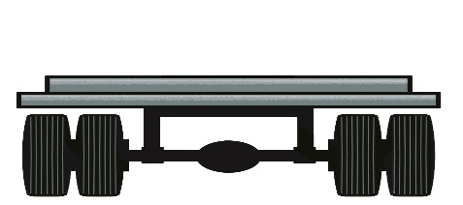

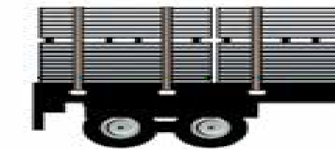
Securement System
A truck’s securement system has three components:
Vehicle Structure
Securing Devices
Blocking and Bracing Equipment
Notes:
SAY: A truck’s securement system has three components:
Vehicle structure - floors, walls, decks, headboards, bulkheads, stakes, posts, or anchor points. You must ensure that all these vehicle elements are in good working condition.
Securing devices - devices specifically designed and manufactured for cargo securement to a vehicle or a trailer, such as ropes, fasteners, etc. A key securing device is the tie-down, which is an assembly of securing devices that can be adjusted for tightness.
Blocking and bracing equipment- structures, devices or articles placed against or around cargo to prevent horizontal movement or tipping. This equipment must be strong enough to withstand splitting or crushing by the cargo. When wood is used, it must be a hardwood, properly seasoned and free from rot, knots, and splits.
Reference: Information on securement systems is in Lesson 9 of the Textbook under Cargo Securement – Securement System.

Slide 8
Securement System
By regulation, all parts of the securement system must be:
In proper working order
Matched to the cargo type, size, shape, and strength
Free of damaged, vulnerable, or weakened parts
Secured such that they will not unfasten while operating on a highway
Able to withstand specified force in forward, rearward, sideways, and downward directions
Notes:
SAY: By regulation, all parts of the securement system must be:
In proper working order
Matched to the cargo type, size, shape, and required strength
Free of damaged, vulnerable, or weakened parts
Secured such that they will not unfasten while operating on a highway
Able to withstand specified force in forward, rearward, sideways, and downward directions

Slide 9
Review
When must the cargo be
re-inspected?
Answer: At all of these points:
80 km from where it was loaded
Change of duty
Driven 3 hours
Driven 240 km
Notes:
DO: Ask question to class and get some responses, then click to reveal answers

Slide 10
Cargo Placement and Restraint
After completing this section, you should be able to:
Explain that articles of cargo must be secured to prevent forward, rearward and sideways movement, and in some cases must also be secured to prevent upward movement
Explain that all cargo must be secured so that it cannot shift in a way that can affect a vehicle’s stability or manoeuverability in a negative way
Explain that cargo must be loaded in such a way that it does not interfere with the driver’s ability to drive the vehicle safely, and does not block vehicle entry or exit
Notes:
DO: Read slide.

Slide 11
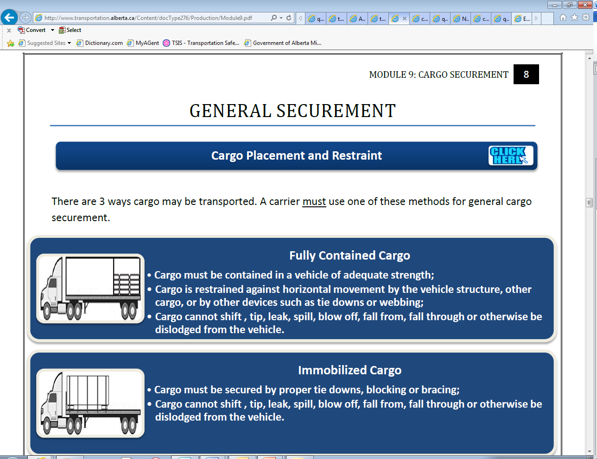
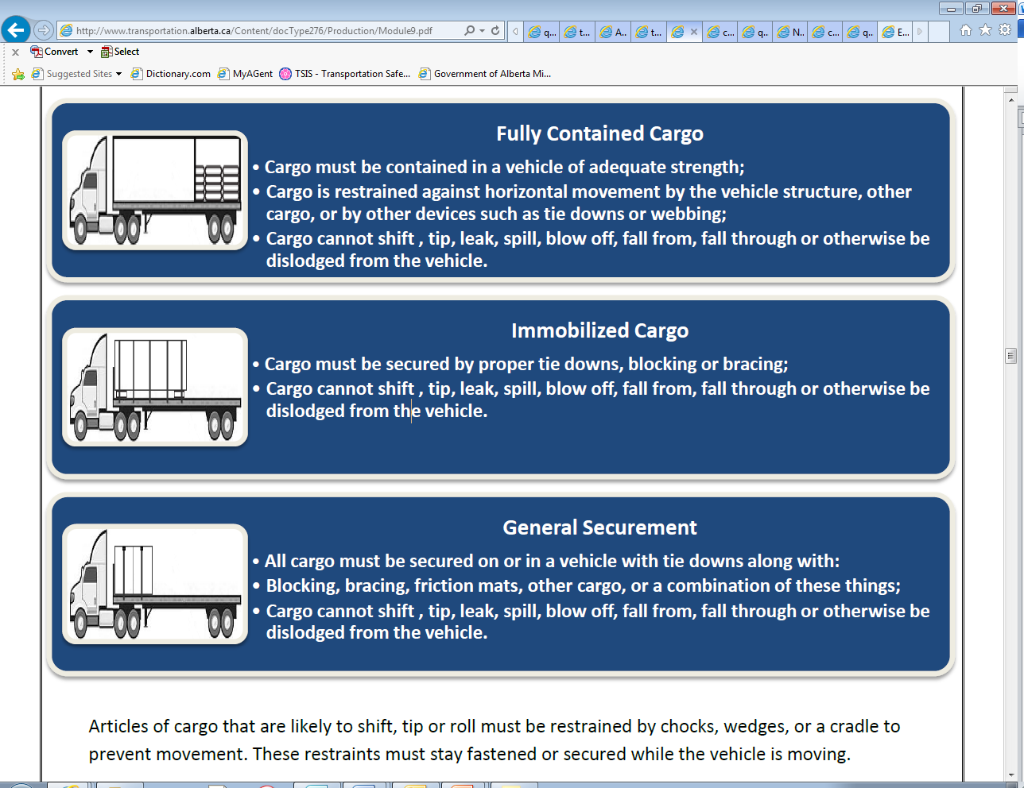

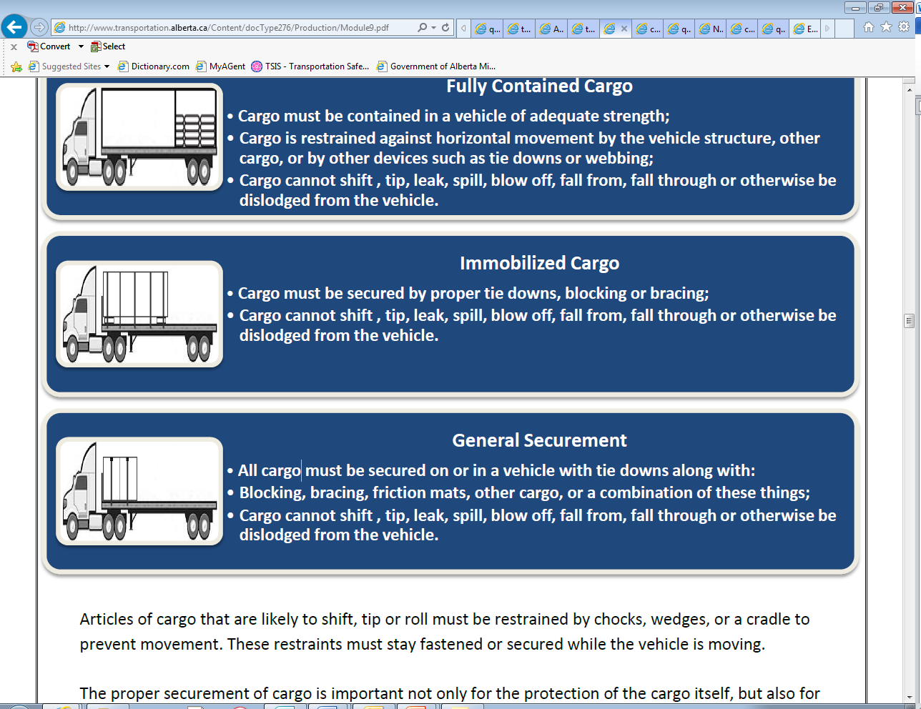
Cargo Placement & Restraint
There are 3 main forms of cargo securement:
Fully Contained Cargo:
Immobilized Cargo:
General Securement:
Cargo that is likely to shift, tip, or roll must be restrained to prevent movement.
Notes:
SAY: There are 3 ways cargo may be secured. A carrier must use one of these methods for general cargo securement.
Fully Contained Cargo
Cargo must be contained in a vehicle of adequate strength;
Cargo is restrained against horizontal movement by the vehicle structure, other cargo, or by other devices such as tie-downs or webbing;
Cargo cannot shift, tip, leak, spill, blow off, fall from, fall through, or otherwise be dislodged from the vehicle.
Immobilized Cargo
Cargo must be secured by proper tie-downs, blocking or bracing;
Cargo cannot shift, tip, leak, spill, blow off, fall from, fall through or otherwise be dislodged from the vehicle;
Securement involves the combination of vehicle structure, blocking and bracing which safety secures the cargo from shifting or tipping.
General Securement
All cargo must be secured on or in a vehicle with tie-downs along with blocking, bracing, friction mats, other cargo, or a combination of these things;
Cargo cannot shift, tip, leak, spill, blow off, fall from, fall through or otherwise be dislodged from the vehicle.
Articles of cargo that are likely to shift, tip or roll must be restrained by chocks, wedges, or a cradle to prevent movement. These restraints must stay fastened or secured while the vehicle is moving.
The proper securement of cargo is important not only for the protection of the cargo itself, but also for ensuring the safety of you and the motoring public. Cargo that shifts or tips may cause a vehicle to tip or operate in an unsafe manner.
Reference: Information on cargo placement is in Lesson 9 of the Textbook under Cargo Securement – Cargo Placement & Restraint.

Slide 12
Weight Distribution
Uneven distribution can cause problems such as:
Damage to axles, the frame, springs, bearings, and tires
Difficulty controlling the vehicle
Steering weight that is too light
The load shifting to the side and falling off
To evenly distribute a load in a trailer:
Know the legal, axle and total weight
Load half in front and half in the rear
Adjust according to axle weight limitations
Spread the load evenly, with heavy freight on the bottom
Notes:
SAY: Cargo weight must be balanced between the drive and rear axles to allow easy handling and steering of the truck. Uneven distribution can cause problems such as:
Damage to axles, the frame, springs, bearings, and tires
Difficulty controlling the vehicle if you have to perform an evasive manoeuvre
Steering weight that is too light, if front axles are underweight
The load shifting to the side and falling off, If the center of gravity of a flatbed is too high
To evenly distribute a load in a trailer:
Before you start, know:
The legal weight of the tractor-trailer
Axle weights
Total weight of the cargo
If possible, load half in front and half in the rear
Adjust according to axle weight limitations
Spread the load evenly over the trailer floor to prevent sideways shifting
Load heavy freight on the bottom to avoid tipping, and spread it out evenly to prevent concentrated stress on the trailer’s floor
When unloading, remove freight strategically to allow for even weight distribution.
DO: Review images on next slide for proper loading.

Slide 13
Weight Distribution
To evenly distribute the load in a trailer:
Notes:
SAY:
In these pictures. you can see how cargo loading techniques are applied to evenly distribute weight on the trailer

Slide 14
Weight Distribution
To evenly distribute the load in a trailer:
Notes:
DO: Review the images and explain why this is not proper cargo loading techniques. You may wish to play a video or use an online tool to help reinforce cargo securement techniques. The following are some sources that you may use:
Cargo Securement Tips brochure https://safetydriven.ca/resource/cargo-securement-tips/
Load Securement video https://safetydriven.ca/resource/load_securement/
Tarping safety online tool https://safetydriven.ca/resource/flatbed-tarping-best-practices-safety-driven/
Below are links to previews of videos from J.J. Keller. The full videos can be purchased directly if you wish to show them in your class.
Flatbed securement https://www.youtube.com/watch?v=_onyIEFUL-g
Dry Van Cargo securement https://www.youtube.com/watch?v=NUFqYV_2PDs
SAY:
[Moving from left to right, top to bottom] - A very heavy concentrated load should not be positioned against the cab as the distribution of the load may cause the frame to bend, perhaps permanently. It will also overload the front tires and may even cause a blowout on a worn tire. Steering will also be difficult.
The type of loading shown in this image should never be permitted. The frame could bend, the rear tires are extremely overloaded and enough weight is taken from the front tires to make steering almost impossible.
A very heavy load should not be positioned on one side. This overloads one spring and the tires on that side. This loading could cause the brakes to lock the wheels on the lighter side and cause flat spots on the tires or a skid on a wet surface.
The type of loading shown below results from using the wrong vehicle for the job. On rough roads, loading your vehicle like this can make your truck pivot on its rear wheels, taking the front wheels entirely off the road.

Slide 15
Tie-downs and Working Load Limits
After completing this section, you should be able to:
Explain that articles of cargo are generally secured against the vehicle’s structure by using devices such as tie-downs, blocking and bracing
Describe methods for rating the strength of devices used to secure cargo and recognize that most cargo requires a minimum number of tie-downs with particular working load limit ratings
Explain that tie-down ratings are determined by manufacturers, expressed as a “working load limit” (WLL) and marked on the tie-downs
Describe how the combined strength of individual tie-downs used together to restrain cargo is called the “aggregate working load limit”
Notes:
DO: Read slide.

Slide 16
Tie-downs
Tie-downs are a primary device for cargo securement
Use inside any rub rails
Use edge protectors wherever a tie-down may be worn down, cut, or crushed to the point it touches an article of cargo
The working load limit (WLL) is the maximum they can handle during normal service
  Unmarked tie-downs do not
  comply with regulations and
  cannot be used
Notes:
SAY: Tie-downs are a primary device for cargo securement. Because of their importance, the manufacture and use of tie-downs is regulated.
Manufacturers test securing devices to determine their working load limit (WLL) - the maximum they can handle during normal service. The aggregate (combined) WLL is the sum of WLLs of individual devices in a tie-down.
Tie-downs must have a manufacturer’s mark indicating their WLL. Unmarked tie-downs do not comply with regulations and cannot be used.
Whenever practical, tie-downs and other parts of a cargo securement system must be located inside any rub rails (side rails that protect the vehicle from impact). Use edge protectors wherever a tie-down may be worn down, cut, or crushed to the point it touches an article of cargo.
The number of tie-downs needed to secure the cargo depends on the cargo’s length and weight, and whether the cargo is blocked or positioned to prevent forward movement by a headboard, bulkhead, or other means.

Slide 17
Working Load Limits (WLL)
Calculating aggregate (combined) working load limits
Tie-downs that go from one anchor point to another on the vehicle
  Add the WLLs of each tie down
Must be at least half of the weight of load being secured
Tie-downs that go from one anchor point on the vehicle to an attachment point on the cargo itself
  Add 50% of the WLL of each end section of a tie down attached to the cargo
Notes:
SAY:
To calculate aggregate WLL:
For tie-downs that go from one anchor point to another on the vehicle, add the WLLs of each tie-down.
For tie-downs that go from one anchor point on the vehicle to an attachment point on the cargo itself, add 50% of the WLL of each end section of a tie-down attached to the cargo.

Slide 18
Tie-downs Required
For Blocked Cargo:
For Non-Blocked Cargo:
# of tie downs | Length | Weight
1 | .01 - 3.04 metres | N/A
+1 | each additional 3.04 metres | N/A
# of tie downs | Length | Weight
1 | 0.01 - 1.52 metres | 1 - 500 kg
2 | 0.01 - 1.52 metres | > 500 kg
2 | 1.53 - 3.04 metres | N/A
+1 | each additional 3.04 metres | N/A
Notes:
SAY: The number of tie-downs needed to secure the cargo depends on the cargo’s length and weight, and whether the cargo is blocked or positioned to prevent forward movement.
For blocked/positioned cargo:
1 tie-down for cargo less than 3.04 metres
1 tie-down for each 3.04 meters and any remaining length
For cargo not blocked/positioned:
1 tie-down for cargo 1.52 metres or less and not more than 500 kg
2 tie-downs for cargo 1.52 metres or less and more than 500 kg
2 tie-downs for cargo 1.52 - 3.04 metres regardless of weight
For cargo longer than 3.04 meters, 2 tie downs for the first 3.04 meters plus 1 tie down for each additional 3.04 metres and any remaining length
There are specific examples for both of these in your textbook. You will want to review those examples before your next exercise.
Reference: Section 9 - Cargo Securement – Page 108

Slide 19
Exercise: 1
Time: 10 minutes
Complete Exercise 1: Cargo & Securement
Notes:
SAY: You will have 10 minutes to complete Exercise 1 in the Exercise Book.

Slide 20
Review
What must be marked on the
tie-down?
Answer: Working load limit
Notes:
DO: ask question to class and get some responses, then click to reveal answer

Slide 21
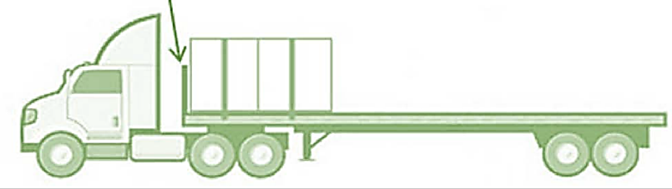
Front End Structure
Some vehicles transport cargo that is in contact with the vehicle’s front-end structure:
A vertical barrier placed across the front of a deck that prevents cargo from moving forward.
      A cab shield is not a front-end structure
      or part of the cargo system.
Notes:
SAY: Some vehicles transport cargo that is in contact with the vehicle’s front-end structure, which is a vertical barrier placed across the front of a deck that prevents cargo from moving forward.
Reference: Requirements are listed in Lesson 9 of the Textbook, under Cargo Securement – Front End Structure on Commercial Vehicles.

Slide 22
Front End Structure
CRITERIA | REQUIREMENTS
Height | Prevent cargo from moving forward 122 cm above the deck
Width | Prevent cargo from moving forward Wide as the vehicle
Front End Structure Strength | Horizontal forward static load of 50% where: Front end structure: < 1.83 m Distributed over the front end structure Horizontal forward static load of 40% where: Front end structure: = > 1.83 m Distributed over the front end structure
Front End Penetration Resistance | Resists penetration of cargo that contacts it when the vehicle decelerates at a rate of 6.1 m per second.
Notes:
DO: Refer students to the table under “Front End Structure on Commercial Vehicles” in Lesson 9 of the Textbook.
SAY: Front end structures must meet the following requirements:
Tall enough to prevent cargo from moving forward, and 122 cm above the deck
Wide enough to prevent cargo from moving forward, and Wide as the vehicle
Front End Structure withstands a horizontal forward static load of 50% of total cargo weight where:
The height of the front end structure is shorter than 1.83 m
The cargo is uniformly distributed over the front end structure
And withstands a horizontal forward static load of 40% of total cargo weight where:
The height of the front end structure is 1.83 m or higher
The cargo is uniformly distributed over the front end structure
Front End resists penetration by an article of cargo that contacts it when the vehicle decelerates at a rate of 6.1 m per second.
Reference: Requirements are listed in Lesson 9 of the Textbook, under Cargo Securement – Front End Structure on Commercial Vehicles.

Slide 23
Specific Cargo Securement Requirements
Under the NSC, certain cargo types have specific securement requirements :
Logs & Dressed Lumber
Metal Coils
Paper Rolls
Concrete Pipe
Intermodal Container
Vehicles as Cargo
Roll-On/Roll-Off and Hook Lift Containers
Boulders
Ensure you refer to the section in your textbook “Cargo with Specific Securement Requirements”
Notes:
SAY: Certain types of cargo have specific securement requirements:
Logs
Dressed Lumber
Metal Coils
Paper Rolls
Concrete Pipe
Intermodal Container
Vehicles as Cargo
Roll-On/Roll-Off and Hook Lift Containers
Boulders
DO: Refer students to the “Cargo with Specific Securement Requirements” section of the textbook to discuss the individual requirements for each cargo type listed.
Reference: Specific cargo requirements are listed in Lesson 9 of the Textbook, under Cargo Securement – Cargo with Specific Securement Requirements.

Slide 24
After-Class Assignment
You will:
Complete Exercise 2 after-class.
We will review any questions you have at the beginning of next class.
Notes:
DO: Read slide.
SAY: Your exercise book for this lesson has questions related to specific cargo securement. Please complete Exercise 2 on your own time after reviewing the section on cargo securement in the textbook.

Slide 25
Review
What is an anchor point?
Answer: Structure, fitting or attachment on a vehicle where a tie-down is attached.
Notes:
DO: ask question to class and get some responses, then click to reveal answer

Slide 26
Review
What are the 3 ways cargo can be transported?
Answer:
Fully contained
Immobilized
General securement
Notes:
DO: ask question to class and get some responses, then click to reveal answer

Slide 27
Review
In regards to weight distribution, if the front axles are underweight, what impact can it have on vehicle operation?
Answer: It affects safe steering of the truck.
Notes:
DO: Ask question to class and get some responses, then click to reveal answer.

Slide 28
Review
Where can you find specific cargo securement regulations?
Answer: North American Cargo Securement Standard (NSC Standard 10)
Notes:
DO: Ask question to class and get some responses, then click to reveal answer

Slide 29
Summary
You should now be able to:
Comply with basic cargo securement laws and requirements
Safely distribute cargo weight during loading
Notes:
SAY: You should now be able to comply with basic cargo securement laws and requirements and safely distribute cargo weight during loading.

Slide 30
Quiz
Lesson 9 Quiz
Time: 30 minutes to complete
Notes:
DO: Provide students with a printed copy of Lesson 9 Quiz. Time provided for this quiz is 30 minutes. Tell students how the quiz will be scored and weighted. Explain what is required for a passing grade.
When complete, fill out the assessment tracker for each student and the classroom assessment tracker.

Slide 31
Practical In-Yard Training
Cargo Securement Procedures and Trip Checklist
Use the procedure in your exercise book as a reference for the securement of cargo and cargo pre-trip, en route and post-trip inspections
30 minutes to observe
Notes:
DO: Go into the yard and practice tie-downs and securing cargo on a truck. As an instructor you may need to adjust this slightly based on your available yard space and equipment. If full demonstration and simulation of a real world scenario is not feasible, we encourage you to use the time to work with something that may be smaller in scale but still provides students with an opportunity to demonstrate their skills.
SAY: We will now head out to the yard where an instructor will demonstrate how to properly secure cargo using the correct procedure in according with regulations. Please bring your exercise book which has a checklist you need to reference for this in-yard activity.

Slide 32
Practical In-Yard Assessment
Cargo Securement Procedures and Trip Checklist
Use the knowledge from the demonstration and your reference materials to perform cargo securement in-yard.
30 minutes to demonstrate
Notes:
SAY: Your instructor will assess your understanding. You will receive a copy of your assessment after you have completed it.
DO: Instructor will grade students using the checklist in order to assess students on their cargo securement skills as it relates to regulations and road safety. As this is often covered in detail my an employer and the specific process and procedures may be different in their work instructions, the mark obtained in the In-Yard Assessment is not counted towards their final course mark.
It is critical to stress that cargo securement is not only part of loss prevention, but more important is about workplace health and safety.

